Slide 1

VALUEx Vail
June 20, 2013

Slide 2
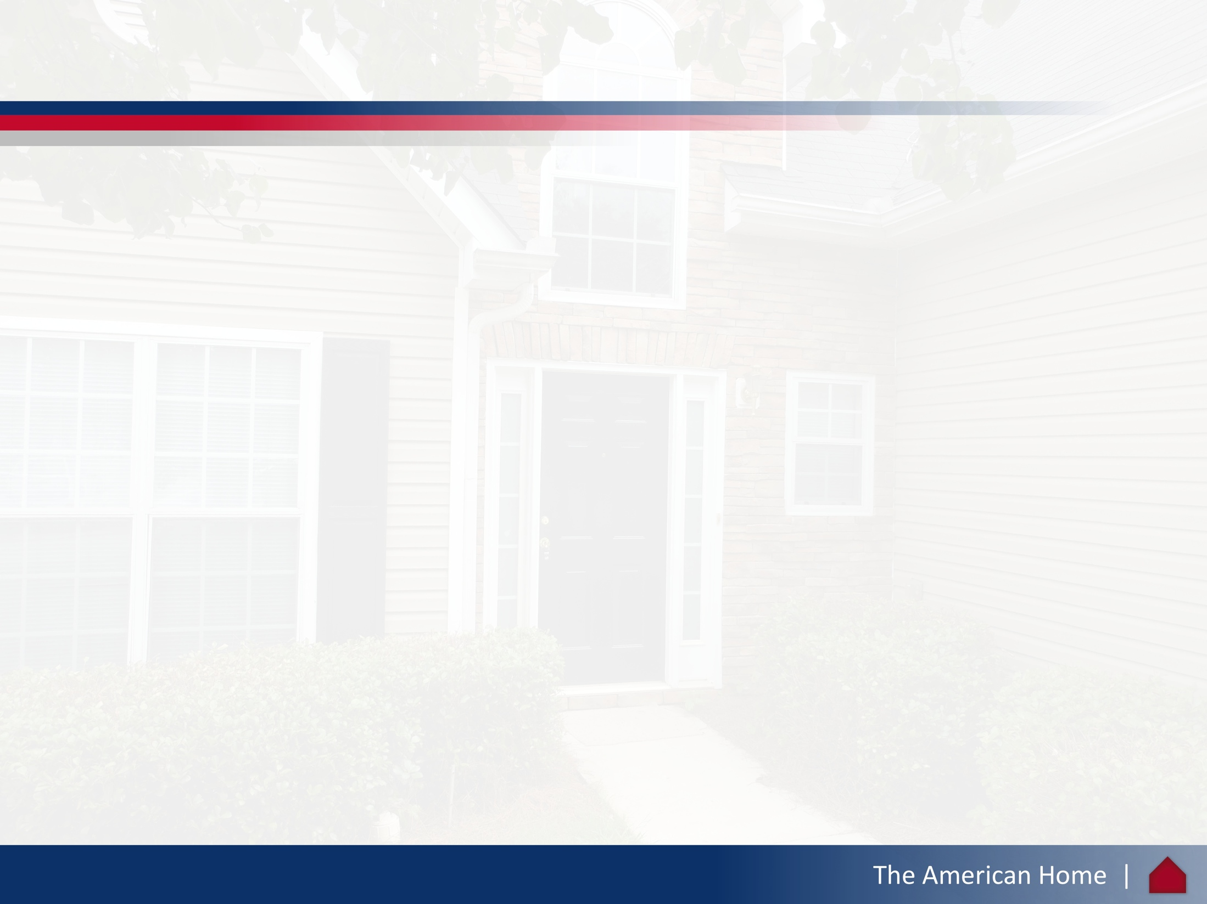
Disclaimer
The content and analyses contained herein (the “Management Presentation”) are the property of The American Home (“TAH” or the “Company”) and may not be copied or distributed without the express consent of TAH or its representatives.
This presentation may contain statements that are not historical facts and are considered "forward-looking" within the meaning of the Private Securities Litigation Reform Act of 1995. These forward-looking statements are identified by their use of the terms: "expect(s)/, "intend(s)," "may," "plan(s)," "should," "could," "will," "believe(s)," "anticipate(s)," "estimate(s),“ "forecast(s)," or similar terms. The Company or its representatives may also make similar forward-looking statements from time to time orally or in writing. These forward-looking statements are subject to a number of risks, uncertainties, or other factors that may cause (and in some cases have caused) actual results to differ materially from those described in the forward-looking statements or accompanying financial projections. TAH operates in a continually changing business environment and new factors are frequently emerging in that environment. TAH cannot predict such factors nor assess their impact, if any, on TAH's financial position or its results of operations. In light of the significant uncertainties inherent in the forward-looking statements contained herein, you should not rely on forward-looking statements. Neither TAH nor any of its representatives undertake any obligation to publicly update or revise any forward-looking statements, whether as a result of new information, future events or otherwise.
2

Slide 3
Table of Contents
TAH Overview
Market Opportunity
Implications
3

Slide 4
  TAH Overview
4

Slide 5
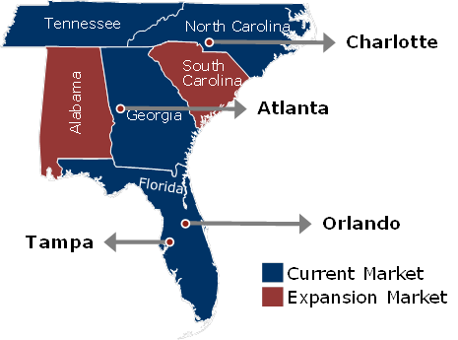
TAH Overview
The American Home Real Estate company (“TAH”) is a fully integrated and internally managed real estate investment company formed to acquire single-family houses as investment properties in the Southeastern U.S.
Founded in 2009 by CEO Aaron Edelheit with support from financial sponsor Route 66 Ventures beginning in 2011
Focused on the Southeastern U.S. where attractive long-term housing demographics, significant inventory overhang and distressed pricing maximize the SFR risk/return profile
As of March 31, 2013, TAH has successfully raised, on a cumulative basis, approximately $205 million of for the purpose of purchasing, redeveloping and renting single-family homes
  As of March 31, 2013, approximately $185 million has been invested in homes currently owned, with the remainder committed to funding under contract homes, redevelopment projects in process, or has been invested in infrastructure. We expect to be fully deployed by July 2013
In total, as of March 31, 2013, TAH owned or controlled 2,455 single-family homes
TAH is led by an experienced executive management team, further supported by the experienced financial sponsorship of Route 66 Ventures
5

Slide 6
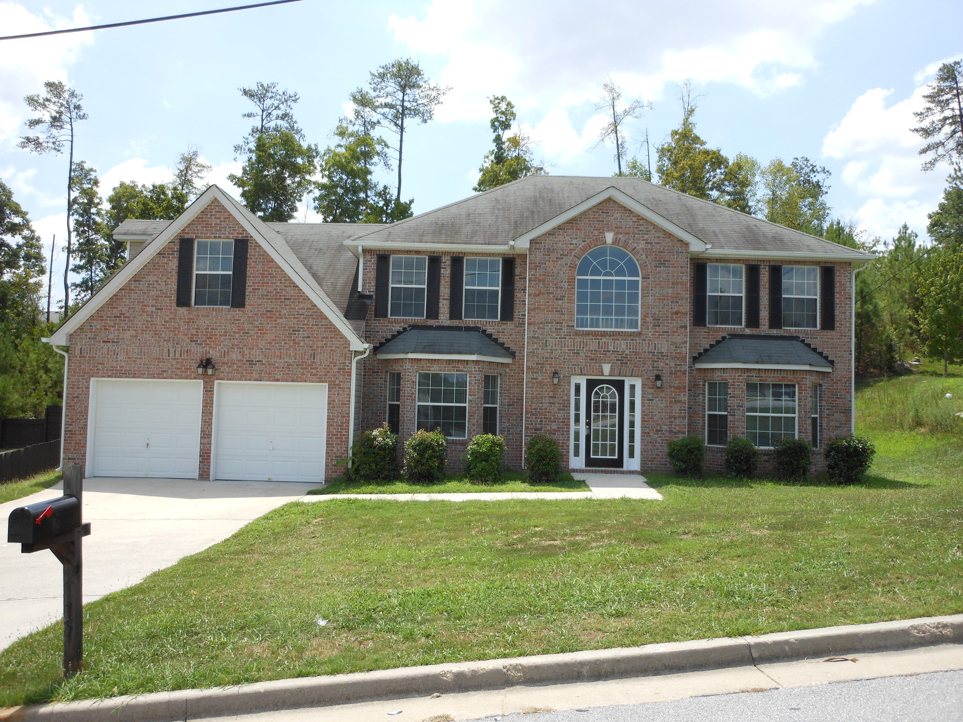
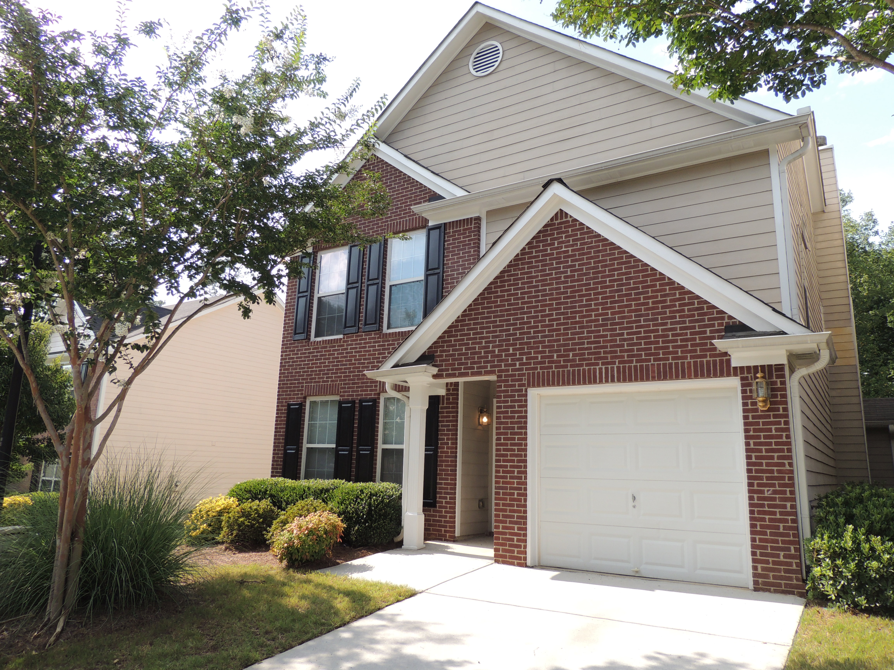
TAH Overview: History of our Company
TAH identified the investment opportunity to purchase, redevelop, lease and manage single family homes in March, 2009
The benefits of an internally managed portfolio, aligning management incentives and investor returns, eliminated nearly all external management fees, and provide all investors with the benefits of generating economies of scale
TAH’s current portfolio has been underwritten and currently produces a gross yield of 14% and was purchased at a 35% discount to replacement cost, completely renovated
6

Slide 7
  Market Opportunity
7

Slide 8
Market dynamics suggest an extremely robust outlook for housing prices, particularly for single-family rentals
Rental housing demand is surging.
  Household formation has normalized after plunging during the financial crisis.
  The rate of homeownership has dropped toward the long-term norm following a spike during the pre-crisis bubble, reflecting tight credit conditions, foreclosures, and an overall soft economy.
  Increasing household formation and declining homeownership have fueled a sharp increase in rental demand.
Housing supply is dwindling, particularly at the relatively low price points within the reach of renters.
  As a share of GDP, residential housing investment has been at historic lows for five consecutive years.
  Investment in single-family homes has been especially muted, with construction of starter homes declining in 2013 from historically low levels.
  Access to bank financing remains sharply limited, further constraining home-building.
  Foreclosures and shadow inventory have boosted supply, but the stock of distressed housing has been declining.
New home construction will not recover until housing prices increase above the cost of construction, providing incentive for builders to build.
We believe that -- until home prices exceed the cost of construction -- rents will jump, house prices will soar, or both.
8

Slide 9
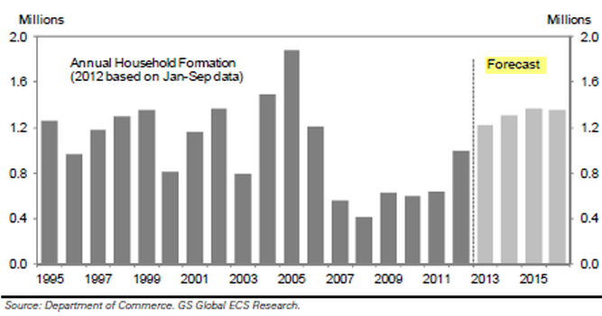
Household formation is normalizing after plunging during the crisis
9

Slide 10
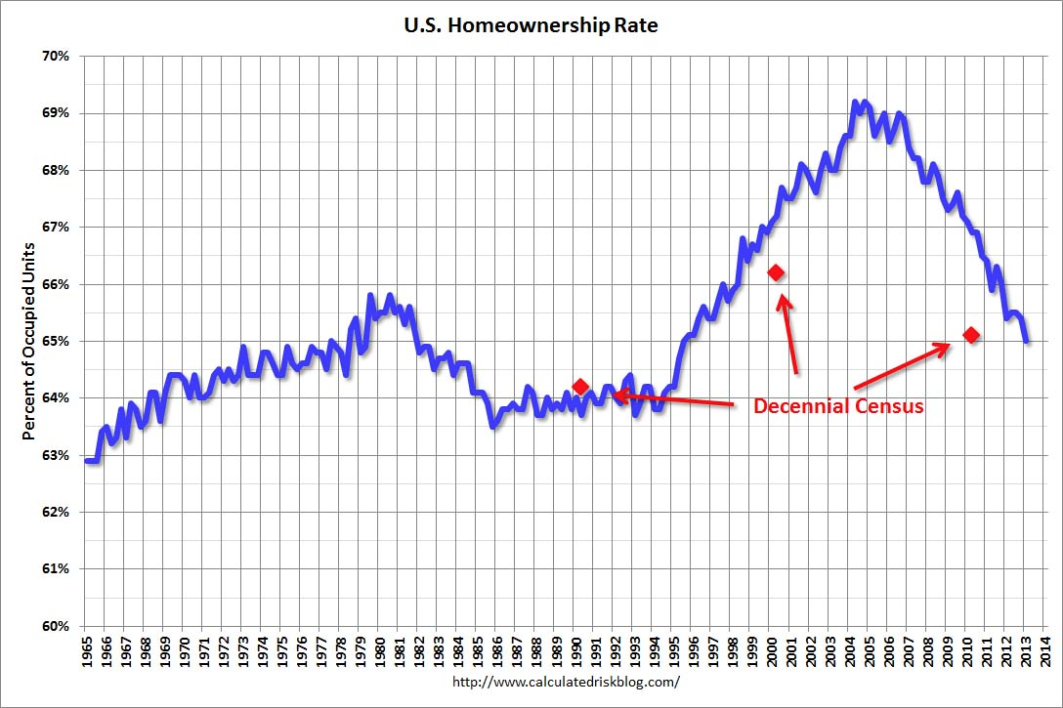
The homeownership rate has dropped toward the historical norm
The decline in homeownership reflects tight credit, foreclosures, and the generally soft economy.
10

Slide 11
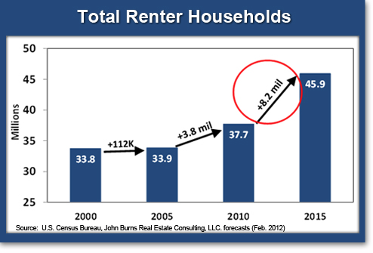
Rental demand is surging
Increasing household formation and declining homeownership have fueled a sharp rise in renters.
11

Slide 12
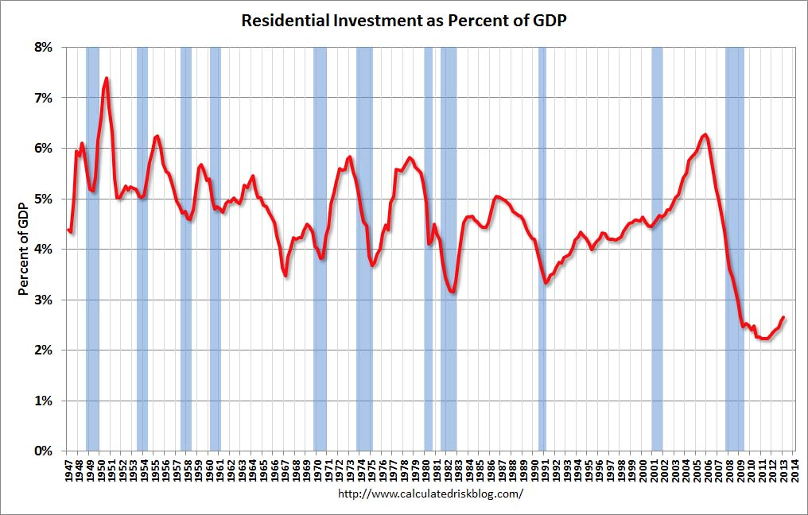
Residential housing investment remains at historic lows
As a share of GDP, housing and apartment construction have remained at post-WWII lows for five consecutive years.
12

Slide 13
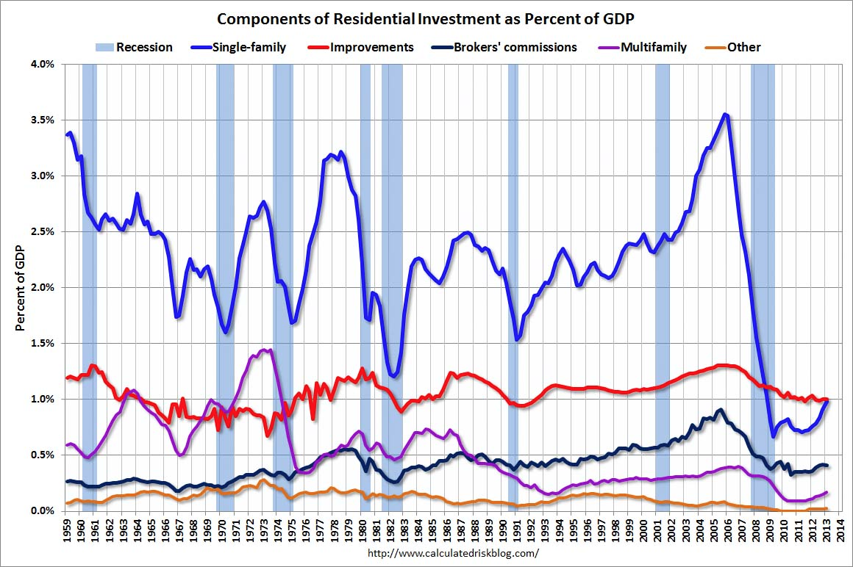
Construction of single-family homes has been especially muted
As a share of GDP, single-family housing starts would have to double to revert to the mean.
13

Slide 14
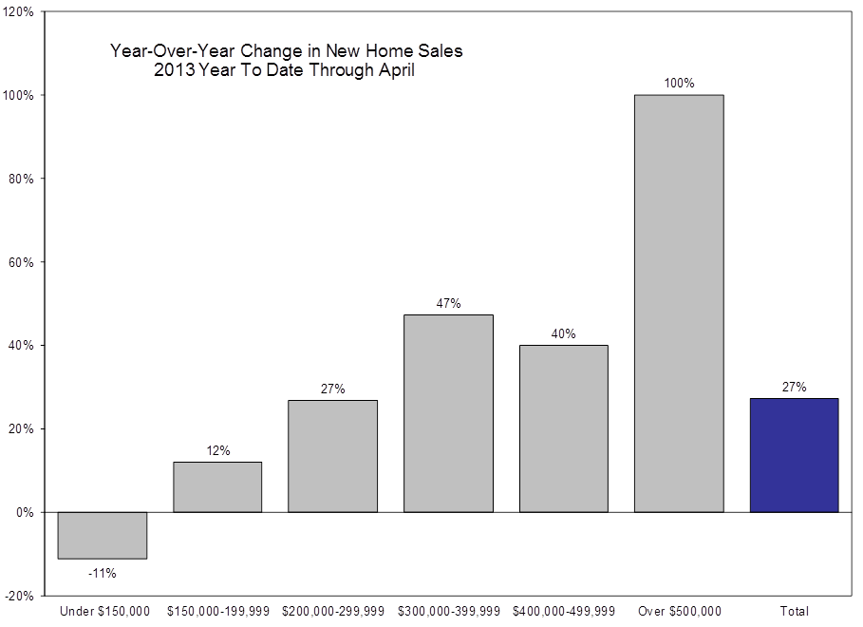
Home builders are not building starter homes
Homes priced under $200,000 are down 2% year-to-date, and homes priced under $150,000 are down 11% -- from a historically bad year.
14

Slide 15
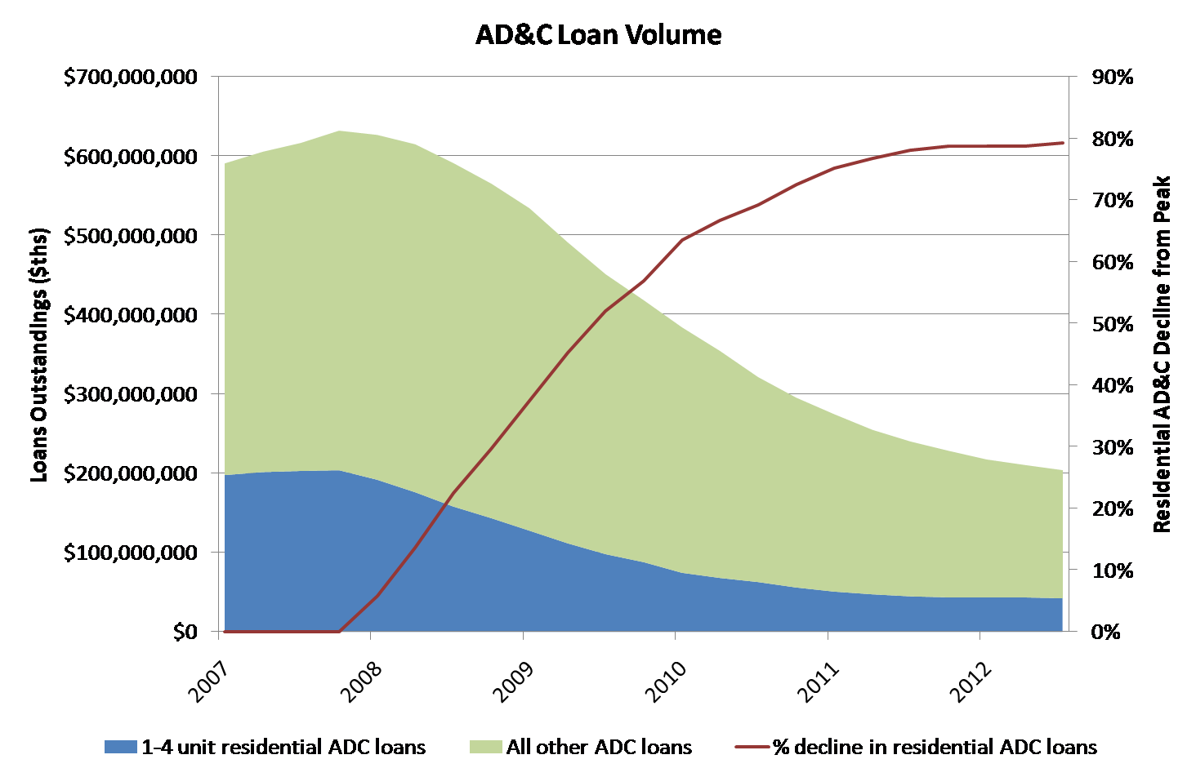
Bank financing for new development has yet to recover
AD&C loans on 1-4 unit residential properties, which fund land development, have declined 80% from the peak.
15

Slide 16
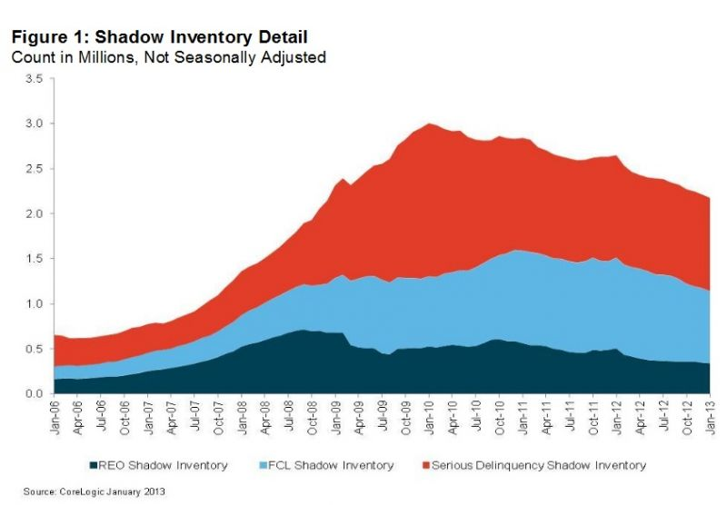
Foreclosures and shadow inventory have boosted supply, but have been declining
Shadow inventory provides opportunity, but does not provide new supply. Former homeowners need to live somewhere.
16

Slide 17
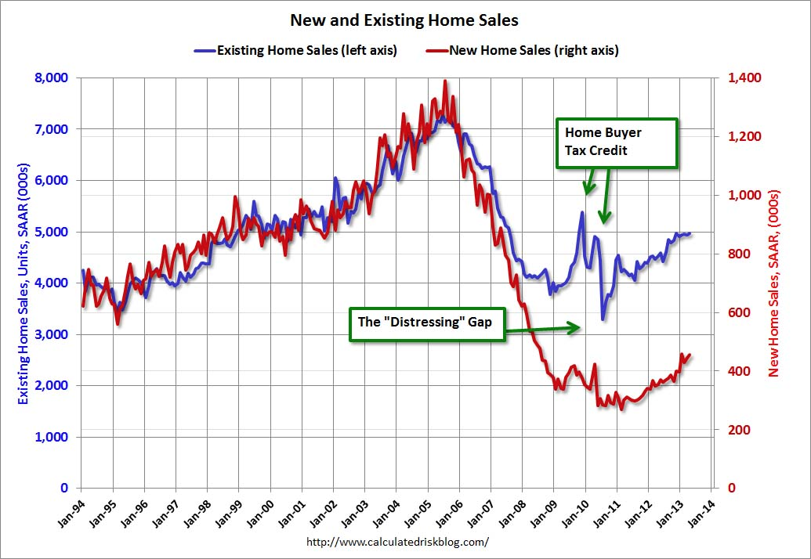
New home construction will not recover until housing prices increase above construction costs
Builders must have incentive to build. Until existing home sales return to a price that is profitable for new homes to be built, there will not be enough new homes built and sold.
17

Slide 18
  Implications and What We are Doing
18

Slide 19
We are Buying Single Family Homes
We are investing directly into single-family homes
Very inefficient market compared to debt and equity markets
Institutions just entered this market 18 months ago
According to the 2010 Census, there are 14 million SFRs
Institutions own between 60,000 and 75,000 homes
Very large opportunity to consolidate the market
Lots of capital still needed, as evidenced by Florida’s 400,000 homes in foreclosure backlog
19

Slide 20


