Slide 1
Things to consider before shorting Canadian banks
Brian Bosse

Slide 2
As the only Canuck in Vail….
RELEVANT DISCLOSURES
Do not work for a CADbank.
No positions in CADbank stock.
No mortgage with any CADbank.
Comfortable making money long or short
VK called BB ‘thoughtful’…however he did not explain what that actually means!

Slide 3
Terminology
Canada has 5 big banks. All very similar, so we shall use STBANKX INDEX to represent them. [RY TD CM BMO BNS]
USA has many more names in the space. KBW’s BKX INDEX of 24 will represent them.
“Jingle Mail” - home owners impair a bank’s balance sheet by mailing back title when market value cannot cover the bank’s total exposure.
Rsqrd of GCB to UST rates is 85%.

Slide 4
What are we taking about?
Canada = 35M people.
1.2% annum stable population growth since 1972
(Toronto 2.6/5.6) (Montreal 1.6/3.8) (Vancouver .6/2.3) (Calgary 1.0/1.2) (Edmonton .8/1.1) (Ottawa .8/1.2) (Everywhere else 20M)
Destination for people and money. 280,681 immigrants in 2010
Imagine California with only 5 firms in loans, banking, brokerage
Those 5 banks are all Toronto HQs. A town with terrible commutes
Bank stocks are an important cornerstone for Canadian investors

Slide 5
Contents
What the Shorts see
Facts on the Ground
CMHC data
Toronto is ground zero
Bank sensitivity to consumer debt
What Brian thinks Shorts are missing
Brian’s advice for shorts
Name that Canadian!

Slide 6

What the Shorts see

Slide 7
PICTURE – STBANKX exposed to consumer debt levels equal to US consumer levels in 2007. And housing bubble too boot!
THE BET – Housing rolls over. ERGO banks will be holding underwater mortgages and consumer debts gone bad. ERGO banks Istatement losses & Bsheets losses.
THE PRIZE - 1989 STBANKX had TRA of -29%USD 07/31/89 to 09/28/90, vs SPX -11.5 vs 10yrGCAN yield moved from 8-12%!].
THE PRIZE - Great Recession BKX had TRA -27% 01/01/07-03/31/09 vs. SPX -44%

Slide 8
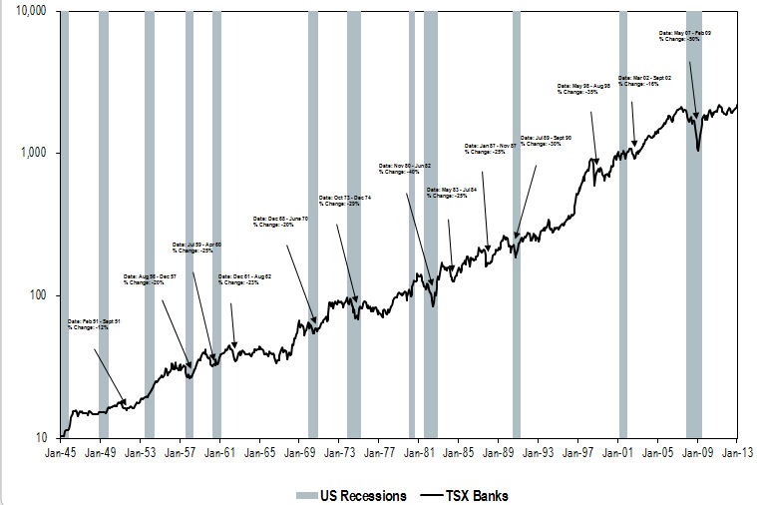
History of the ‘Prize’

Slide 9
The short thesis
All housing bubbles crush all banks, everywhere, because it was true in USA last time. [STBANKX 2013-15 = KBW 2007-09 = STBANKX 1989-90]
They are betting that huge wave of Jingle Mail is coming very soon. They have been making this bet, off and on, since 2008.

Slide 10
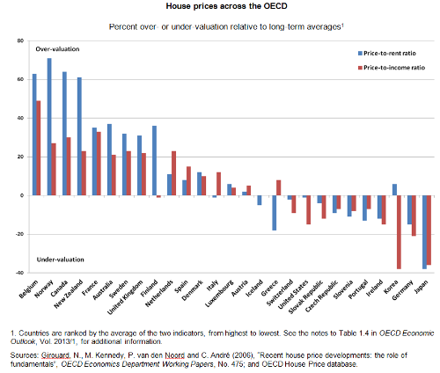
Would you buy Japan banks based on this chart?
Notes:
So we may have a low yields problem (seen a US10YR lately??), but our affordability is better. On the other hand, would you buy Japanese Banks because of this chart? If not, why is Canada Banking a short? The average OECD calculated overvaluation is 48% on this chart. What would a 48% single year correction to do STBANKX?

Slide 11
Comparative Housing charts

Slide 12
Not a robust comparison. FX adjustment kills the argument

Slide 13

Facts on the ground

Slide 14
National Median Family Income is 66k$
These places should have house prices way above National Average, and they do. no problem!
Montreal 220.5 | Calgary 178.4
Toronto 156.1 | Toronto 150.6
Ft. McMurray 144.4 | Ottawa 144.0
Toronto 139.2 | Toronto 153.5
Toronto (Oakville) 133.8 | Toronto 133.7

Slide 15
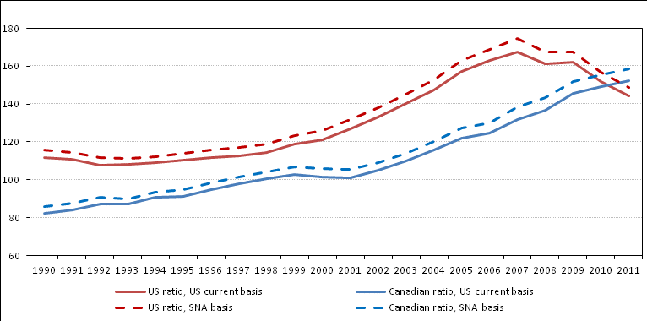
4 adjustments needed. AND ALL make Canada look better than shorts think it is.
A – add NPISH incomes to Canada data
B – Add unincorporated debts to USA data
C – Factor adjustment for NPISH size being larger in USA than Canada. We have no ‘non-profit’ schools and hospitals compared to USA.
D – Adjust for core disposable income stability in Canada vs USA. Specifically 4% healthcare spending by consumers versus 17%, and that illness has less affect upon creditworthiness.

Slide 16
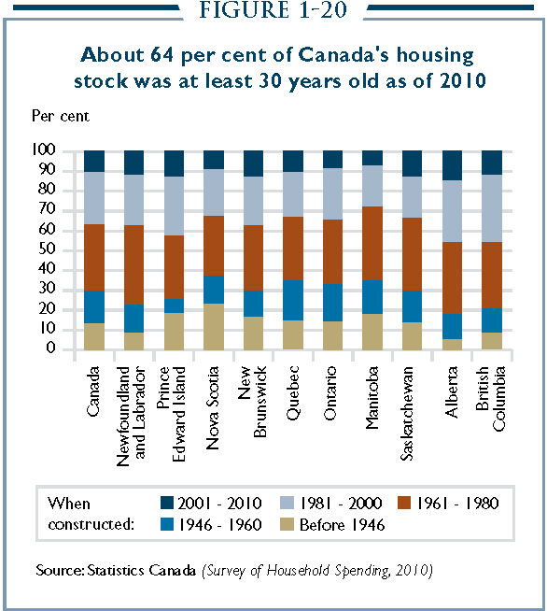

Slide 17
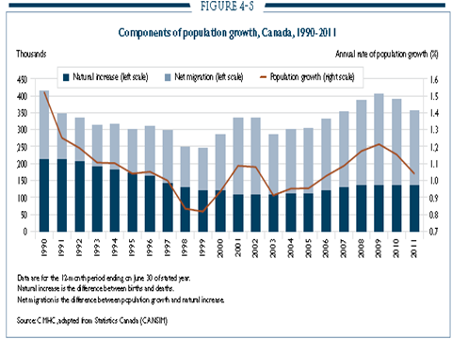

Slide 18
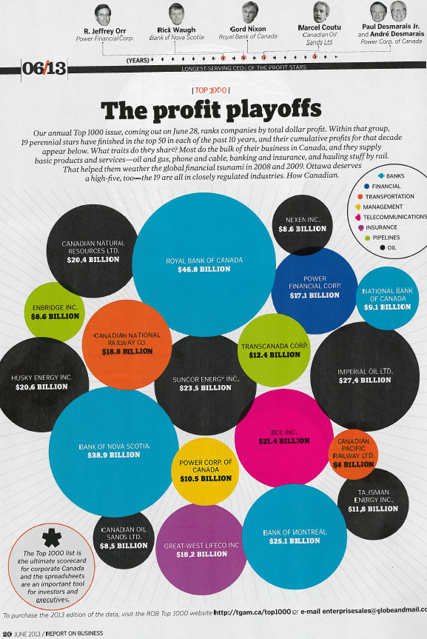

Slide 19
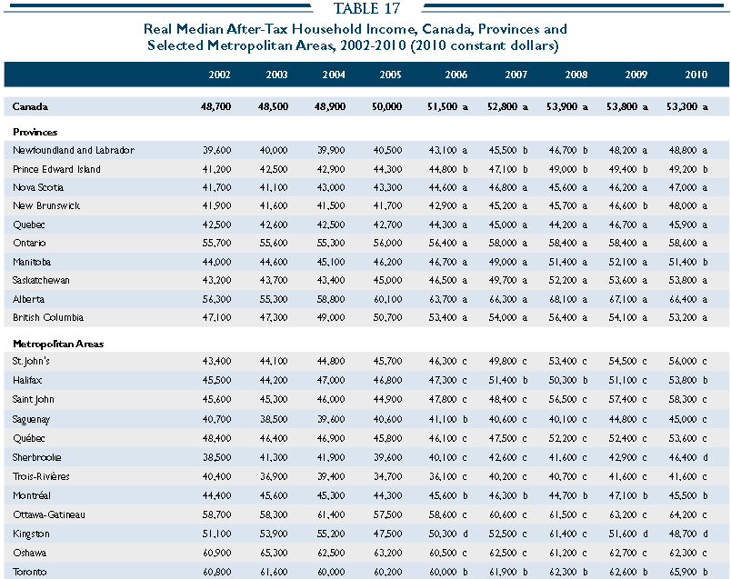

Slide 20
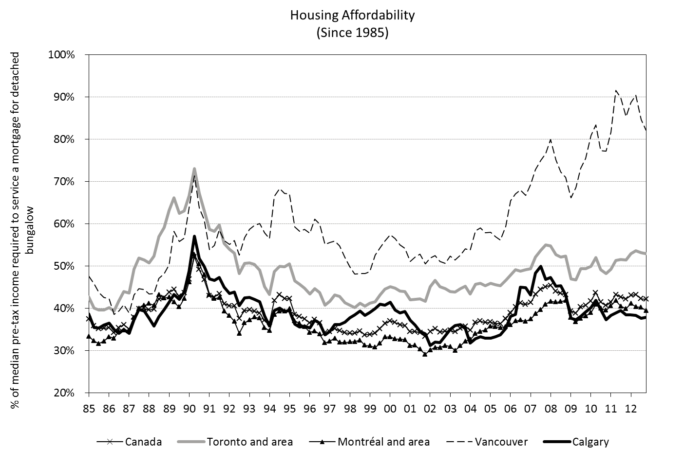

Slide 21
Beware of Data Mirages
This shows, via longer term perspectives, that VCR and YYZ are the problems. Teranet is mktcap weighted…average national income is not.
In fact the correct comparison is not USA to CAD, but NYC to VCR to YYZ. Because VCR and YYZ are also the destination cities for international investment money and money parking. In recent years the TRUMP/Shangri-La/4Seasons brands have all opened their 1st condo hotels in Toronto. Again – pricing these homes against average Canadian Income is a mismatch…because the incomes are not Canadian, the wealth is large, and if there is debt financing, CADbanks are unlikely to have supplied it.
ERGO these shorts are betting against an inflection in the FED’s QE4VR policy regarding 10yr rates…not against banks Istatements…they are just the pass-through vehicle. In fact even their Bsheet exposure is passed through.
YYZ income trades at 25% premium to CDN average. And the house prices are…25% premium too.

Slide 22
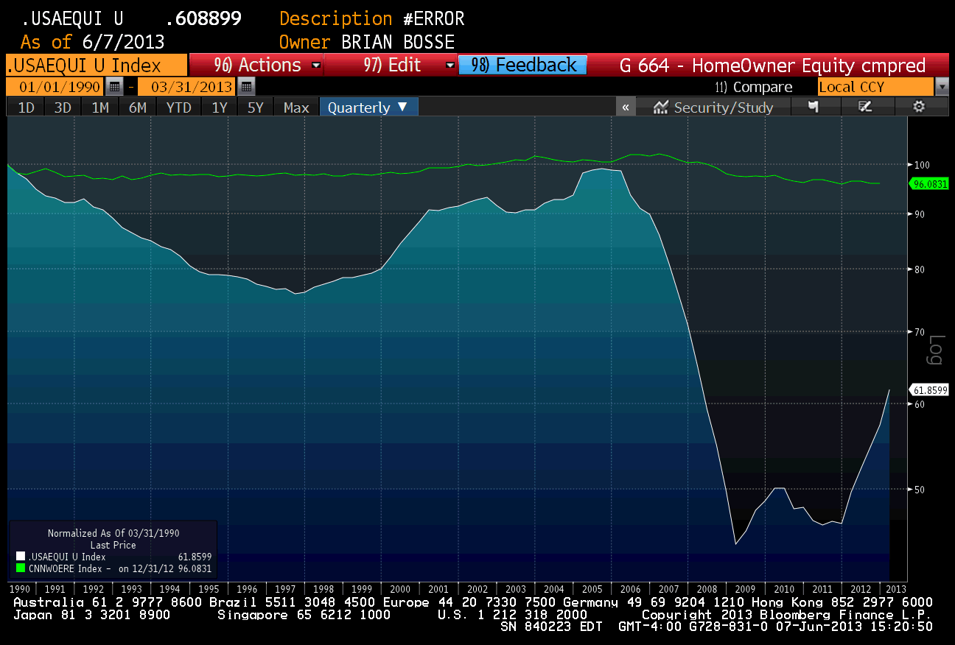
These are hand calculated proxies for Home owner’s equity percentage, in each country. Both data sets are indexed to 100 level in 1990. We can clearly see that the two systems have shown different volatility characteristics. What about the Green line makes you think that a large ‘everyone is underwater’ moment is coming?

Slide 23

CMHC

Slide 24
Canada Mortgage & Housing Corporation
Nearly 600$B insurance portfolio, 2/3rds of total.
CMHC is also overseen by OSFI. OSFI also oversees the banks
A Crown Corporation, owned by the Federal Government.
5% minimum down, even for insured loans
CURRENT DEFAULT RATES ARE…

Slide 25
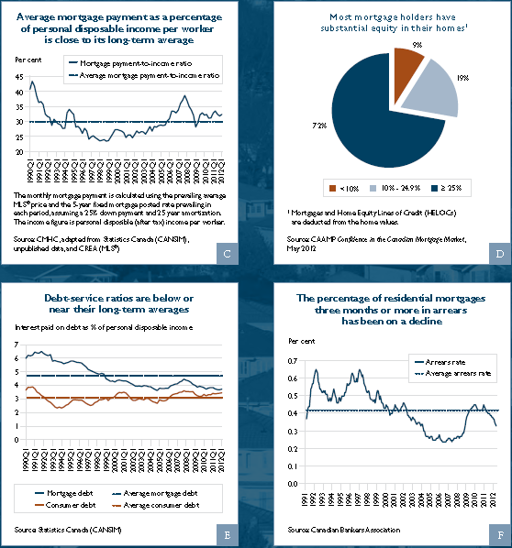

Slide 26
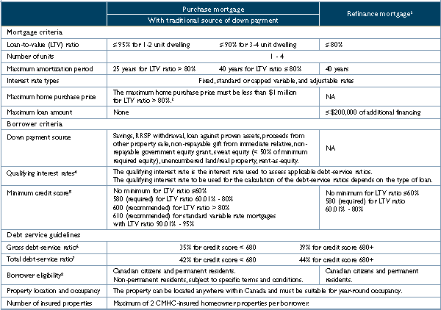

Slide 27
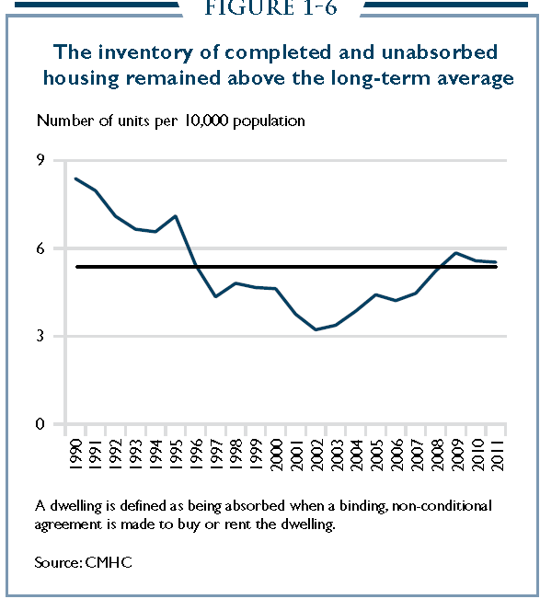

Slide 28
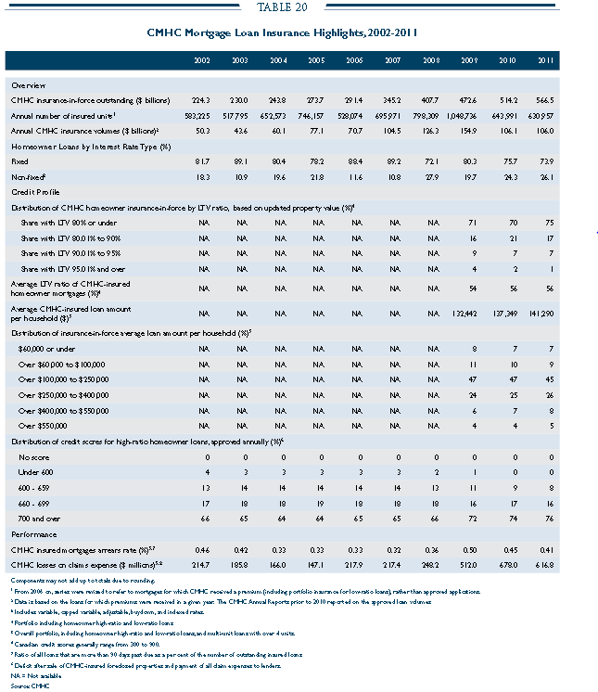

Slide 29
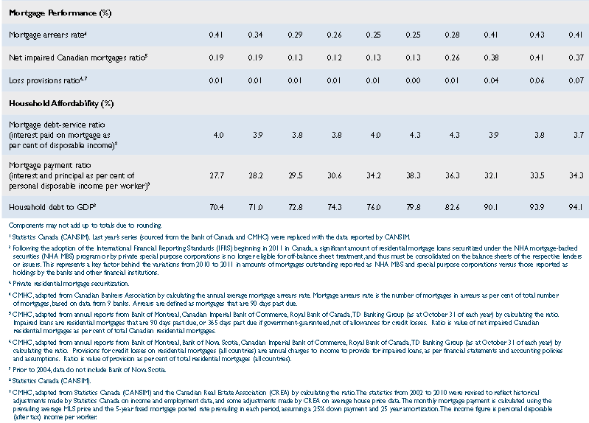
Loan Vintage Data

Slide 30

Toronto

Slide 31
154 Cranes
Downtown Toronto is adding jobs, and people, faster than rest of country.
It is wealthier than rest of the country
It has higher income than rest of country
It’s core is pulling from its fringes
Skyline barely changed from 1990 until 2005. 2 huge current projects were 50 years overdue.
500k Millenials can live+work w/o cars. Currently no children, and lifetime of earnings ahead.

Slide 32
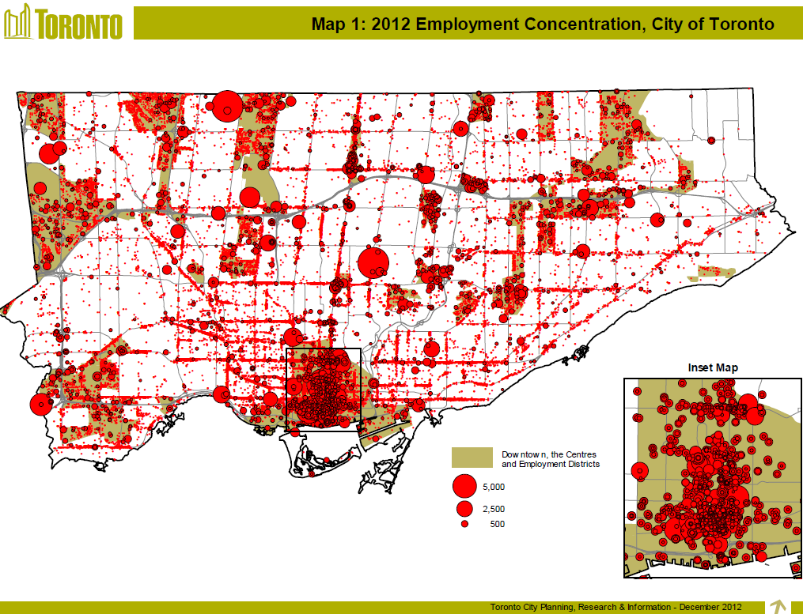

Slide 33
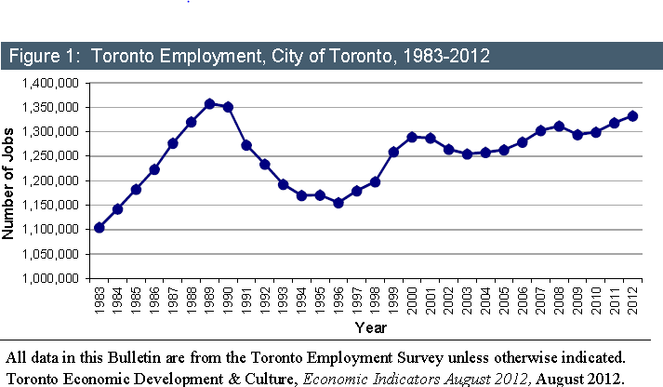
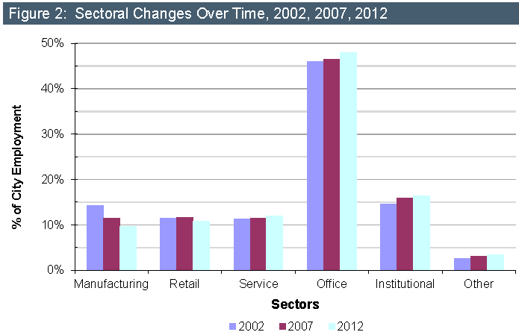

Slide 34

Housing rollover cannot kill STBANKX

Slide 35
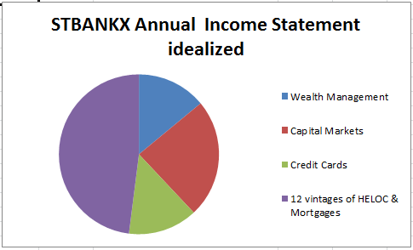
The 35$B annual pie

Slide 36
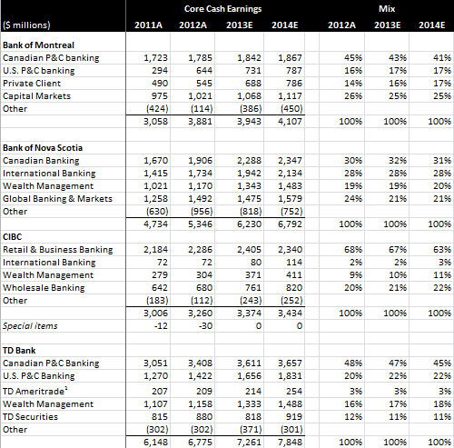
Income Statement overview (rbc)

Slide 37
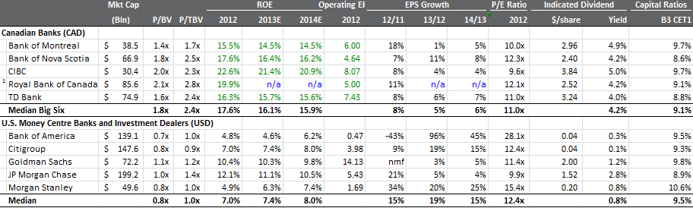
Quickie Comp. Chart (rbc)

Slide 38
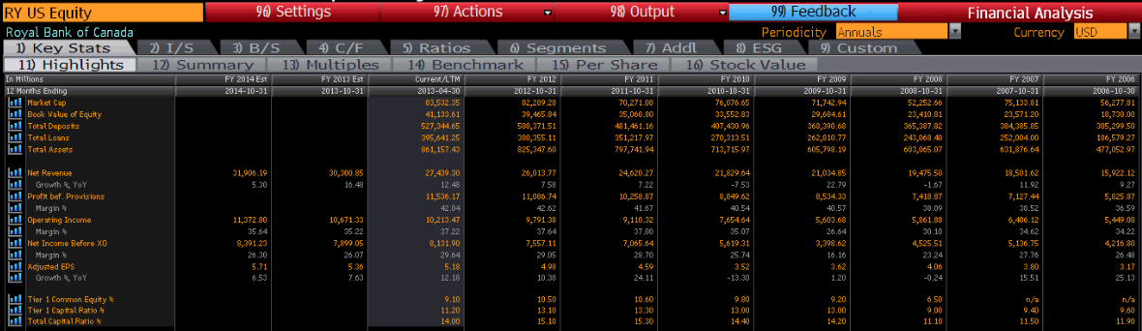

Slide 39
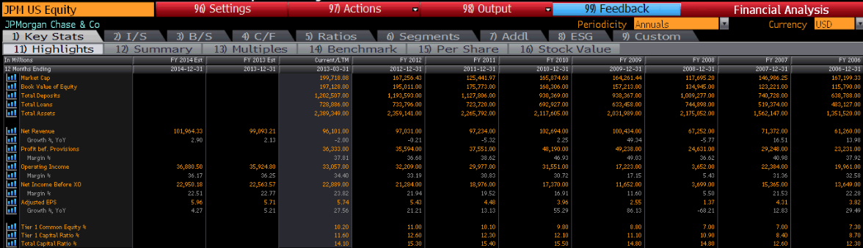

Slide 40
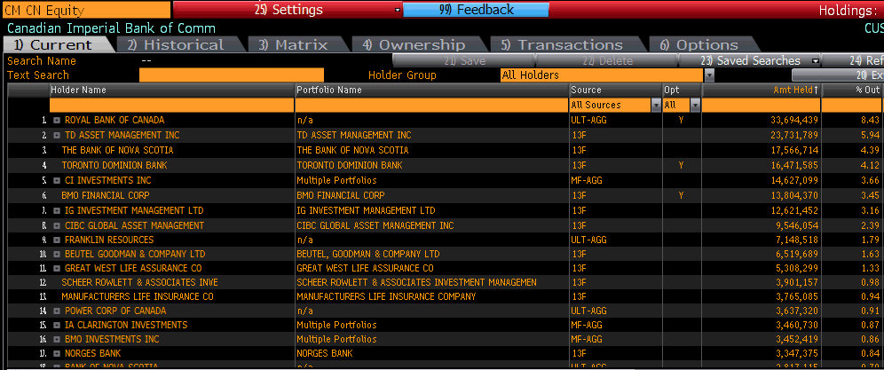
STBANKX shareholder base, eg.

Slide 41
THOUGHT EXPERIMENT - When does Housing create an Existential Threat to STBANKX?
1st 20% down books to the owner.
Next 53% books to CMHC. Too simple a statement, but illustrative…2/3 of mortgages insured, times 80% LTV, is 53%
Ignoring the knock-on affects…bank exposure is to the bottom 27% of a fall in house prices, assuming that housing went to zero.
ERGO – the OECD implied 48% correction would hurt, but not kill, STBANKX earnings

Slide 42

What Shorts should focus on

Slide 43
Behavioural Framing Issues with “The Bet”
Income Statements for STBANKX is more than mortgage lending.
Balance Sheet management is all that banking is really about. And the CADbanks have a long history of doing it well in conjunction with the OSFI.
Subprime Lending’ in Canada means LTV=80%. We prime those using CMHC insurance. CADbank balance sheets are explicitly indemnified, including legal costs.

Slide 44
STBANKX are essentially GSEs of OECD’s best house on the street
Even if 3 years of Real Estate vintage goes sour, the direct impact is only 12% on earnings, for 3 years. So housing is not an existential threat to these banks. Which makes shorting a timing exercise.
STBANKX current PE is 11. Divvy 4.1%. If we use 8x to represent book value, implied growth is 1.5%. So, how is this expensive versus 2% GDP growth? Paying 5% total borrow cost to find out is counterproductive.
50% consumer economy in CAD vs 70% in USA. And a lower CAD value sparks other sections of the economy, which benefits STBANKX. Resources&Manufacturing&Technology&FDI.
According to Statistics Canada, growth of 25-40yrs old between 2011 and 2016 is 6.94% (490k)...these are the condo buyers causing a lot of cranes. 490k/couples/30stories/30units=272 cranes
Uninsured LTV runs 55% nationally

Slide 45
No systemic ‘dumb money’ . Securitization is a non-event.
VCR & YYZ are 35% of housing value annual turnover, yet people compare house pricing to the national income???
Non standard loans…23% USA 2006, 5% CAN 2005, 7% CAN 2012
Mortgage vintages have not gone bad.
STBANKX controls many industries. Exchanges, AUM, Investment Banks, AUA, Student Loans, Credit Cards, Auto Loans, Toy Loans, HELOCs, Insurance, Regulations, Prime Brokerage, etc.
@ 4% Short Interest, STBANKX reaps 62M$ in cost of borrow from hedgies. [CM is 31B$mcap. 4%SI @ 5%annum is 62M$!!]. @ 1.5% NIMspread, 62M$ is like 4.1B$ in loans
All borrowers must qualify for a 5 yr fixed… even if they are asking for 3yr float.
No refi can take homeowners below 20% equity. Spec buying (non owner occupied) requires 20% down + insurance. 25yr max amortization on all CMHC loans.
No more CMHC backing on HELOCs. No CMHC on homes above 1M$.

Slide 46
Before deciding about Bubbles.
Canada is recourse (except AB). Defaulting homeowners cannot walk. They declare and the bank has claim to other assets if Foreclosure does not make the bank whole as a secured creditor.
Insurance applications are NOT vintage based. Each deal gets vetted & approved. So – no putbacks!
Borrowers required to prove that the down-payment is theirs.
Banks do not ‘compete’ to lend in USA sense (no interstate billboards for fishing boat loans). They are relationship lenders, aiming to take the entire fee wallet as recompense on any lowered interest rates offered.
When large commercial loans made do turn bad, banks will either workout, take the a foreclosure hit, or sell the debt to vultures.
ALL mortgages are term loans, regardless of amortization period. (3,5,7yrs)
No NINJAs, No Liar Loans, No Teaser Rates, No Interest expense deductions, Max 2 CMHC’s per person
VCR outperformance began in advance of 1999 Hong Kong handoff, and continues as Asian wealth needs to be stored offshore.
Condo construction is tiny % of loan books. It is 80% loan to costs instead of LTV.

Slide 47

Advice to shorts

Slide 48
Brian’s Advice to Shorts
Wait for a clear catalyst which could topple the affordability of consumer debt levels.
I rate shock
Employment shock
US recession
The proper short basket must include Sovereign - CAD and GCB.
*remember that GFC = housing bust + short term funding window @ zero + MBS investment writedowns. Not a simple analogy to STBANKX in 2013

Slide 49

Thank you very much

Slide 50
Questions & Video

Slide 51
This presentation is solely the work of Brian Bosse. Although the author is a registered Portfolio Manager with Goodman & Company, Investment Counsel Inc. (“GICI”), this is not an official publication of GICI and the author is not a GICI research analyst. The views (including any recommendations) expressed in this material are those of the author alone, and they have not been approved by, and are not necessarily those of, GICI or its parent company, Dundee Corporation.
Assumptions, opinions and estimates constitute the author’s judgment as of the date of this material and are subject to change without notice. The information contained in this presentation has been compiled from sources believed to be reliable, however, we make no guarantee, representation or warranty, expressed or implied, as to such information’s accuracy or completeness. No representation or warranty, express or implied, is made as to the fairness, accuracy, or completeness or correctness of the information, opinions and conclusions contained in this presentation. None of GICI, its directors, employees or agents, or any other person accepts any liability, including, without limitation, any liability arising out of fault or negligence, for any loss arising from the use of information contained in this presentation
The information contained in this presentation is not investment or financial product advice and is not intended to be used as the basis for making an investment decision. This presentation has been prepared without taking into account the investment objectives, financial situation or particular needs of any particular person. Past performance is not indicative of future results and no returns are guaranteed.
This presentation is for information purposes only and is neither a solicitation for the purchase of securities nor an offer of securities.
No part of this publication may be reproduced without the express written consent of GICI and Brian Bosse.
Brian Bosse, CFA. Vice President, Portfolio Manager

