Slide 1
A Search for
Advantaged Value Investments
VALUEx Vail
June, 20th 2013
Ethan Berg
G4

Slide 2
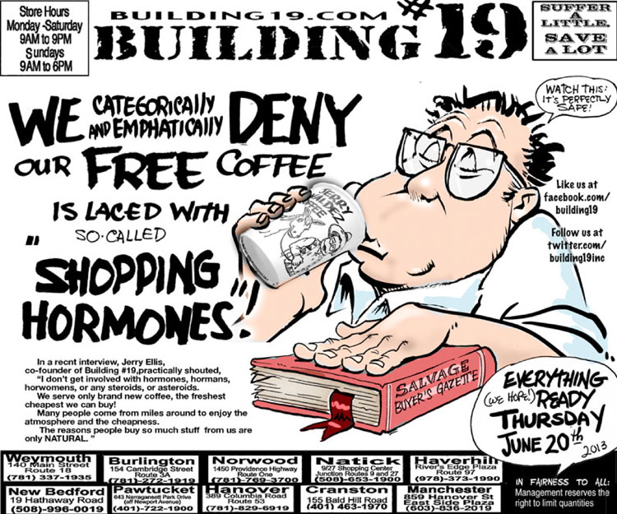
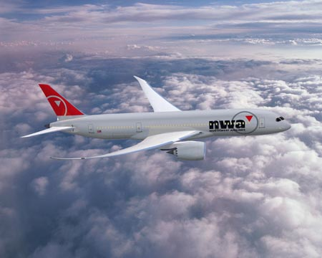
Pricing Anomalies Are All Around Us

Slide 3
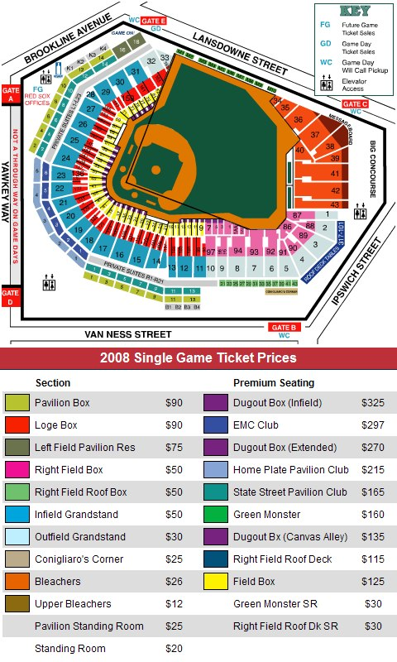
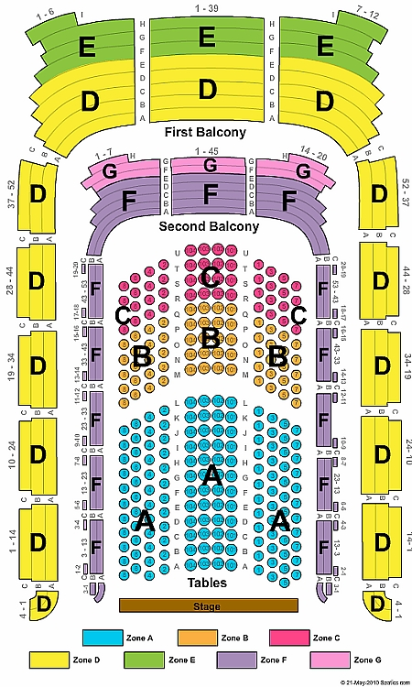

Slide 4
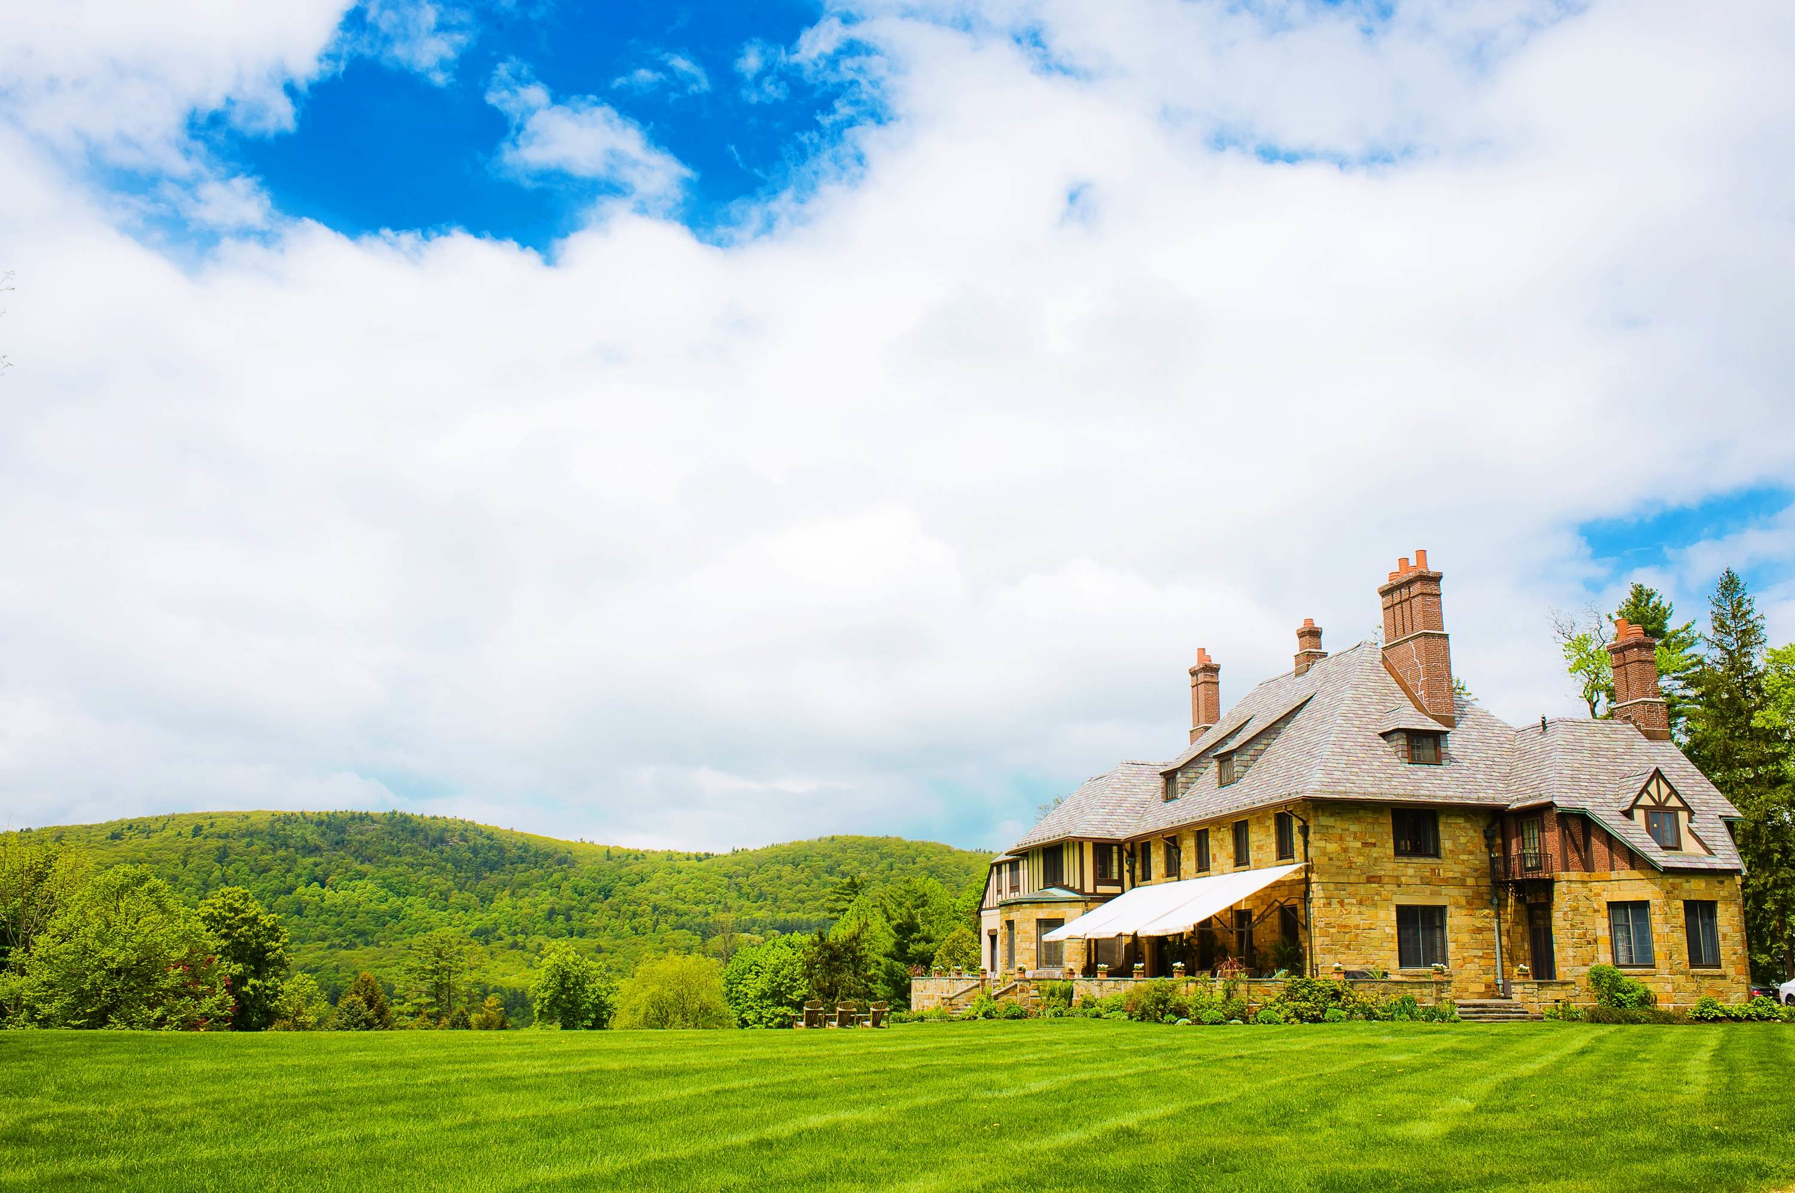
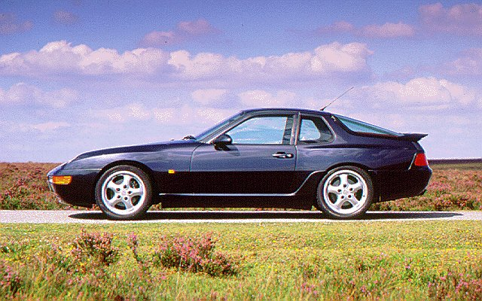

Slide 5
The Creation of Strategy
Value Analysis
Segmentation
Relative Position
Industry Analysis
Competitive Dynamics
Economics
Strategic Choice
End-Customer
Capabilities
Industry Definition
External
Segmentation
What Constitutes end-customer value?
What are the strategically distinct segments?
How do our capabilities compare to our competitors?
What is the scope of the industry?
How will our competitors, customers and suppliers react to our actions?
Position A
With
Advantage X
What are the economic implications of the choice?
Relative Attractiveness
Industry Structure
Channel
Costs
Internal
What constitutes channel value?
How attractive is each segment?
How do our costs compare to our competitors?
What are the economic drivers of the industry?
What are the implications for the organization pursuing the choice?
Position B
With
Advantage Y
Customer Insight and Action
Costs and Capabilities
Industry Evolution
Economics of Choice
Source: Monitor Company

Slide 6
There is often a disconnect between stock prices and how the company is evolving…

Slide 7
Advantaged Value
High
Check Point
Competitive Advantage
Low
Low
Good Value
High
(Cheaper)

Slide 8
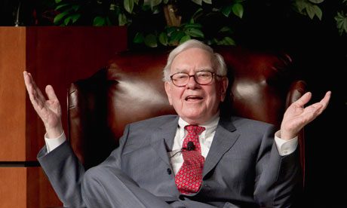
“In business, I look for economic castles protected by unbreachable ‘moats”.
-Warren Buffet
Berkshire Hathaway Annual Report, 1995
Porter’s Competitive Advantage is 500+ pages!

Slide 9
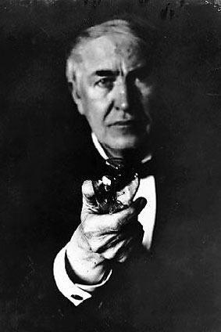
“Gents: I have decided to keep your grand piano. For some reason unknown to me it gives better results than any so far tried. Please send bill with lowest price.”
Yours,
Thomas Alva Edison June 2nd 1890

Slide 10
“
.”
“Gents: I have decided to keep your grand piano. For some reason unknown to me it gives better results than any so far tried. Please send bill with lowest price.”

Slide 11
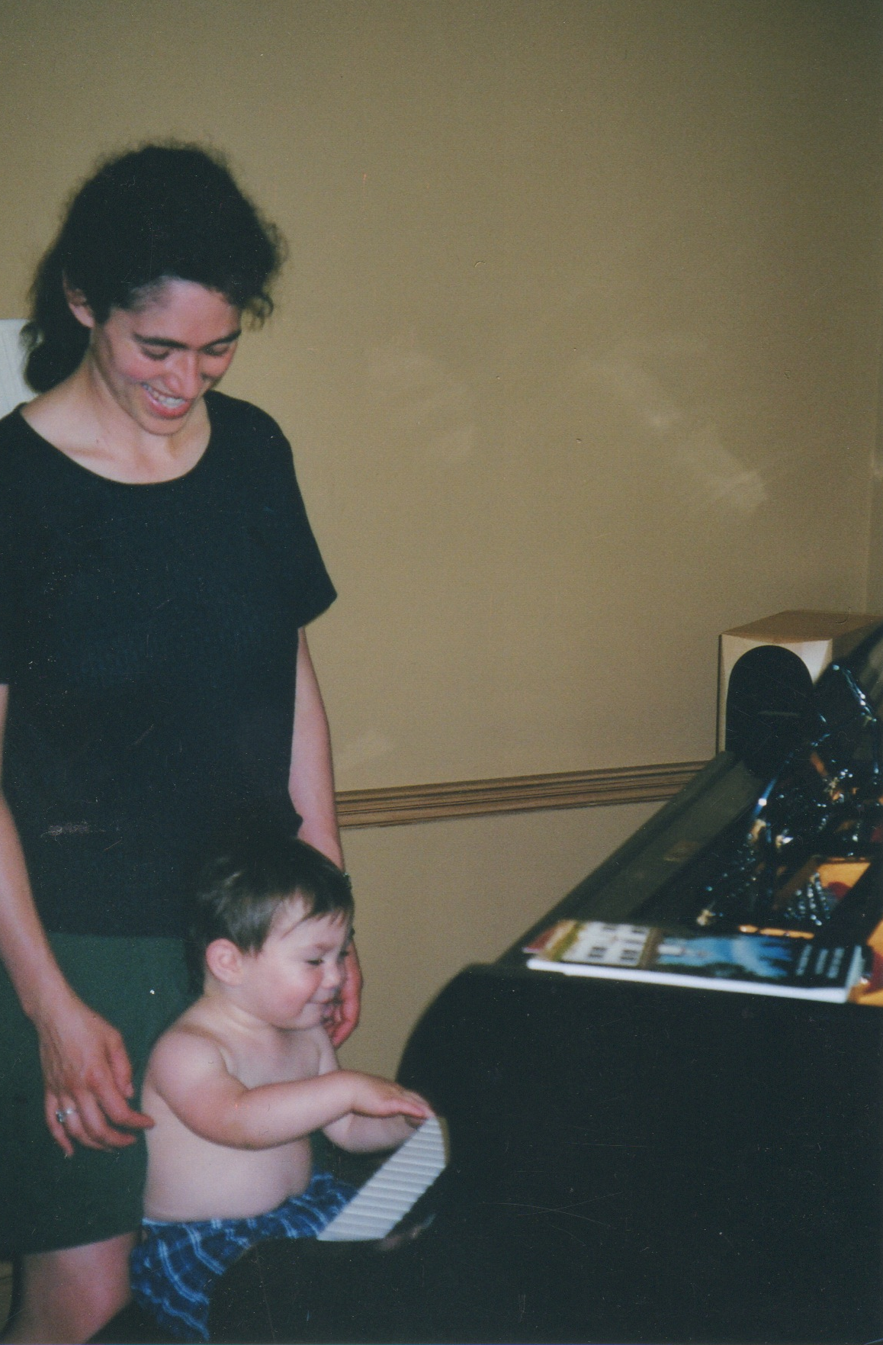
Wow! This thing sounds great!

Slide 12
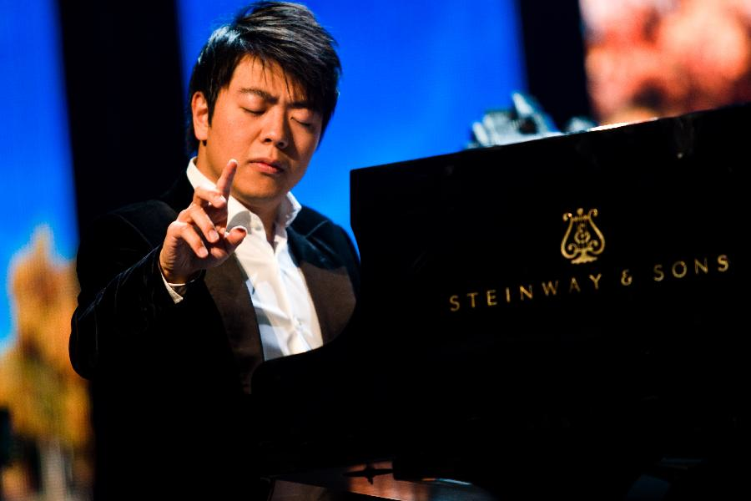

Slide 13
Steinway: Customer Value
Customer Segments
Purchase Criteria
+
Professional/Serious User (6)
Furniture (8)
Institutions (i.e. Julliard) (8)
Families (70)
Voice
Size, Wood
Durability, Price
Price

Slide 14
Steinway Activities System: Costs and Capabilities
Wood Technicians
>100 Patents
All
Wood Action
Steinway Hall
Technical Excellence
Steinway Concert Service
Finest Raw Materials. Aged.
Master Piano Technicians
Exclusive Use of Artist Names
Relationship 95% Concert Performers
10 Tone Regulators
Craft Methods
Voicing Process
(20 hours)
1,500 Unpaid endorsers
Steinway Village Factory
Piano
Bank
Steinway Village Factory
3rd GenerationSkilled employees
12000 Parts
Informed Testers

Slide 15
“
.”
“We use the concert pianist as a proving ground. They know it. Part of this association with performing artists is the fact that we say, “Look, we are trying to make a better piano for you guys, will you try this one?” And a Gary Graffman or a Grant Johannesen or a Rudolf Serkin or one of today’s fine performing artists say, “Sure.” They’ll try it and come back and say, “Johnny, you know that dog- I just couldn’t get what I wanted out of it,” and that’s what I want to know. That’s the help they give us. There’s no real scientific laboratory way you could take an experimental action, put it in a piano and test it, and say, “This is 89.27 percent better than the other” or something. I want Gary Graffman to try the thing.”

Slide 16
Steinway: Passionate Customers
“
.”
“Steinway is the only piano on which the pianist can do everything he wants. And everything he dreams.” – Vladimir Ashkenazy
“When one plays a Steinway, there is a warmth and nobility in the sound that is unequaled by any other instrument.” – Emanuel Ax
“A Pianist without a Steinway, for me, is the same as a singer without a voice.” – Rudolph Buchbinder
“The Steinway pianos of today are the finest I have ever played.” –James Levine
“The more I hear its nuances of sounds, the more I realize the wealth of colors only a Steinway piano can produce.” – Murray Perahia

Slide 17
Steinway: Relative Advantage
100
90
80
70
60
50
Steinway
Yamaha
Voice Rating
80K 70K 60K 50K 40K 30K 20K 10K
Cost

Slide 18
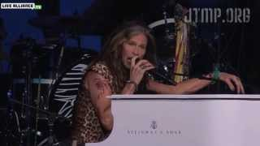
Steven Tyler, Aerosmith @ Boston Strong

Slide 19
Steinway (LVB): Valuation
Market Cap
=
$359.29M
Normalized FCF
~22mm
Liquidation Value
LI Factory: $150M
Piano Bank: $130M
Brand: $25M
German Factory: ?
Not necessarily cheap today, but it has been in the past and will be again in the future. Meanwhile, their advantage in certain segments is enduring (123 years and counting…).

Slide 20
Three Most Valuable Things In Searching for Advantaged Companies
Customer Segmentation and Value Analysis
Who is the core buyer?
What are their purchase criteria, exactly?
Does the company have leading market share?
Will anyone miss them if they are gone tomorrow?
The Company has Unique Set of Assets and Activities (Costs and Capabilities)
Unfair advantage: “They are cheating!”
Understand what their actual advantage is
Build an “Activity System”
Evidence of Barriers to Entry (Historic Returns on Capital)
Not replicable no matter what another company spends
Demonstratably Lowest Cost Producer
Fit Between the Two
Good Value:
Low multiple of normalized Cash Flows
Positive Free Cash Flows – Predictable, recurring, consistent
Monetizeable Assets
Discount to conservatively assessed value
Out of Favor Holdings that carry less risk of loss

Slide 21
Pricing Anomaly: Life Sciences/ Biotech
Disconnect between VC and scientists’ timeline
FDA phases disproportionately affect valuation
When publically traded, story trumps science
Analysts focus only on lead candidates

Slide 22
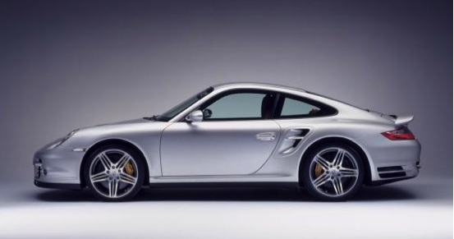
One more Advantaged Value “Investment”

Slide 23
Appendix

Slide 24
Winning the Value Equation
Dollars
Customers’
Willingness to Pay
-
Cost of Creating Value (Incl. Capital Costs)
=
Margin
Winning the value equation:
Correctly interpreting “value”
Understanding cost dynamics

Slide 25
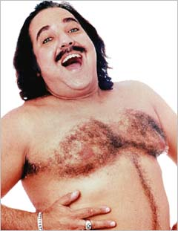
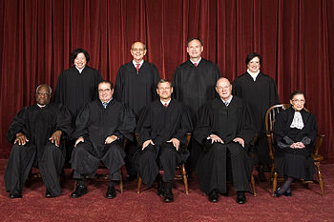
Identifying Advantage:
“I know it when I see it…”

Slide 26
Contango Oil & Gas Company (MCF) as a case study
Core Beliefs from Inception
The only competitive advantage in the natural gas and oil business is to be among the LOWEST COST producers.
Virtually all the exploration and production industry’s VALUE CREATION occurs when drilling of successful exploration wells.
The whole point of a business is only and always to increase shareholder wealth… with conditions.
“Beliefs are optional, results are mandatory and the only result that matters is total return to shareholders.”
-Kenneth R. Peak

Slide 27
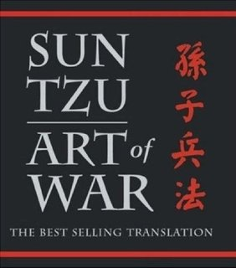
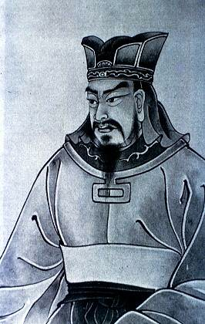
Strategy, Positioning and Sustainable Advantage
“The highest form of generalship is to conquer the enemy by strategy. The next highest form of generalship is to conquer the enemy by alliance. The still next highest form of generalship is to conquer the enemy by battle. The worst form of generalship is to conquer the enemy by besieging walled cities.”
“If you know the enemy and you know yourself, you need not fear the result of a hundred battles. If you know yourself but not the enemy, for every victory gained you will suffer a defeat. If you know neither the enemy nor yourself, you will succumb in every battle.”
“The general who wins a battle makes many calculations before the battle is fought. The general who loses a battle makes but few.”
-General Tzu,
The Art of War (Circa 450 B.C.)

Slide 28
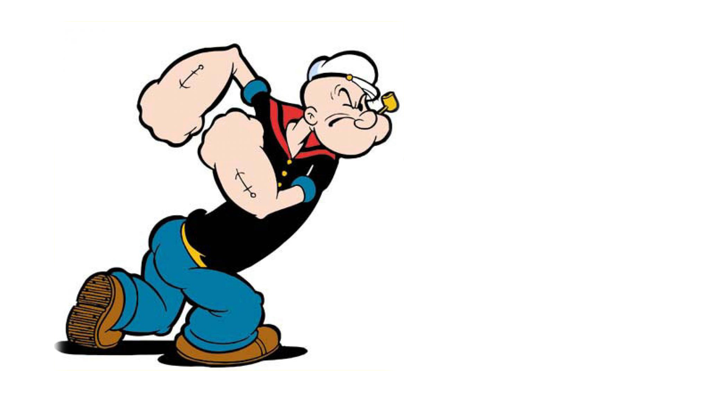
“I yam what I yam!”
–Popeye

Slide 29
Types of Advantage:
High Customer Switching Costs
Economies of Scale/Low Cost Provider
Intangible Assets
The Network Effect
Threat of Entry

Slide 30
Relationship Between Strategy and Activity Systems
Strategy is an integrated set of choices about where to play and how to win
The goal is to make choices that enable the firm to create sustainable advantage relative to competitors
The purpose of an activity system is to transform a set of choices into what an organization must do on a day to day basis to create sustainable competitive advantage.
The essence of great strategy is a unique activity system- choosing to perform activities differently or to perform different activities than rivals in order to win the value equation
Sustainable competitive advantage arises from the way activities fit and reinforce each other.
The system is greater than the sum of activities: synergy
The whole system is more difficult to replicate by competitors than each individual activity.

Slide 31
Activity Systems Within the Context of Cascading Choice
Heart of Strategy
Activity System
What are our goals and aspirations?
Where will
we play?
How will we win in chosen markets?
What capabilities must be in place to win?
What management systems are required?

Slide 32
Highlighting the Main Strategic Choices
Pick the main “Where to Play” and “How to Win” strategic choices using the following principles
Which of these represent significant sources of:
Value?
Advantage?
These main “Where to Play” and “How to Win” choices become the major hubs of your activity system. You will generate activities in support of each of these major hubs
Major Hub #1
Major Hub #2
Major Hub #3
Major Hub #4

Slide 33
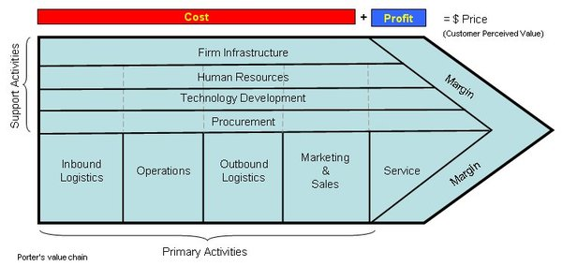
Brainstorm Activities in Support of Each Major Hub
Generate a list of distinctive activities or unique combinations of activities in support of each major hub using the value chain to simulate your thinking
Include activities that the firm may not do now but to which it can gain access through suppliers, alliances, in-licensing, etc.
An activity system, in contrast to a value chain, reflects choices on which particular activities will create sustainable competitive advantage for the firm.
Actively consider how to exploit the core competencies, capabilities, technologies, resources. In doing so, you may invent new strategic options or create new major hubs for the strategy
Which Activities Support Each Hub?
Major Hub #1 Activity one Activity two Activity three Etc. Major Hub #2 Activity one Activity two Activity three Etc.

Slide 34
Criteria to Evaluate the Activity System as a Set
Distinctiveness
Do differences vs. competitors yield distinct advantage?
Do overlaps vs. competition exist? Can we claim advantage?
Does this activity show where we will not play?
Impact on Value Creation
Do the activities create value for consumers? Channels?
Do the activities create value for shareholders?
Sustainability
What is the longevity of our advantage? How likely is it to be imitated?
Fit
How do the activities complement and reinforce each other?
Breakthrough thinking
To what extent does this activity system enable us to “change the rules of the game?”

Slide 35
Ten Year Weighted Average Return on Capital For Selected Industries

