Slide 1
Engility Corp
A Defense Industry Spinoff
Evan Tindell
Ballentine Capital
etindell@ballentinecap.com
Vail VALUEX 2013

Slide 2
Spinoffs– Shown to Outperform
A number of theories to explain returns
  Management focus
  Ability to optimize cost structure
  Execution of new business models
  New stock useful as acquisition and compensation currency
Artificial causes of investor disinterest
  Frequently much smaller in size
  Often involves change of industry
  Above result in lack of analyst coverage
Source: “Predictability of Long-Term Spinoff Returns”, McConnell 2004
Combo of business advantages and investor disinterest creates opportunity
Notes:
First a quick look at why spinoffs are interesting in general
The reason is, they outperform.
The typical outperformance is about 25% over a period of two years or so.
There are a number of theories as to why spinoffs business tends to improve.
They include management focus, ability to change the cost structure, the freedom to change business models, and the ability to us the new stock in both compensation and acquisitions.
There are also a few reasons why investors may be uninterested in the stocks in the short term.
They are often a lot smaller in size, and or are in a different industry. This means that certain funds may be simply unable to hold the new stocks.
Smaller size and industry changes also often result in a lack of analyst coverage.
I think this analyst and investor disinterest potentially leads to undervaluation.

Slide 3
Meet the Parent: L-3 (LLL)
Defense contractor that needed a change
  Top 10 contractor by revenues
  Poor stock performance, lagging peers last 3 years
  Revenues declining despite billions spent on acquisitions
  2011: decides to spin off SETA, war related business as Engility
Sources: Bloomberg, LLL 10-k’s
Notes:
Note history of defense contractors spinning off their service biz due to OCI concerns

Slide 4
Why L-3 Wanted Out
Reduced exposure to Iraq/Afghanistan
  Troop drawdowns are drag on services revenues
  War budgets scheduled to decline further over next few years
Services business hurting income statement
  Margins lower than corporate averages
  Total revenues ex-Engility were flat
Engility’s addressable market constrained as part of L-3
  Federal rules make it tough for SETA firms to work on projects where parent co may be a supplier
  L-3 management says worth “a few hundred million” ^{[2]} in foregone revenue
Thus a spinoff is born… Agility + Engineering = “Engility”
[1] EGL 2012 10-K
[2] LLL Q2 2012 Conference Call
Notes:
Ok so a little more on why they wanted to spin off Engility
As I mentioned, Engility’s revenues were declining primarily due to a decrease in funding for the Iraq and Afghanistan wars as those are wound down.
So spinning off Engility reduced that exposure.
Relatedly, it improved the optics of there income statement, resulting in revenues that were basically flat, as opposed to down a billion.
Finally, Engility’s business was constrained as a part of L-3. I’ll get more into this later but Federal Regulations make it tough for firms to advise the govt when there is a conflict of interest, such as your parent company being a potential supplier on the project you are advising.
For all these reasons, they spun it off in June 2012. The combined firm was named Engility which is a combo of Agility and Engineering.

Slide 5
Engility At a Glance
Engility Corporation
Price: $28.00
Market Cap: $480m
Net Debt: $335m
2013E Revs: $1500m
2013E EBITDA: $130m
Largest Holders:
Abrams 15.5%
Deccan Value 8.8%
Pzena 4.7%
Analyst Coverage
Stifel
CRT Capital
Source: Bloomberg, my own estimates
Notes:
You can see the revenue decline I mentioned, from 2.5 to 1.5B
A lot smaller than parent at 480m vs 10B
Only two analysts cover it, and one is CRT capital which I’ve never heard of (no offense to anyone from CRT if they are in the room)

Slide 6

An Orphan…
  Tiny size relative to parent
  Little analyst coverage
  Low margins, declining sales
  Fears over DoD budget and troop drawdowns
Lots of reasons to for investors to stay away, so what’s the valuation?
Notes:
So what we have here is an orphaned stock.
Its tiny relative to its parent, only $480m vs $10B
Only two analysts cover it
Sales are declining and not particularly high margin
And of course there are the general defense budget fears

Slide 7
…And the multiple to Prove it
Defense stocks generally trade at a discount to the market
Engility trades at the greatest discount of them all
XLS looks cheap until you see the $2B underfunded pension
Source: Bloomberg, my own estimates
Notes:
And that is reflected in its multiple
Defense industry as a whole is pretty cheap over sequester fears and the wind down of the wars
But Engility trades the cheapest of the industry, at <8x FCF

Slide 8
What They Do
Professional Support: $900m
technical/financial consulting
procurement/program management
IT network engineering
systems engineering & integration
Mission Support: $700m
logistics, supply chain, asset management
int’l law enforcement training
linguistic support
$300m in war related revenues
Many small contracts, 75% with DoD
Largest 10 contracts 38% of revenues
No contract is >10% of revenues
Benefits to DoD Contracting
1. Revenues generally profitable
2. Contracts extend for years
3. Revenues insulated from economy
4. Employee security clearances
are barrier to entry
Accounts receivable always get collected (eventually)
Problems with DoD Contracting
1. Margins (especially gross) are low
2. Contracts can be canceled at whim
3. Revenues dependent on congress
4. Employee leaks are a risk (BAH)
Accounts receivable always get collected (eventually)
Notes:
Now onto their business
Engility’s business is broken into two segments, Professional support and mission support
Professional support is the technical advisory side, and mission support tends to be the international work, and includes most of the war-related revenues.
What management says is that after the decline in revenues over the last few years, only about 300m in overseas contigency operations (OCO) funded revenues remains
100m is troop dependent
100m for supporting systems that should remain in place
100m “we believe will continue to be funded”
Super pixelated graphic

Slide 9
Benefits to the spinoff
Larger addressable market
Freedom to pursue low price strategy
Ability to change cost structure
Notes:
A few reasons to believe that Engility’s business will improve post spin
For one, it will remove the Conflict of Interest constraint I mentioned earlier and increase their addressable market
Second it gives them the freedom to execute a new price disruptive strategy, a big part of which is a change in their cost structure

Slide 10
Benefits to the spinoff
Larger addressable market
Freedom to pursue low price strategy
Ability to change cost structure
Notes:
So no onto why I think their addressable market should grow

Slide 11
The Addressable Market
Organizational Conflicts of Interest
  Federal Acquisition Regulations (FAR) restricts ability of advisory firms to work on projects where Parent is supplier
  Rules strengthened in 2011 (emphasis mine):
  Contractors must be granted a waiver if conflicts exist
9.504 Contracting officer responsibilities.
(1) Identify and evaluate potential organizational conflicts of interest as early in the acquisition process as possible; and
(2) Avoid, neutralize, or mitigate significant potential conflicts before contract award.
Federal Acquisition Regulations Subpart 9.5– Organizational Conflicts of Interest
Notes:
So as I mentioned, Federal Acquisitions Regulations have this consideration called “Organizational Conflicts”
An Organizational Conflict is when a company is advising the govt on a project where another part of the company may be a supplier.
The conflict of interest rules have existed for a while but were strengthened in 2011.
Where as before it was more of a grey area, now the guidelines say that the govt should seek first to avoid conflicts if possible, making it much more difficult to win business as an advisor with conflicts of interest

Slide 12
The Addressable Market
Results of OCI Constraint Removal
  Can now bid on all projects, even if L-3 involved
  $15B market going to $21B
  Increase $2B per yr for 3 years
  This is a +12% CAGR
  Won’t win them all, but should gain their fair share
Source: EGL management
Notes:
But now, as a separate company, Engility will not have this constraint. They can now bid on any and all projects.
The result is that their addressable market should grow significantly over time as contracts come up for renewal.
What management has estimated is that their addressable market will go from about 15 billion to 21 billion over a period of three years.
Obviously they won’t win all of this business, but I definitely think it serves as a large tailwind.

Slide 13
Benefits to the spinoff
Independence increases addressable market
Freedom to pursue low price strategy
Ability to change cost structure
Notes:
The second benefit to the spinoff is Engility’s new low price strategy.

Slide 14
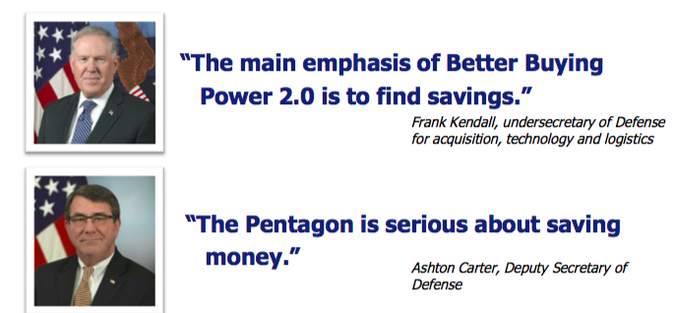
Disruptive pricing strategy
Increasingly price focused customer
  Budget problems are well known (ie, sequester)
  Better Buying 2.0 memo released in late 2012
  Increasing importance of “low price, technically acceptable” (LTPA) procurement
Source: EGL April 2013 Investor Presentation
Notes:
As you all know from the daily news stories on the sequester, it’s not a secret that the govt budget as a whole and the defense budget in particular is increasingly coming under pressure
One result is that the defense department is increasingly focused on price in determining contract winners, and placing less emphasis on past performance
Two good examples of this trend are the better buying 2.0 memo, and the move toward low-price technically acceptable contracting.
The better buying 2.0 memo was released in late 2012 and detailed a bunch of different ways the DoD was going to try to save money
Also something called low price technically acceptable contracting has emerged, where price is the only factor considered after an initial determination that bids meet the technical specifications
So while every customer always wants to save money, I think the defense industry is particularly ripe for disruption from a price and value-focused business model

Slide 15
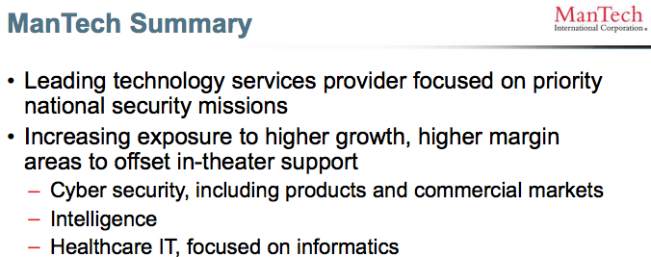
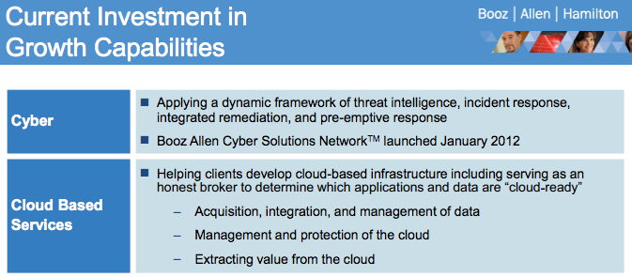
Disruptive pricing strategy
Other firms firms all focused on same growth areas
  Cyber, Healthcare IT, Intelligence sub-segment
  Trying to move up the value chain, which raises their costs (R&D)
  This is allowing Engility to bid 12-15% below the competition
  Price advantage should allow Engility to take market share from incumbents over time
Source: MANT, BAH investor presentations
Notes:
Another reason that their price disruptive strategy may be poised to work well is that it appears to be the exact opposite of what a lot of their competitors are doing
Most of their competitors focused on moving up the value chain, towards perceived higher growth segments like cyber, healthcare IT, etc.
You can see examples of this in the two slides below.
What this does is it raises these competitors indirect cost, like R&D.
This is allowing Engility to come to market with bids tthat are 12-15% below their competition.
I think this price advantage should work well with the defense departments increasing focus on on price, and should allow Engility to unseat incumbents on contracts and take market share over time.

Slide 16
Benefits to the spinoff
Independence increases addressable market
Freedom to pursue low price strategy
Ability to change cost structure
Notes:
Now I will discuss the cost cutting efforts they have undertaken to enable these low prices

Slide 17
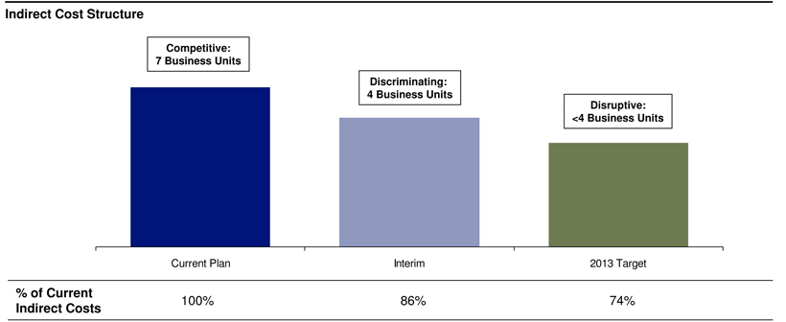
Changing the Cost Structure
Took a “clean sheet” approach to cost takeouts
  Enabled by the spinoff from parent
  Decided to consolidate business units and cut indirect costs
  Consolidation executed in Q4 2012
Source: EGL 2012 Roadshow Slides
Notes:
After the spinoff, Engility was able to take a fresh look at their cost structure.
They decided that they didn’t need nearly as many business units, and could use consolidation to significantly cut costs.
They moved from 7 business units to 3 business units , and have cut a lot of the indirect costs that were duplicated between the units such as accoutning, HR, IT, etc.
They made these moves in Q4 or last year.

Slide 18
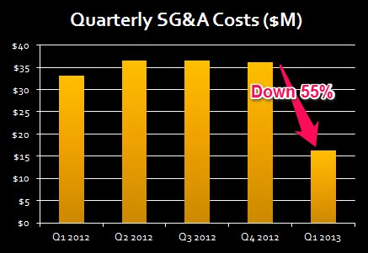
Changing the Cost Structure
Realignment already showing results
  Cut indirect headcount by 40% and infrastructure costs by 26%
  Guidance for 75m in indirect costs for 2013, down >40%
  Should flow to bottom line and allow continued price advantage and hopefully market share gains
Source: EGL 10-Q’s
Notes:
And here we see how drastic the results have been.
They cut 40% of headcount and infrastructure costs by 26%.
This resulted in about a 55% decrease in indirect costs QoQ.
The full year costs will be more like 40 or 45%, but still huge cost savings.
These cost cuts should allow Engility to continue their price advantage as well as letting some flow to the bottom line.

Slide 19
Working Capital Release
Accts Receivable balance too high
  $379m in AR vs $270m in current liabilities
  95 DSO vs 75 for comps
  Company guided for $80-100m CF, which implies ~$25m release ^{[1]}
Move to 75 DSO implies $80m in additional cashflow or >$4 per share
[1] Relative to my projection of ~$65m for the business itself
Notes:
The final issue, which is independent of the spinoff, is the potential for a working capital release
Receivables balance simply too high for their new level of business
In many industries, this would be a sign that they might be increasing credit to their customers in an effort to boost otherwise poor sales. Or they might be assets that would be eventually written off as bad debts.
However, given that their customer is the department of defense, and will almost certainly pay their bills, I think there is a high potential for a reversal.
I think it is quite likely that over time, we will see their DSO’s move to the industry median of about 75, which would release $80m dollars.
This is quite large relative to a market cap of less than $500m.

Slide 20
A Few Scenarios
Base case
OCO revs decline fast per ‘14 DoD budget
Some gains in SETA biz from OCI removal
Move to industry median 9.6 FCF multiple
$40m working capital release
Upside case
Add share gains due to price disruption
10x FCF multiple
$80m working capital release
Only $200m in OCO revs lost ($100m kept)
Downside case
Assume 450 in OCO revs (1.5x guidance)
Multiple 8x for terminal value
Only capture ¼ of benefit of TAM and zero from pricing disruption
Value Change
$35.7 +29%
$45.9 +66%
$22.8 -20.8%
Notes:
Here we have a few scenarios that I think are plausible.
There’s a lot of stuff here, but basically my upside case gives Engility on partial credit for some of the business improvements I’ve talked about, whereas the upside case gives them closer to full credit.
Both cases incorporate an expansion in the multiple.
My base case is is for the stock to move into the mid 30s and I think the upside is to the mid to upper forties.
Even if things get really bad, and it turns out that a greater than expected portion of the revenues go away with the ending of the Afghanistan war, I think the stock is pretty unlikely to be worth less than $20.
So your downside at $27 or $28 is not so large.

Slide 21
Base Case Forecast
Assumes non-OCO revs grow due to new TAM, while OCO revenues fall
Revenues more conservative than Stifel
2% market share per year due to low price strategy
$40m in working capital release translates to front loaded FCF, significantly higher than EPS
Notes:
Here’s a deeper look at the base case forecast.
What it assumes is that the non-OCO revenues grow somewhat with the new addressable market and new pricing strategy.
My projections are slightly more conservaitve than Stifel, which also projects slowly increasing revenues over the period.
The bottom chart shows how the working capital release of $40m results in a lot of cash flow up front.
However even in the out years, if they can in fact stabilize the business as I’m projecting, they should be producing >$4 in FCF per year.

Slide 22
Engility Summary
Underfollowed spinoff
<8x FCF--cheapest in cheap industry
Addressable market to grow over time
New price disruptive strategy
Cost structure to back it up
May generate significant cash from working capital

Slide 23
Questions?
Evan Tindell
Ballentine Capital
etindell@ballentinecap.com
Vail VALUEX 2013

Slide 24
Appendix: Top 10 Contracts
Contract
PERIOD OF PERFORMANCE
Forfeiture Support JV
Software Eng and C4ISR for SSES/S3
Law Enforcement Training Afghanistan
Seaport Engineering Life Cycle Support
ROTC Cadet Recruitment/Training
Marine Corps Logistics & Acquisitions
Naval Command Systems Engineering
International Police Training for DOJ
Kuwait Warfighter Training/Exercises
Iraq Army Strategic Planning Assistance
April 2011- April 2018
Oct 2001- Oct 2013
Aug 2008- May 2014
April 2004- April 2019
Sept 2011- Sept 2014
July 2002- June 2015
Jan 2010- Jan 2015
June 2011- May 2018
May 2010- April 2014
Jan 2012- March 2014
Notes:
Weighted average life of 4 years

Slide 25
Appendix: Defense Expenditures
Below is Defense Budget of Second Term Democrat President
Base budget increases while winding down Afghanistan
OCO said to be “placeholders” in out years– I assume big declines in my modeling

Slide 26
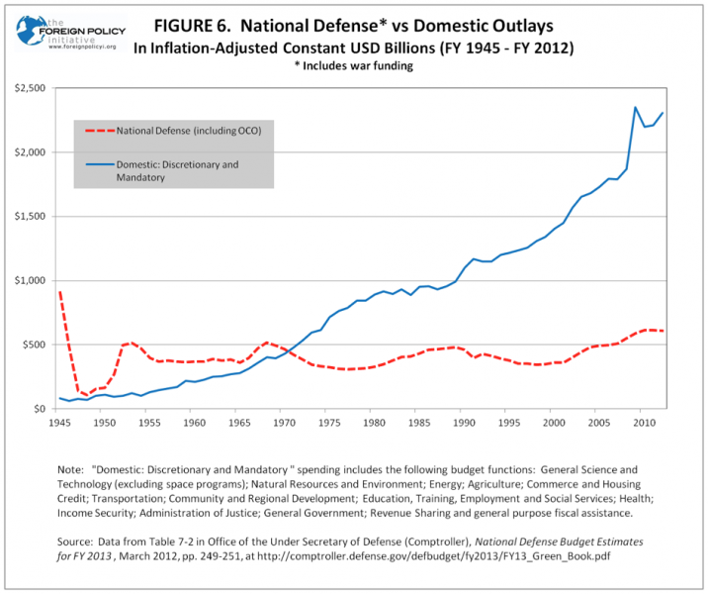
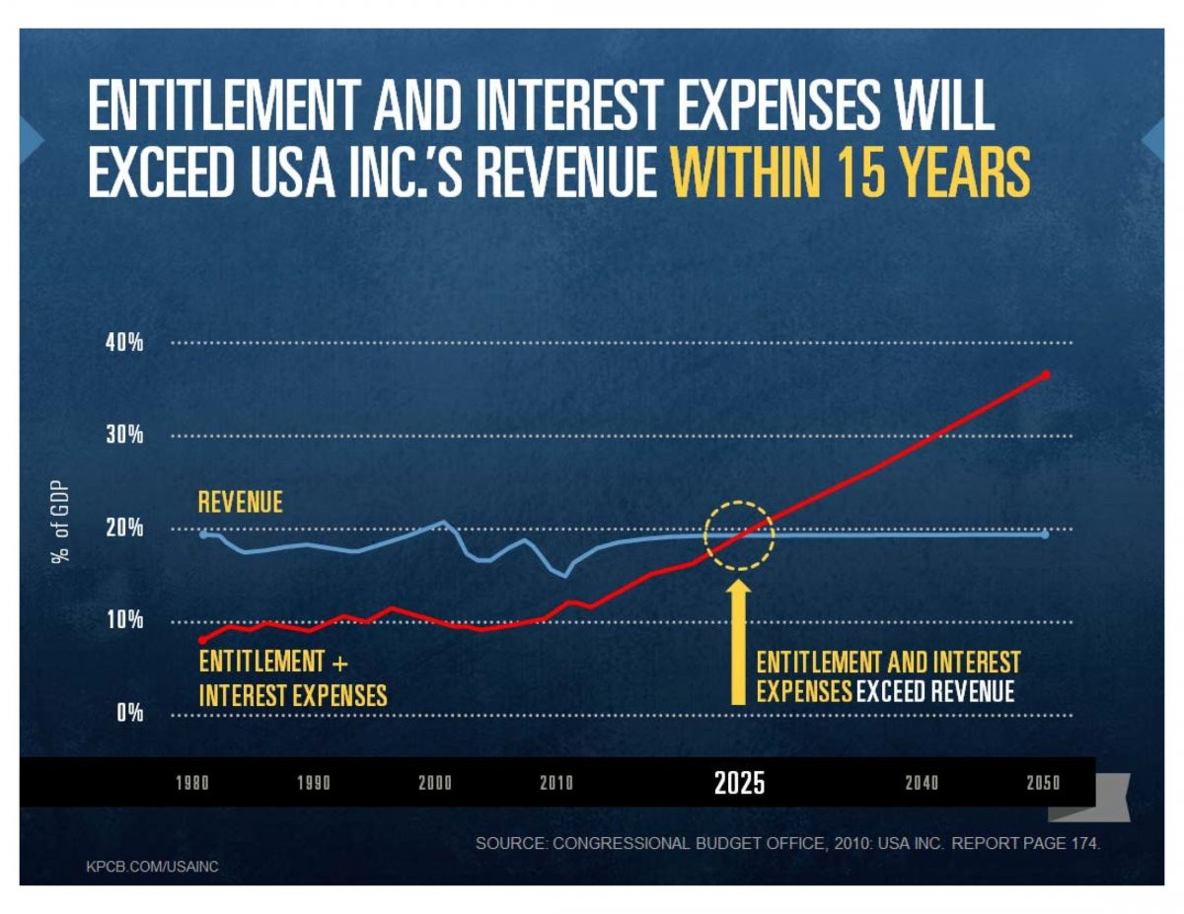
Appendix: Defense Expenditures
Defense spending not the US’s prime budget problem
  Medicare, Medicaid, Social Security drive the deficit going forward
  Not a commentary on absolute defense spending
Sources: Foreign Policy Initiative, Mary Meeker “USA Inc”

