Slide 1
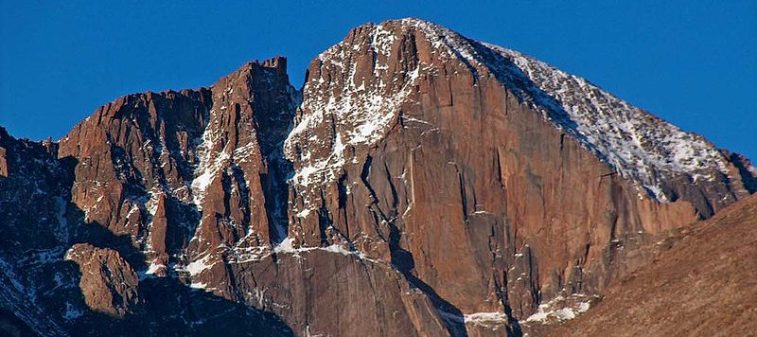
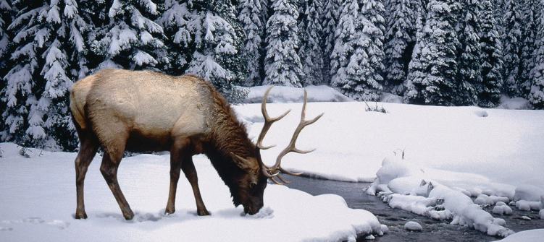
Crescat Capital
VALUEx Presentation
June 19, 2013

Slide 2
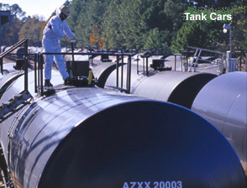
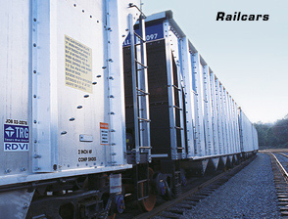
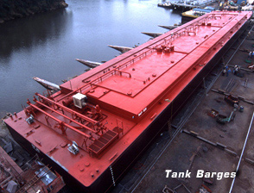
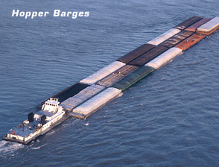
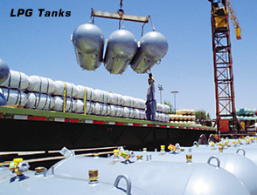
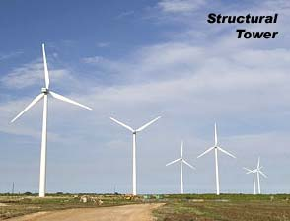
TRN: $38.43 (6/17/13)
Right Place/Right Time

Slide 3
Investment Process – Dynamic and Reflexive
Global Macro Investment Themes
Data-Driven Fundamental Analysis
Proactive Investment Execution

Slide 4
Current Macro Themes
New Oil and Gas Resources
Digital Evolution
Nanoscale
U.S. Housing Recovery
Global Fiat Currency Debasement
China Infrastructure Bubble
Aussie Housing Bubble
Resolution of the Global Debt-to-GDP Bubble

Slide 5
Process for Vetting Macro Themes
Material, quantifiable importance relative to global economy
Robust set of investment opportunities within theme to exploit
Investment opportunities that present the possibility of 100+% return potential in less than 3 years
Compelling, clearly articulated thesis
Substantial support for thesis based on multiple data points
Robust evaluation of conflicting data and hypotheses
Clear rationale for why investment opportunities should be performing now
Identifiable triggers for determining exit

Slide 6
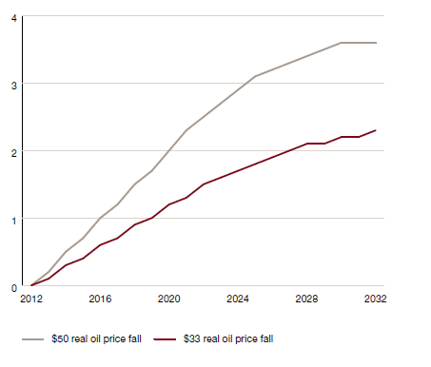
New Oil and Gas Resources Theme:
Material, Quantifiable Impact on Real Global GDP
Source: PricewaterhouseCoopers

Slide 7
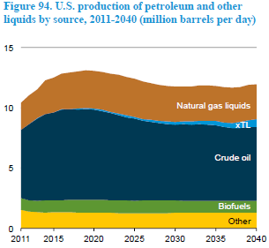
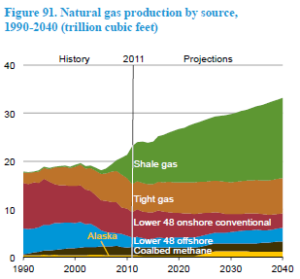
New Oil and Gas Resources Theme is Happening in U.S. Now
U.S. Crude Oil Production Forecast
U.S. Natural Gas Production Forecast
Source: EIA

Slide 8
Data-Driven Equity Fundamental Scoring Model
Value
P/E 4-Qtr Trailing
P/E 4-Qtr Forward
Growth
EPS Gr. Recent
EPS Gr. LT Actual
Sales & EPS Dynamics
Analyst EPS Est. Revisions
Analyst Sales Est. Revisions
Dividend Dynamics
Industry Leader
Quality
Price to Book
Price to Cash Flow
Sales Gr. Recent
Near vs. Recent
EPS Gr. Near Est.
LQG-5-Year Avg.
Sales Surprise
EPS Surprise
Dividend
Yield
Dividend
Increase/
Decrease
Earnings
Coverage
Analyst EPS Estimate Revisions
Operating Profit Margin
Operating Profit Margin
Return on Equity
Return on Equity

Slide 9
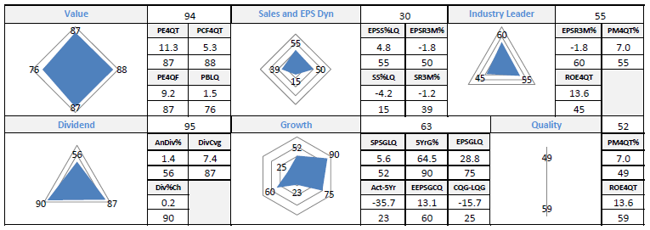
Fundamental Model Dashboard – TRN Snapshot

Slide 10
Trinity Industries – Levered to the U.S. Shale Oil and Gas Production Boom
1. Railcar Manufacturing and Leasing: 60% of Revenues
2. Inland Barges: 15% of Revenues
3. Energy Storage Tanks 13% of Revenues

Slide 11
Railcars in High Demand for New Domestic Oil and Gas Production
Crude oil and NGLs are shipped in tank cars that are owned or leased by the shipper. A single tank car can carry approximately 680-720 barrels of crude oil.
Frac sand and most drilling materials are shipped in covered hopper or open-top railcars that may be owned or leased by the shipper. A single hopper car can carry approximately 196,000 to 220,000 pounds of frac sand.
Casing, tubing, drill pipe, is often shipped in gondolas or bulkhead flatcars. A single gondola or bulkhead flatcar can carry approximately 163,000 to 205,000 pounds of OCTG
Source: BNSF

Slide 12
Some Positives
Capital intensive business presents barriers to entry
Traditionally low-ROIC industry keeps others away
Significant operating leverage for this cycle
Low energy and iron ore prices also benefits them on input side during this unique cycle
Management seizing opportunity to meet raging new demand
Good use of low interest debt in capital structure at right time presents levered upside to equity holders

Slide 13
Fundamentals and Valuation
Date | 6/17/2013
Price | 38.43
Mkt Cap | $3,026 M
Revenues T4Q | $3,902 M
CFO T4Q | $558.2 M
CAPEX | $410.50
Pr/CFO Trail 4Q | 5.3
Pr/Book | 1.5
P/E Trail 4Q | 11.3
P/E Fwd Street | 9.1
EPG Growth YoY | 28.8%
CFO Growth YoY | 43.3%
Div Yld | 1.4%
Payout Ratio | 13.50%
Dividend Growth Rate | 22%
Total Debt | $3,190 M
Cash | $360 M
Credit Rating | Baa3/BBB-

Slide 14
Near-Term High Earnings Growth Catalysts
Delivered 5,230 railcars in Q1 03
Took orders for 14,505 railcars in Q1 03
60% of total industry orders for freight railcars
80% in high margin tanker cars
Record Book to Bill = 2.77
Backlog now at record 41,265 railcars
Two years of visibility
Company earnings guidance and street estimates are too conservative

Slide 15
Valuation
TRN is trading at 9.7x and 8.7x Street estimates for FY13 and Y14 earnings. It’s normal cycle average multiple is 13.6x and Street. Cycle is stronger than ever before and Street estimates are too low.
2012 Actual EPS | $3.19
2013 Est. Street | $3.96
2014 Est. Street | $4.44
2013 Crescat Est. | $4.95
2014 Crescat Est. | $6.44
12-18 Month Target Price | $87
Appreciation Potential | 126%

Slide 16
Other Companies Crescat Owns Levered to New Oil and Gas Resources Theme
Railcar Manufacturing: American Railcar (ARII), WABTEC (WAB)
Cryogenic Industrial Gas Equipment: Chart Industries (GTLS)
Petrochemical: Axiall (AXLL)
Land Drilling Rigs: Helmeric & Payne (HP)
Engineering & Construction: Chicago Bridge and Iron (CBI), Jacobs Engineering (JEC)
Refining: Marathon Petroleum (MPC), Tesoro (TSO), Valero (VLO)
Automotive: Ford (F), General Motors (GM)
Oil and Gas Pipelines: Kinder Morgan (KMI), Transcanada (TRP), Spectra (SE), Williams (WMB)

Slide 17
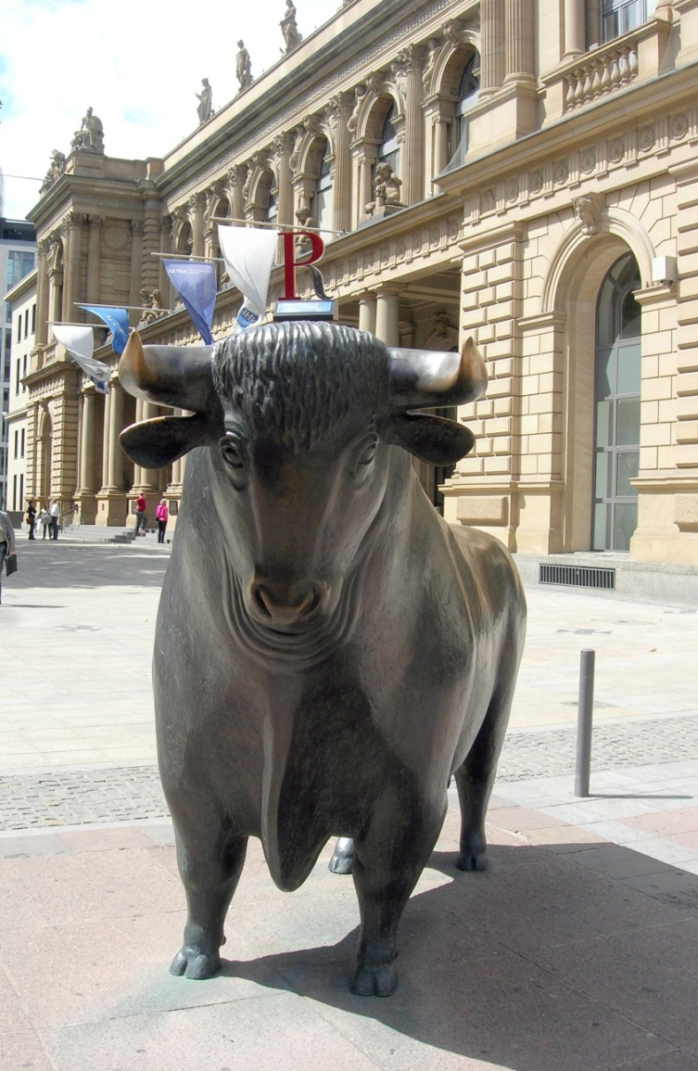
Disclosures
Crescat Capital LLC, through its wholly owned subsidiary Crescat Portfolio Management LLC, is an investment adviser registered with the U.S. Securities and Exchange Commission. Reported returns are purely historical, no indication of future performance, and may be adjusted subsequent to third party accounting verification and audit. The information contained herein does not constitute an offer to sell nor the solicitation of an offer to buy interests in any fund. Such an offering is made solely by means of a fund private placement memorandum as presented by a fund principal. The information contained herein is not being distributed publicly, is confidential, and is not to be redistributed to any other persons without the prior permission of Crescat Capital. Only qualified investors will be admitted as limited partners to a Crescat fund.

Slide 18
Contact Info
Crescat Capital LLC
1560 Broadway, Suite 2270
Denver, CO 80202
Office: 303-271-9997
Fax: 303-271-9998
Kevin C. Smith, CFA
CEO/CIO
ksmith@crescat.net
Notes:
18

