Slide 1
Investment Idea: Acacia Research Corp (ACTG)
Luis Ahumada
Thrive Capital

Slide 2
Intellectual Property: center of innovation and value creation in world economy
Patents are temporary monopolies protected by US constitution and issued by the United States Patent and Trademark Office (USPTO).
Licensing in US has grown to a $500 billion industry in last 30 years
Criteria for patent: has to be useful, novel and non-obvious (broad and somewhat vague – more on this later)
Controversy: the patent system has been abused by “patent-trolls” who use aggressive tactics to assert frivolous claims (more on this later)
Notes:
A patent is issued by United States Patent and Trademark Office, typically for a term of 20 years from when the application was first filed. Successful applications usually take 18 months to process from submission date.
Patent law is enshrined in the Constitution of the United States in Article 1, Section 8. First patent law was enacted in 1790; law underwent a general revision in 1952 and again more recently in the American Inventors Protection Act in 1999.

Slide 3
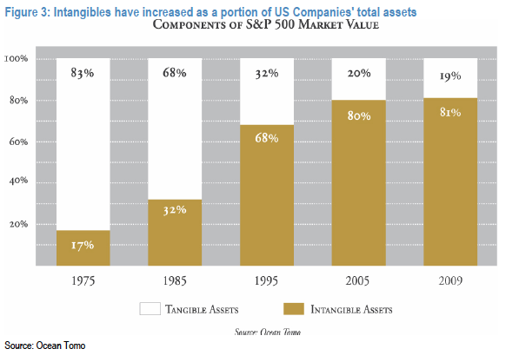

Slide 4
IP is a strategic asset, licensing is a business
Companies are becoming more adept at exploiting their intellectual property
IP historically has been used as an entry barrier; firms that acquired and owned patents passively – often licensing only to protect against anti-trust
Today IP has become a growth driver and profit center
Patent dealers and NPEs are pure-play IP plays
Non-practicing entities secure patent portfolios and license them out through agreements to operating companies
They can sue to protect from infringement without fear of being countersued
Notes:
Licensing by companies such as IBM and AT&T was generally done in generous terms with a view to avoiding antitrust rulings
US corporations became more actively assertive in protecting and monetizing their IP in the 1980s with companies like Texas Instruments, Intel and others using licensing as a business model
Since then patent applications have increased, patent enforcement actions have shot up, and IP has become a profitable business for industry giants like IBM, Intel, Texas Instruments, Philips and others.
Licensing pure-plays, such as Qualcomm (wireless) and Dolby (digital media) have emerged that command above average gross and operating margins

Slide 5
Notes:
This slide shows how the IP ecosystem is used and monetized. Freemium vs up-front licensing business models

Slide 6
IP market remains inefficient and adversarial
No liquid exchange or transparent markets
No price discovery mechanism / no information sharing or pooling of risk
Differences in perceived value of patents and lack of signals often causes some participants to ignore market and gravitate towards litigation
Enter Non-Practicing Entities (NPE’s)

Slide 7
“The patent market has been extremely inefficient, and over time with any new asset class there will be a variety of business formats that rationalize the process that make the markets more efficient. Historically, the only way you can get paid for a patent, and pretty much 99% the way it is today, is you have to resort to the legal system in order to transact. You'd literally have to sue another company or they generally will not talk to you. And if you talk them inappropriately, they can countersue you. They can file a declaratory judgment against you for just offering a license. So the structure of the market place really requires a lot of enforcement. Fortunately, we're far enough down the road, we've done so many deals that we have legal arrangements with a lot of leading companies where both sides preserve their legal right and can enter into arms length of discussions without litigation. And we think we'll be moving more and more in that direction, which is great for our shareholders and great for our IP partners because it lessens the friction cost of all the lawyering, improves our margins.” - Paul Ryan, CEO of Acacia

Slide 8
Acacia: a market maker and asset management company?
Patent aggregators, like Acacia, create liquidity, transparency and pricing signals to all participants
ACTG is a Non-Practicing-Entity - which basically means it buys, sells, and licenses patents, but doesn’t actually use its patents directly by manufacturing products / services
Acacia’s goal is to add value through the management of a portfolio of assets through fundamental research, due-diligence, and deal-making in an effort to deliver good risk-adjusted returns in an inefficient market that is complex, illiquid, misunderstood, and ever-changing
Acacia gets paid by monetizing IP for its clients and its owned portfolios. It coordinates campaigns and licensing programs and uses litigation as a backdrop to future agreements; however, as market matures and becomes more fluid there is less friction and less litigation

Slide 9
Business: A leader in patent licensing
Has 274 IP portfolios that have led to thousands and controls tens of thousands of patents
Only 154 of their portfolios are licensed (most just partially with plenty of runway), creating a strong pipeline for revenue growth
Selectively increasing AUM through structured partnership deals and focusing on +NPV portfolios drive excellent returns on capital
Acacia is one of the most active active dealers in secondary markets
Investments / partnerships in mobile, location-based-services, computer power management, flash memory, telematics, data storage has yielded great returns on capital
Recent diversification into medical technology, automobile technologies and energy has huge potential
Notes:
Sources of competitive advantage also include deep domain expertise, economies of scale and scope, and brand recognition from partners – both operating companies as well as inventors.

Slide 10
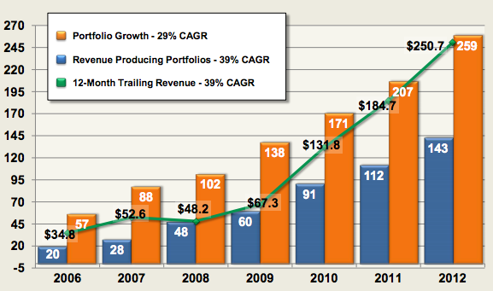
Strong track record

Slide 11
Investment philosophy: Value
They think like asset managers with an ROI mindset
Not looking for home-runs; mainly singles and doubles
Better information, brokers and market makers are emerging creating efficiencies in market.
Acacia seeks portfolios that will provide predictable licensing revenues over uncertain litigation – which can be costly, time-consuming and incredibly unpredictable
Look to deploy capital, ink-deals and approach settlements taking into account timing of monetization / cashflows and magnitude (build DCF’s for portfolios)
IRR and NPV focused
Eat risk-adjusted returns

Slide 12
Customer value proposition: monetization with low-risk and protection
ACTG provides a turn-key solution and acts like a proxy for patent authors and large companies to execute licensing agreements through subsidiaries without fear of IP counter-suits
It enables the monetization of non-core assets while avoiding the marketing / legal complexity of enforcement and marketing
Use of comprehensive licensing agreements are becoming increasingly attractive for big firms. This represents a multibillion dollar opportunity for Acacia.

Slide 13
Management
Acacia employs 55 people in Newport, California.
This is a human capital business as there is only a select few in the market that know how to effectively manage IP
Organization is managed through an intersection of legal/IP and licensing experts (who underwrite the business development efforts), engineering & tech experts, and vertical specialists with extensive backgrounds in those fields
CEO Paul Ryan is architect of IP strategy and operations. He has a Ph.D. and a legal/banking/VC background with top firms. Cornell B.S. and NYU MBA.
Team includes dozens of VPs of Engineering and science/technology experts that typically have 15 – 20 years experience coming form firms like Intel, Nortel, Texas Instruments, Marvell, Sony, Schlumberger and dozens more…
All have good salaries, but are highly incentivized to close deals and sign license agreements through bonus structures. (management owns ~3% of company)

Slide 14
Investment thesis: a great asset class and attractive business model
Acacia is a key player in a fast growing market: first player in IP monetization sector
Scope of portfolio, track-record and size makes Acacia the go-to company for operating companies looking to ink agreements that provide upside and protection
Network effects in licensing / sourcing deals. IP portfolio AUM has more than doubled in two years
Avoid litigation: over 1200+ licensing deals and settlements / only 4 trials in 10 years.

Slide 15
Business model and profile
Business model operates as follows:
Company acquires patents from partners and places them in operating subsidiaries;
They prepare the portfolio for licensing (e.g. review contracts, define portfolios, match patents with portfolios) which can take ~18 months;
Launch of portfolio-specific revenue generating program;
This results in licensing agreements / settlements for the portfolio, using litigation only when necessary (company has gone to trial 4 times in its history)

Slide 16
Business model and profile
Most licensing deals are one-off agreements that capture the economics for patents previously used and in current use
Avoid royalties due to higher costs to enforce and oversee and belief that licensees will generate work-arounds. Avoid long-tails
ACTG’s business model yields >50% PF gross margins and >40% PF operating margins (more recent 30% Op margins)
Margins will further expand through:
Operating leverage / scale
Mix shift towards hybrid & wholly owned portfolios
Lower enforcement costs as model veers away from litigation

Slide 17
Flexibility in deal-making
Acacia generally follows three models:
Partner Model – 50/50 revenue share with patent owners, license to corporate users. Typical partners include corporations, research labs / universities, individuals
Purchase Model – 100% ownership. Typically bought from distressed situations and failed startups backed by VCs
Hybrid Model – Up front cash to partners and revenue share
*Legal fees paid on contingent basis

Slide 18
Flexibility in deal-making
Partnership Model
Purchase Model

Slide 19
Hybrid model
Consists of Acacia putting up capital to the original IP owner and recouping investment from first dollars out of licensing revenues
Higher back-end participation
This model is expected to be norm going forward for high-quality patents
Remains fairly capital light

Slide 20
Dozens of verticals…
Advertising
Internet / Ecommerce
Communications
Computers/Peripherals
Consumer Electronics
Database
Digital Media
Energy /Lighting
Mechanical
Medical
Security
Semiconductor
Software
Wireless

Slide 21
Return on portfolios has improved with time; pipeline strong
Many multiples of capital invested with a blended 40% yoy ROIC economic profile. Portfolios with plenty of runway for higher licensing turnover:
Access/Palm (smartphone/wireless)
Rambus (displays)
Adaptix (wireless 4G / LTE)
Nokia-Siemens (wireless infrastructure)
Boston Scientific (medical: cardiac)
Bonutti (medical: orthopedics)
Renesas (semiconductors)
Breed (automotive)
IP intake to replace maturing portfolios is also strong with dozens of portfolios added every year

Slide 22
Licensees
Pretty much every Fortune 100 company:
AMD
Boston Scientific
Dell
Exxon
General Electric
Hewlett Packard
Hitachi
IBM
Intel
LG Electronics
Microsoft
Nokia
Samsung
Sanyo
Siemens
And on and on…..

Slide 23
“Purchase” Case study: Adaptix
Note: Capital intensity of deals varies according to type of deal structure (Partner / Purchase / Hybrid) but returns can be equally attractive for each
Up front payment of ~$150 MM in 1Q of 2012 for a portfolio of 4G LTE standards patents (130+ patents)
Immediately licensed out to Microsoft and Samsung for $65 million. Since deal closed, with three license deals, 2/3 of investment has been recouped (no litigation)
Mgmt. expects full payback in 2013 and expects dozens of more licensing deals for next 10 years

Slide 24
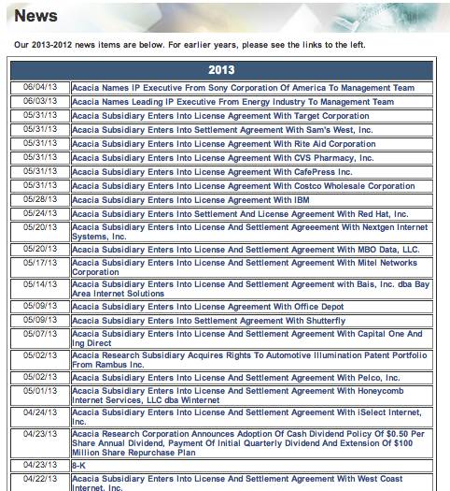
They are busy…
One month’s news, 19 licensing and settlement agreements (higher than historical rate in prior Q’s):
Target
Sam’s West
Rite Aid Corp
CVS Pharmacy
CaféPress
Costco
IBM
Redhat
Office Depot….and more

Slide 25
Stock provides Value…
Stock Price: $24.50
Market Cap ~$1200 MM
$327 MM in cash ($6.67 per share); no debt
EV of ~$875 MM
6.50x on 2013 EBITDA
4.60x on 2014 EBITDA
Cash EPS >> GAAP EPS
2013 cash EPS of $2.25 (excludes amortization & non-cash comp)
Run-rate is $2.25+ next 3 years and $3.00 to $4.00 in next 5 yrs.

Slide 26
…and Growth
ACTG has generated $936 million of high margin revenue since inception
TTM revenue of $250 MM (CAGR of 39% over last six years) is still in early stages of monetization of its major portfolios that remain largely unlicensed
Despite no official guidance, due to difficulty in timing of closing of deals and settlements, management expects its yearly growth to continue at its two-year ~35% run-rate

Slide 27
Valuation
An investment in Acacia is an investment in the firm’s intellectual capital and intangible assets
The IP intangible assets ACTG uses to generate cashflow can have wide ranges of potential value (from conservative to aggressive)
Trying to value each portfolio is very difficult; however, understanding its key portfolios is helpful while also looking at trends such as monetization rates, revenue per portfolio, and deal size / structure
Each portfolio, on average, should have somewhat predictable return characteristics
Notes:
In a market that likes intangible assets and there exists visibility to comparable transactions, IP valuations hold up and can expand. In an environment where the market pulls back from intangibles and favors tangible assets, IP stocks (Acacia in particular) get overly beat up.

Slide 28
Valuation
Method: Monetized IP + Un-monetized IP + New IP
Slightly >50% of portfolios are generating revenues, but only ~40% of ultimate value has been extracted (it takes 5 – 7 years to fully license a typical portfolio)
Historical monetization rates / timing to gross up can give a ballpark idea of the NPV of a new portfolio
Finally, a big driver we also assign value to, is unsecured new IP that will be acquired through purchase / partner / hybrid models and generate attractive returns on capital
Notes:
In a market that likes intangible assets and there exists visibility to comparable transactions, IP valuations hold up and can expand. In an environment where the market pulls back from intangibles and favors tangible assets, IP stocks (Acacia in particular) get overly beat up.

Slide 29
Assumptions
Current portfolios: ~$936 MM of total revenues ITD;
implied revenue per portfolio ~$5 MM;
~40% of value extracted we gross up portfolio value to $13 MM per portfolio
Results in a gross portfolio value of approximately $2,000 MM
Unmonetized portfolios:
106 of which higher proportion is fully owned; assign a $22 MM NPV (higher gross margins) per portfolio – which leads to a gross portfolio value of approximately $2,300 MM
Future IP portfolios:
Using historical data assume 100 portfolios with superior economics considering size, scope and hybrid model being used of $30 – which leads to a gross portfolio value of $3,000 MM
Notes:
In a market that likes intangible assets and there exists visibility to comparable transactions, IP valuations hold up and can expand. In an environment where the market pulls back from intangibles and favors tangible assets, IP stocks (Acacia in particular) get overly beat up.

Slide 30
SOTP Assumptions
 | Current | Un-monetized | New IP
Gross Port Value | $2000 | $2300 | $3000
65% GM | $1300 | $1495 | $1950
% un-harvested | 60% | 100% | 100%
Gross Profit NPV | $780 | $1495 | $1950
Total Gross Profit | $4225
Cum 5 yr. OpEx | $550
Capital Investment | $400
Cum Profit (35% tax rate) | $2128
Enterprise Value per share | $43
Cash on balance sheet | $327
Equity Value per share | $50
Notes:
In a market that likes intangible assets and there exists visibility to comparable transactions, IP valuations hold up and can expand. In an environment where the market pulls back from intangibles and favors tangible assets, IP stocks (Acacia in particular) get overly beat up.

Slide 31
Why is the stock cheap?
Misunderstood; stability of business model is underrated
Revenues are lumpy quarter to quarter making it nearly impossible for analysts to model out (but consistent over yearly time-frames)
No guidance (strategic disadvantage and conflict in negotiating process with licensees)
Headline noise creates fear: stock gets killed each time there is a headline that patent system might get reformed (truth is every single political / legislative initiative has actually strengthened ACTG’s business)

Slide 32
So…what’s not to like?
“They don’t actually produce anything themselves. They’re just trying to essentially leverage and hijack someone else’s innovation to see if they can extort some money out of them.”
- President Barack Obama on so-called “patent trolls”

Slide 33
What is a true patent troll, why are they so hated?
True patent trolls are a subset of NPE’s that use malicious tactics to getting paid. Some of these tactics include:
Marketing low quality “garbage” patents: enforcing broad and poorly designed, arguably worthless, patents on small and mom and pop businesses
Shaking down vulnerable downstream businesses: threats of expensive litigation force profitable businesses to settle and avoid nuisance
Jurisdictional nirvana: setting up fake offices in patent friendly jurisdictions and targeting unsuspecting businesses (again arguing ridiculously broad claims)
Privateering: use of obscure holding companies with fake offices to hide the true ownership of patents

Slide 34
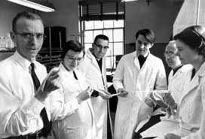
Market is afraid of trolls
Perception: Troll’s ruthless tactics and focus on end-users, rather than manufactures, overwhelms legal system and hurts innocent entrepreneurial bystanders. This hurts innovation and the economy.
Reality: Patents are a property right that fuels the drive of inventors, universities and R&D groups. Weakening these rights by discriminating against those that legally own them (paid for them) flouts on the principle of equality under the law. The protection patents provide drive research and innovation.

Slide 35
Reality: Patents, while imperfect, are a critical part of today’s economy
Over last 100 years the US economy has transitioned from a manufacturing economy, to a service economy, and now to a knowledge economy
Startups, individual inventors, and small and large companies conducting R&D are significant drivers of economic growth
Go to market / direct enforcement for IP isn’t always possible or practical for small firms; using licensing firms, like Acacia, to capitalize on what is theirs actually promotes innovation and growth…

Slide 36
Reality: Risks of going to court are high for everyone involved
The risks of going to trial, particularly in plaintiff-friendly courts, can be huge – which often makes disputes often get resolved through settlements and licensing agreements
But infringement is infringement is infringement…
Use of litigation as a first step is still often necessary, but 99% of these reach an agreement due to compelling evidence of breach
Notes:
If a patent dispute goes to trial, the outcome can be very unpredictable for the patent owner, the NPE, and the operating company (but generally favorable for the lawyers involved). Very few patents can be successfully enforced (under 5% according to our sources) and the cost of maintaining a patent registration and going to court can be very high for a small NPE or an individual. On the other hand, if a jury rules in favor of a patent owner, or an operating company sees need to settle for fear of injunction or unfavorable damage awards, the cost to the operating company can be enormous.

Slide 37
Alphabet soup of legislative and lobbying initiatives
Like most complex issues, the truth lies somewhere in the middle, yet politicians and interested parties go to the extreme
The two sides can be broken down into the Googles of the world, who want intellectual property to be royalty and license free to “encourage innovation”. AKA the anti-IP group.
On the other side, there are the legal advocates of property rights and R&D heavy organizations/entities like universities, the GE’s of the world, and “true” technology / medical industries that need protection from the innovations they create through the patent system
Net net, the anti-IP agenda is outgunned

Slide 38
Executive branch rhetoric won’t lead to significant legislation
Shield Act is redundant and won’t pass
Patent Act is strong and already provides protection against frivolous lawsuits – which, in turn, promotes focus on high-quality patents
Existing law, if properly enforced, already gives courts mechanism and leeway to dismiss cases
America Invents Act – allows post-grant proceedings but they are limited to invalidity issues only (another deterrent to weak claims)
Rule 11: legal system needs reform, not patent industry

Slide 39
“Innovation violates tradition – attacks it in public and steals from it in private.”
Mason Cooley

Slide 40
Summary
Contrarian idea with good risk/reward: investment isn’t for everyone…headlines will create volatility. Risk of persecution from government can’t be dismissed
Capital light; high ROIC business w plenty of runway to reinvest in profitable growth (optionality upside)
Cheap with very strong growth potential
Strong balance sheet with >25% of mkt cap in cash
Operating leverage in an asset class and market that is growing
No direct competition; structural advantages over fragmented one / two man shops
Eat their own cooking: management wins when shareholders win

Slide 41
Q&A
Contact: luis.f.ahumada@thrive-capital.com
Twitter: @thrivecap
Personal blog: www.roicblog.com

