Slide 1
Short Selling In an Era of Socialized Credit Losses VALUEx Vail Conference June 17, 2011 Dan Amoss Editor, Strategic Short Report http://strategicshortreport.agorafinancial.com/

Slide 2
Approach: top-down (macro) analysis identify most attractive sectors for short ideas
Narrow focus to worst based on…
Fundamentals, including competitive position
“Qualitative” research
How does this company make money, and is it sustainable?
The story behind the numbers is crucial
Tools:
“Austrian School” view on the economy vs. consensus view (Keynesian/Monetarist hybrid)
Review 10 years of financials and management’s strategy for investing capital

Slide 3
Core Macro Assumptions, Not Predicting GDP, is How I Approach Top-Down Research
Policymakers are damaging the economy with “kick the can down the road” Keynesian policies. Overconfidence stems from belief that they saved the economy in ‘08. Reality: will spread the credit losses created by the bubble to holders of U.S. dollars/Treasuries over the next decade (result: future supply of money and Treasuries will greatly surprise to the upside)
Keynesian policies act to consume the capital that was created and grown by entrepreneurs.
U.S. had built up enormous capital during 19th & 20th Centuries, but in recent decades, we’ve been borrowing against it, and sold off claims to foreign creditors
Compare the economy to a company’s fundamentals; U.S. economy is in many ways functioning like an “LBO”
Tax code & monetary policy rewards debt accumulation and consumption, punishes savings and capital investment. Result: “Stagflation”

Slide 4
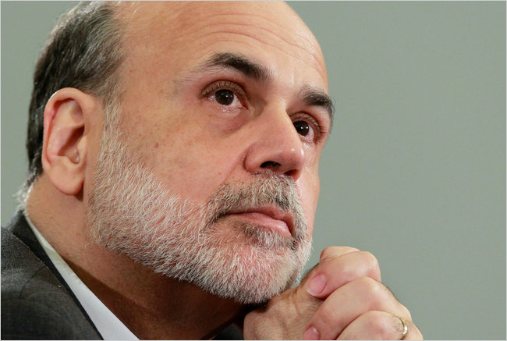
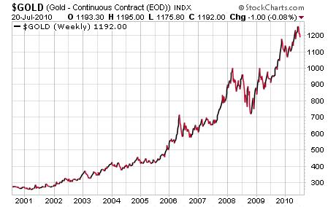
Slide from My 7/22/10 Presentation at Agora Conference: Gold Anticipates Fed Monetization
Fed can slow the pace of deleveraging. As long as the banking system is viewed as solvent, this game can continue (2008 liquidation panic: no faith in solvency)
QE1 swapped new dollars for Agencies & Treasuries, freeing up banks and PIMCOs of the world to reinvest cash received into more bonds
Created phony “savings.” Unless Fed shrinks balance sheet to pre-QE levels, this is deficit monetization
Support for QE2 will go up if: ISM rolls over, initial jobless claims surge, S&P below 900, Case-Shiller Index falls

Slide 5
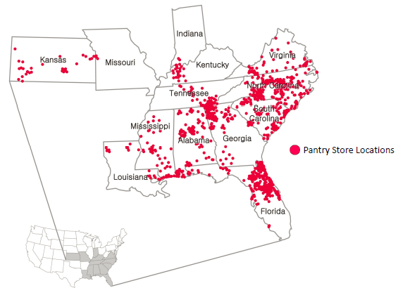
Short Idea: The Pantry (PTRY: Nasdaq)
Chain of ~1,600 convenience stores in Southeast U.S. under the Kangaroo banner
Management pursuing a rollup strategy; 145,000 C-stores in U.S., and 79% are single-store operators or “small” chains
Not a FCF machine
Not asset-rich: own 394 stores, lease 1,244 stores
High on- and off-balance sheet leverage; Z-Score = 1.3, not far from distress
22% of $1.9 billion balance sheet = goodwill

Slide 6
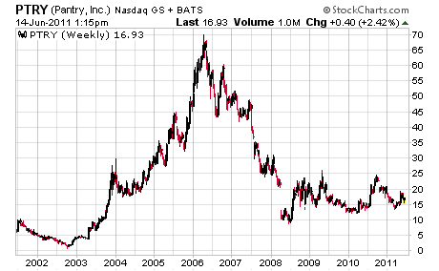
Short Idea: The Pantry (PTRY: Nasdaq)
Convenient stores indirectly buy refined, globally traded goods like gasoline and food, and sell them to struggling U.S. consumers. Rising wholesale prices for gasoline, food, and tobacco are hurting convenience store margins. Rising prices are also squeezing the income of the core convenience store customer.
Pantry: “short” wholesale gasoline and “long” retail demand for that gasoline; also “short” wholesale packaged food/tobacco, and “long” consumer demand for that merchandise
Merchandise gross margins: 33%-37%
Gasoline gross margins: 4%-6%
Pantry’s EBITDA depends heavily on volume and pricing of tobacco products: FY2010 Gross Profit: 70%/30% merchandise/gasoline split

Slide 7
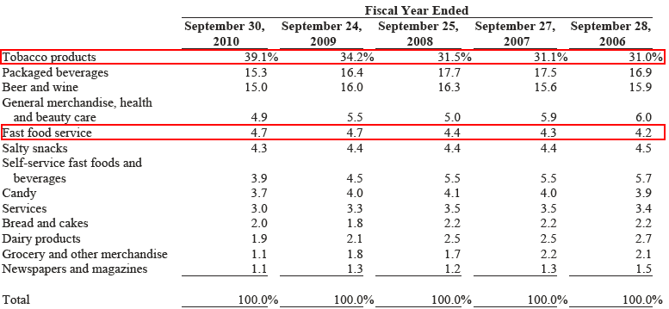
Short Idea: The Pantry (PTRY: Nasdaq)
Tobacco products account for ~40% of crucial merchandise segment, and reliance on tobacco sales has grown...

Slide 8
Short Idea: The Pantry (PTRY: Nasdaq)
Future margin threat: powerful wholesale food distributor McLane, a Berkshire Hathaway company; Pantry purchases ~60% of its general merchandise, including most tobacco and grocery items, from McLane.
Pantry purchases products at McLane’s cost plus an agreed upon percentage, reduced by any promotional allowances and volume rebates. McLane, facing its own margin pressure from its packaged food/tobacco suppliers, could easily cut promotional allowances and rebates to Pantry.

Slide 9
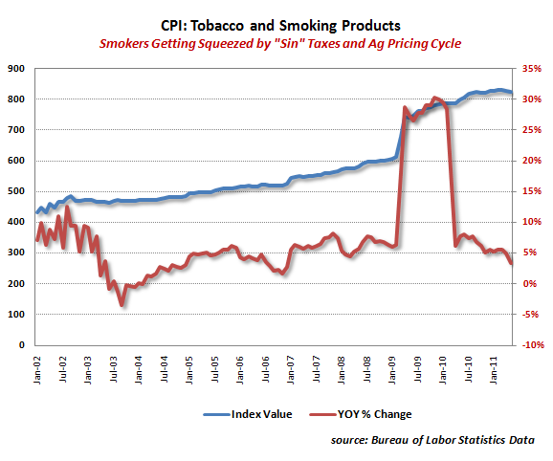
Short Idea: The Pantry (PTRY: Nasdaq)
Selling tobacco products is not an attractive business: shrinking pool of customers
Tobacco customers that remain are getting squeezed on all fronts!
Chronic unemployment among less-educated
Rising gas/food prices
Austerity: Less of a social safety net

Slide 10
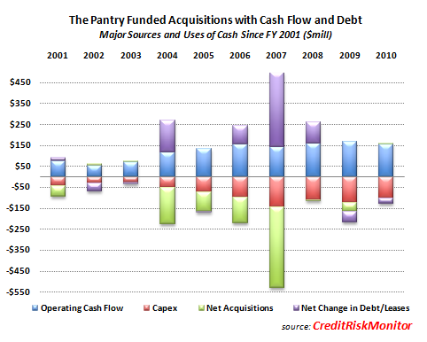
Short Idea: The Pantry (PTRY: Nasdaq)
History: Pantry was a rollup. Private equity group bought Pantry out of bankruptcy in 1996, and used it as a vehicle to consolidate the fragmented convenience store industry.
Reinvested all of past decade’s cash flow – plus debt financing – into acquisitions and capex.
Over the past decade, Pantry converted an average of just 1% of sales into free cash flow.
Recent capex focused on “Fresh” program, including better-quality coffee (an increasingly crowded market with surging coffee bean costs). Yet…fast food service is only ~5% of merchandise sales

Slide 11
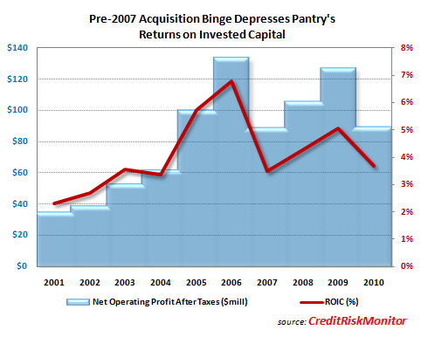
Short Idea: The Pantry (PTRY: Nasdaq)
Even as barriers to entry for convenience stores are low, competition for market share of consumer wallet is as high as ever among the over-stored U.S. economy…

Slide 12
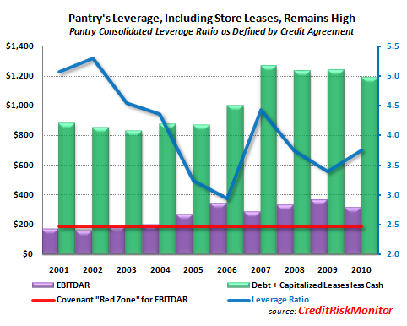
Short Idea: The Pantry (PTRY: Nasdaq)
Market cap: $405 million, EV: $1.5 billion
EV after capitalizing operating leases = $2.1 billion (rental expense * 8, as per credit agreement)
TTM EBITDAR = $305 million
EV/EBITDAR = 7x
EBITDAR flat since 2006, despite acquisitions & capex; at risk from future margin squeeze
Target valuation: $250-$300mm EBITDAR in stagflationary 2011-12 economy, 4.5-5.5x multiple = $5-$7 per share; 60%-70% downside
Conclusion: PTRY is not cheap, considering risks to future to future cash flows. Risks to short: crashing gasoline prices and agricultural prices, and/or rebounding payrolls/housing starts

Slide 13
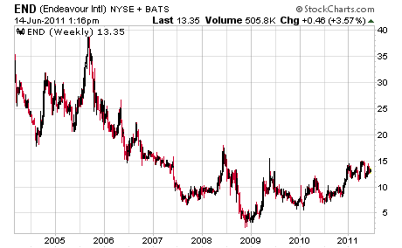
Long Idea: Endeavour Int’l (END: NYSE)
Underfollowed E&P company managed by executives with great track records; focused on shareholder returns, not growth for sake of growth
Management/board ownership: 9% of shares outstanding
Market cap: $500 million; EV = $680 million
2P Reserves: 44 million BOE

Slide 14
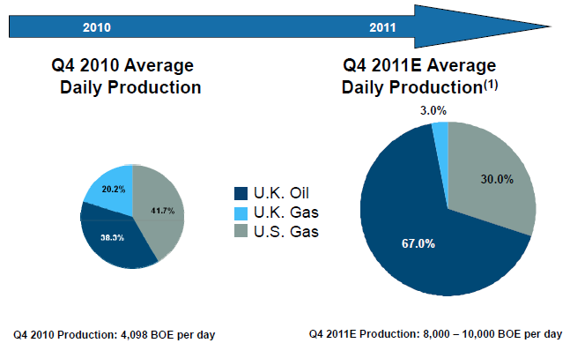
Long Idea: Endeavour Int’l (END: NYSE)
Contrast with The Pantry: Endeavour’s debt- and share-financed capex has been used to invest in assets that have arguably seen underinvestment on a global basis DESPITE high prices: oil & gas projects

Slide 15
Long Idea: Endeavour Int’l (END: NYSE)
Key portfolio assets:
U.K. North Sea oil and natural gas projects (key: U.K. gas prices are linked to Brent oil)
U.S. onshore: acreage/production in Haynesville & Marcellus shale gas plays
Interesting free/cheap options in frontier shale plays Alabama (gas) Heath (oil in Montana)
Management has monetized assets, recycled capital into more promising projects, and successfully de-levered Endeavour’s balance sheet
Recent secondary offering of 11.5 million END shares at $11 per share. part of the proceeds retired $81 million in convertible debt due in 2012.
Currently shopping for $250 mm in 5-year senior notes
Example of capital recycling: Endeavour had invested just $60 million into OER project on Norwegian Continental Shelf; it $95 million in cumulative cash flow for Endeavour, then management sold it for $150 million. (total ROIC: 308%)

Slide 16
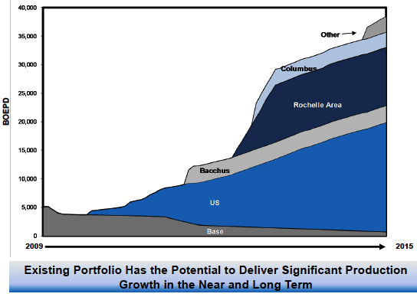
Long Idea: Endeavour Int’l (END: NYSE)
At current Brent crude prices, 2H2011 should be a great time to ramp up oil production
Bacchus: a North Sea oil project operated by Apache; production should ramp up to 4,000–5,000 barrels per day by yearend
Rochelle/Columbus: both high-potential North Sea gas projects

Slide 17
Long Idea: Endeavour Int’l (END: NYSE)
Reasons for discounted valuation:
Shows up as a disaster on screen of its trailing fundamentals
Cash Flows from operations + financing = capex spending for next year or so
Bear case: crashing Brent crude prices would depress expected surge of cash flow from (un-hedged) Bacchus oil production; lower oil prices would also push back project development
Bull case: valuation should converge toward peers as discretionary cash flow surges to $250-$300 million by 2013. Peers trade at 5-7x discretionary cash flow (source: Citi) – a multiple that would put END stock at ~$30 in 2013, up from $13 today.
Even further upside in the stock assuming persistent strength in Brent prices and a rebound in U.S. natural gas prices.
Thank You!

