Slide 1
One Man vs. the World: Workflow Management for Investors
June 2012 ValueX

Slide 2
The key question
This presentation is about performance. How does an investor get better, and keep getting better?
“Everything you learn in investing is cumulative.”
-- Buffett
How do you make investing more cumulative?

Slide 3
Competitive advantages
Each type of investor brings different kinds of advantages to bear on the market. How you structure your day at work should maximize your advantage
Big mutual funds: Three CEOs a day show up in the Fidelity conference rooms in Boston and NYC. Dozens of analysts are industry experts.
Big hedge funds: Teams of industry analysts, event-driven and structured trade opportunism, first call from the sell side in exchange for high volume, high cost specialty research, channel checks at important times.
One man shops: Liquidity without moving the markets. Small cap companies if that’s your thing. Limited LP transparency into portfolio gives you maximum opportunity to be original.

Slide 4
Competitive disadvantages
Each type of investor brings different kinds of advantages to bear on the market. How you structure your day at work should maximize your advantage
Big mutual funds: Institutional imperative, must be concerned with liquidity, no locked up capital.
Big hedge funds: Hot money LPs, spectacular flame-outs from time to time, short entity lifespan dissipates embedded knowledge & experience.
One man shops: As hard as you work, there will always be dozens of analysts, sell side and buy side, who know your companies better than you do.

Slide 5
Specialize where you can add value
The key to a successful investing practice is a repeatable, tested process to search for, analyze, and assemble a portfolio of investments.
Search Strategy
Due Diligence
Portfolio Management
One man shops can turn their weakness into strength by focusing on the search for the most asymmetrical ideas.
Giant fund houses, with legions of young sector analysts & mgmt access, will always have the most internal knowledge.
Big hedge funds, with their ability to use derivatives and adjust their gross/net exposure daily, have the advantage here.
ADVANTAGE
The next few slides will show how I use nothing but free tools to keep tabs on hundreds of companies in the search for the best opportunities.

Slide 6
A traditional search strategy
With 5100 listed companies in the US, how we search for investments plays a big part in our success. Yet few investors think about their search strategy with any rigor.
Traditional sources: Everyone looks at the 52 week low list, at stocks in the news, and at ideas from well-known sources like VIC, SumZero and 13F reports of the big names.
Specialization: Some investors are known for specializing around certain types of ideas, which is almost always a good idea.
Baupost has special sit analysts who look at every Ch. 11, spinoff, etc.
Cantillon limits itself to a select group of high ROE companies globally.
Tom Russo emphasizes beverages, confectioners, and tobacco.
Pershing Square often finds value in real estate on the balance sheet.
Donald Smith & Co. makes most purchases below 0.75X book value.
Horizon Kinetics invests alongside owner-operator CEOs.

Slide 7
Six ways to get better
Thinking across your whole portfolio, there are only a few ways to improve your performance as an investor.
Be right more often: Higher accuracy leads to higher returns.
Make more money when you’re right: Everyone loves multi-baggers, but is there a way to tune your search strategy specifically to find multi-baggers?
Make money faster: If you’re going to double your money, you’d prefer to do it in one year rather than five.
Lose less when you’re wrong: More capital preserved to recycle into your next idea, which hopefully will be huge.
Get out of your losers faster: The Monty Hall strategy – switch from the goat to the Cadillac as soon as you hear bleating.
Know when to double down: The flip side of the last point – improving accuracy when positions move against you and you’re making the buy-sell-hold decision adds huge value, precisely because it is so hard.

Slide 8
My stock tracker spreadsheet
One of my principal tools, I’ve spent years building this spreadsheet. It guides my work, forcing me to update my analysis while focusing on the most prospective opportunities.
*I use Google spreadsheets for this tool mainly because Excel for Mac is terrible. If you run Windows, use Excel.

Slide 9
My stock tracker spreadsheet
Let’s look at the components of the spreadsheet and how it guides my workflow.
Last updated. Conditional formatting based on date forces me to update frequently.
Next steps in research and/or monitoring
Specific performance indicators for this co. or industry
Basic name & ticker info
Target price and rationale. My estimate of IV and some quick & dirty notes of explanation.
Return multiple: How much the stock has to go up to hit IV. Conditional formatting highlights potential multi-baggers.
Rankings of balance sheet, management quality, valuation confidence, revenue growth, buyback skill, etc.

Slide 10
Stock tracker continued…
Let’s look at the components of the spreadsheet and how it guides my workflow.
Tick counter: how many times I’ve taken a close look at the company. The higher, the better I know this company.
Where did this idea come from?
52 week low
Date logged: the older, the better I know this company.

Slide 11
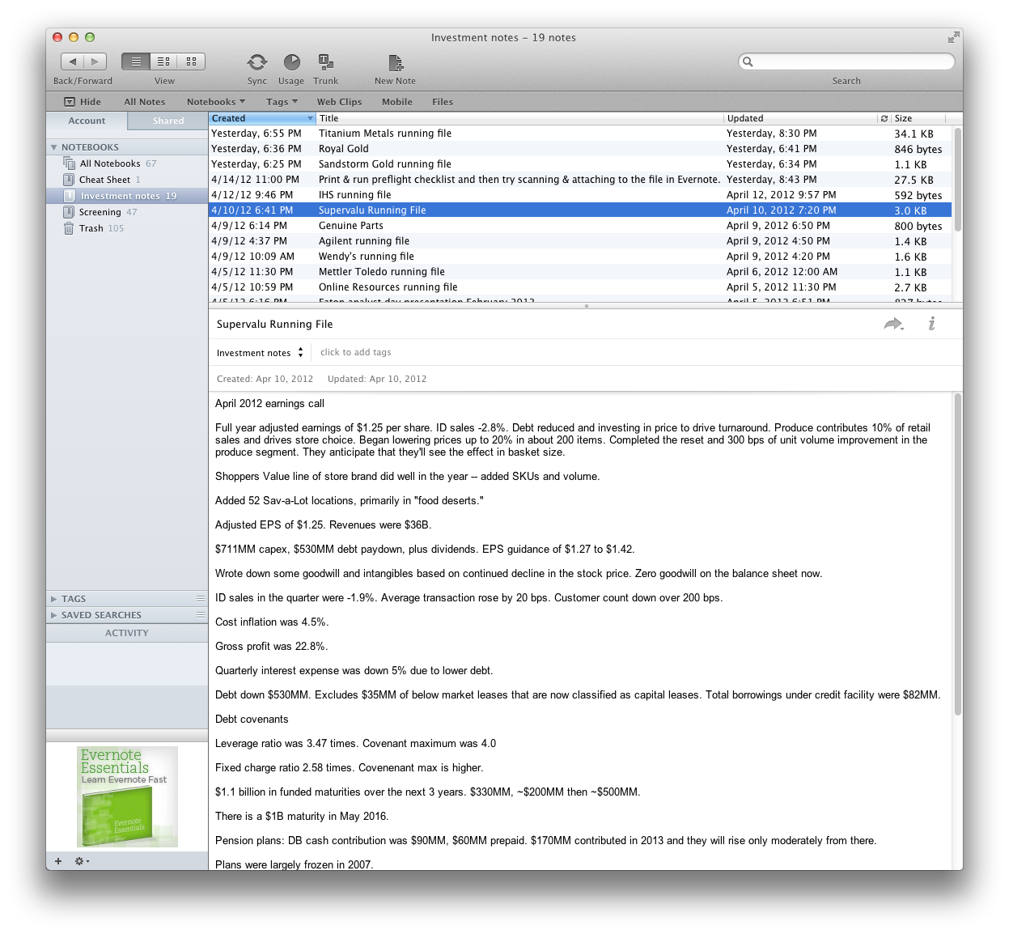
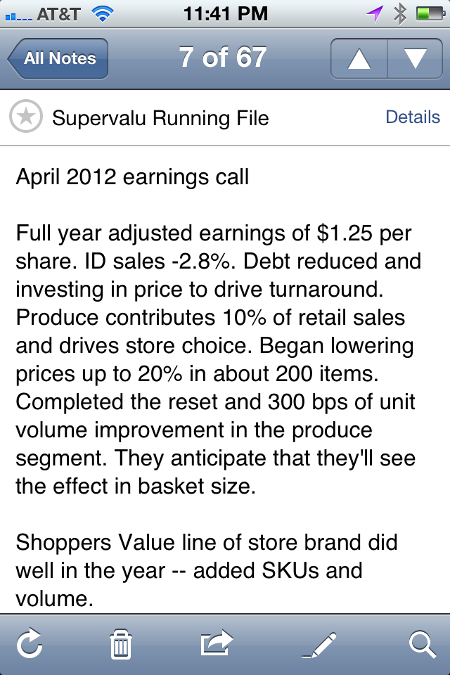
Evernote keeps your brain synced
I used to take notes on 10Ks with pen & pencil, in Word, in emails, etc. But keeping everything synced, available at all times, and up to date is best done in Evernote.

Slide 12
Evernote continued…
I used to take notes on 10Ks with pen & pencil, in Word, in emails, etc. But keeping everything synced, available at all times, and up to date is best done in Evernote.
Desktop, web and mobile apps: Look back on the previous page. The desktop & iPhone apps are loaded to the same file – my notes on the last earnings call for SVU. Everything is synced in real time, so I always have access to all my notes in the cloud.
LOTS of other features: I haven’t even scratched the surface of Evernote. Web clipping, on-the-go audio notes recorded on your iPhone and synced back to your desktop, etc.
Free and paid version: I’ve never needed to upgrade to the paid version. I get all of this for free.

Slide 13
Keeping up with news & filings via RSS
Very few investors use RSS readers, and those that do restrict themselves almost entirely to blogs and news sites. But RSS can do so much more…
EDGAR has extensive RSS integration: At the top of any EDGAR search, there is an RSS icon (see next page)
You can create filings for asset managers so you can see their 13Gs, 13Ds, 13Fs, etc.
You can create a feed of every 13D, or every S-1, or every contested proxy that gets filed with the SEC.
You can create a feed for each portfolio company, so you’ll see every Form 4, every 8K, every shelf registration, every change in comp plans.
Google News alerts: They can be delivered as either email or RSS feeds. I prefer feeds to keep my inbox clean. Literally dozens of ways to use them.
Can use for general idea search (try “tax free spinoff” or “announces buyback.”)
Can use to keep tabs on an industry. If you own Graftech (GTI), then an RSS feed for the keyword “graphite electrode” makes it easy to follow the industry.

Slide 14
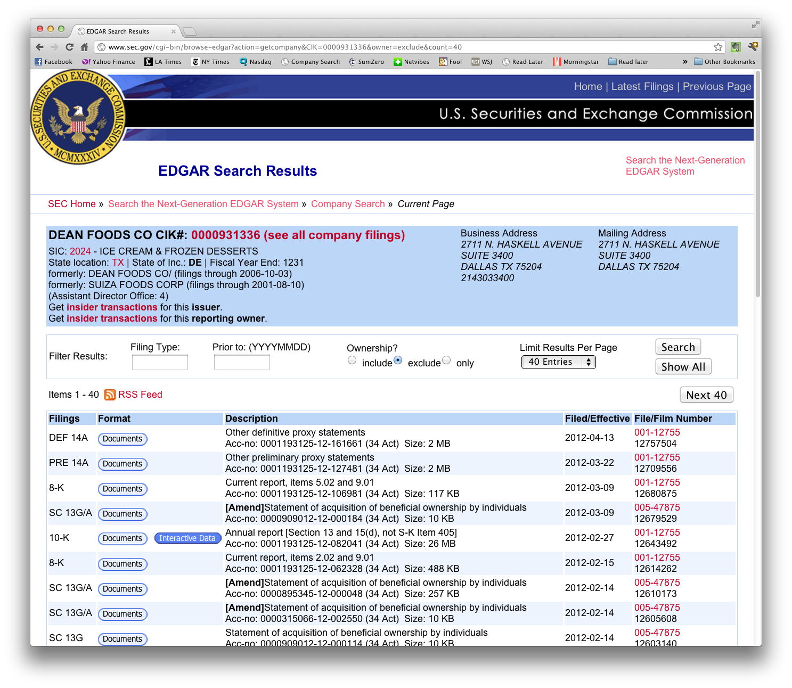
Grabbing RSS feeds from EDGAR
On any search page, just look for the signature orange RSS symbol, right click and copy the link to the clipboard.

Slide 15
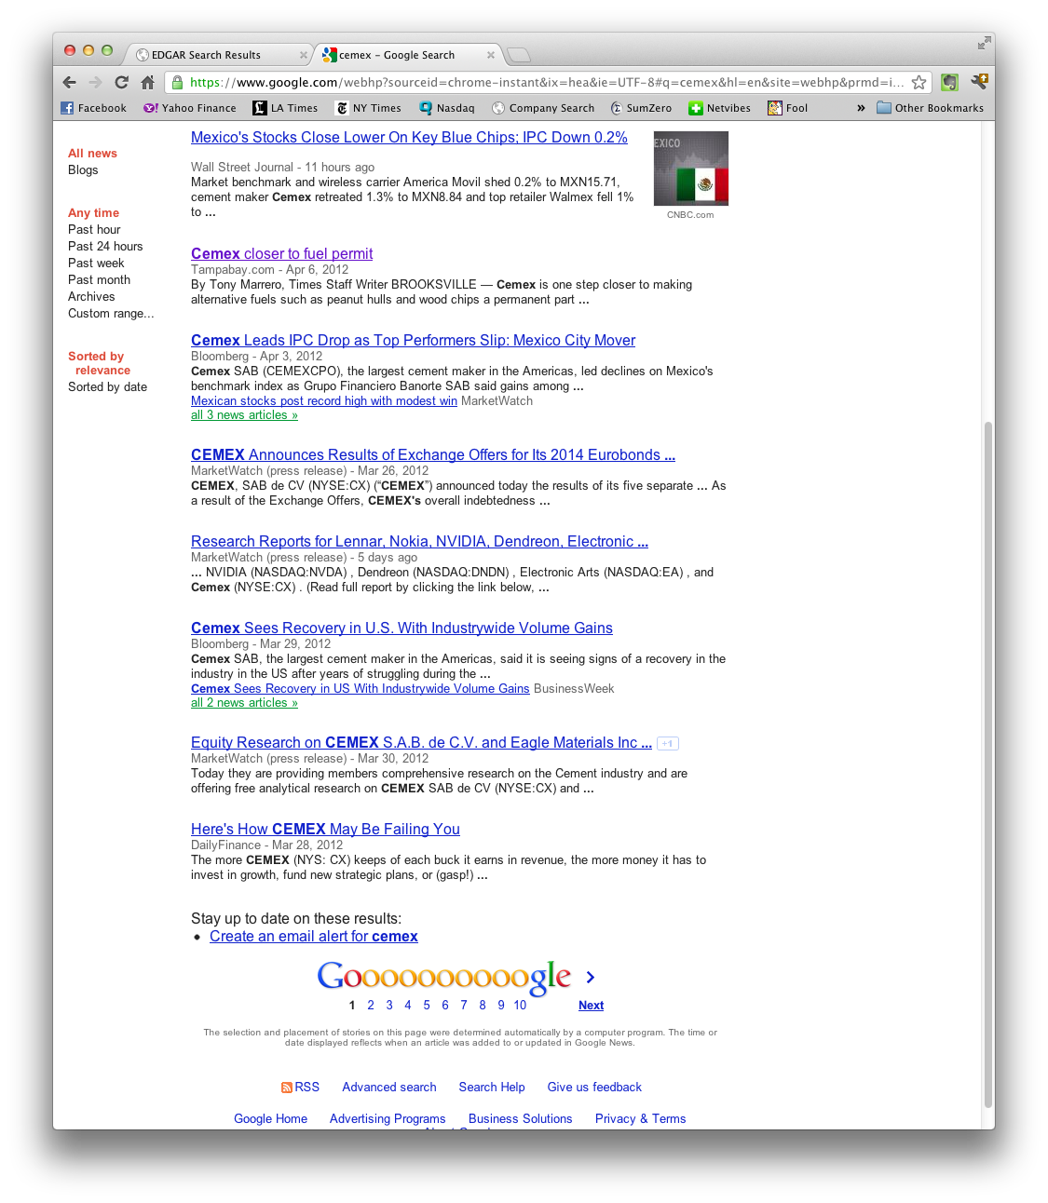
Grabbing RSS feeds from Google
Search for a term – in this case “Cemex” – on Google. Click the news link on the left, and then scroll down until you see the orange RSS icon. Copy the URL for this icon.

Slide 16
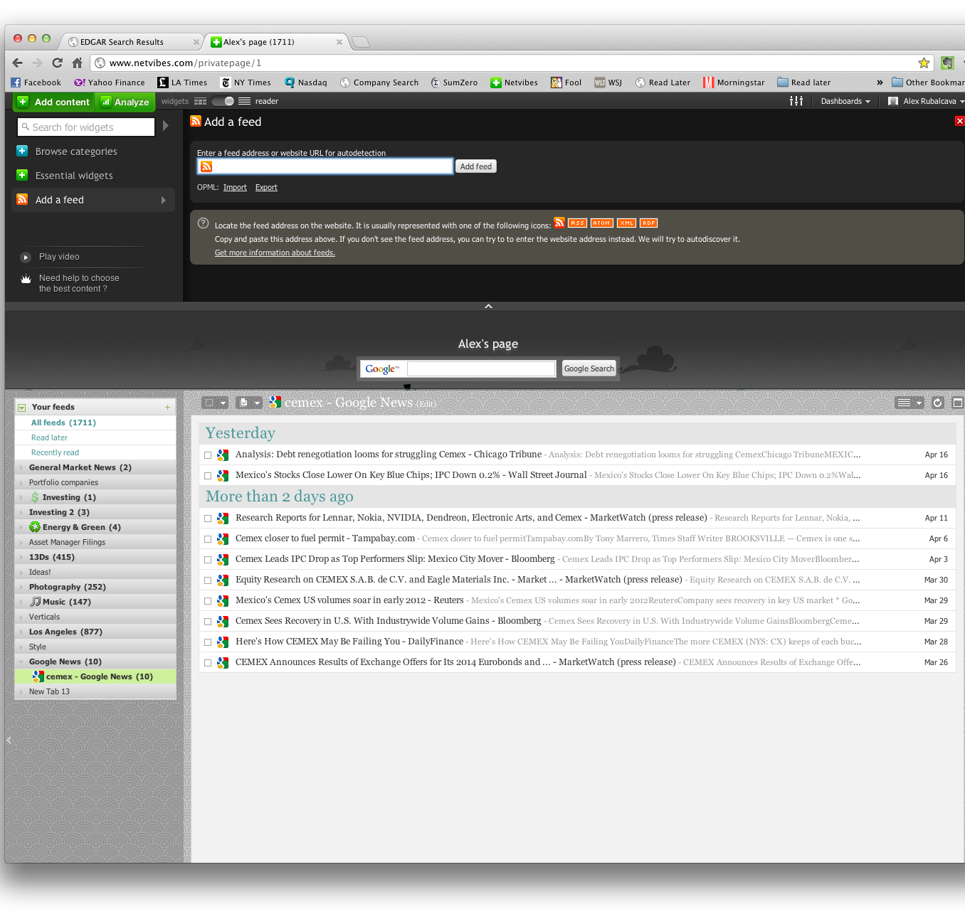
Importing RSS feeds into your reader
I use Netvibes – and I may be their last user. Almost everyone uses Google Reader. But, here’s how you add a feed to Netvibes. It’s very similar at Google.

Slide 17
Examples of how I use RSS
This is my feed of asset managers I follow. You can see 13Ds, 13Gs, and 13Fs from Pershing Square, Baupost, Brave Warrior, Scout, First Wilshire, et. al. here.

Slide 18
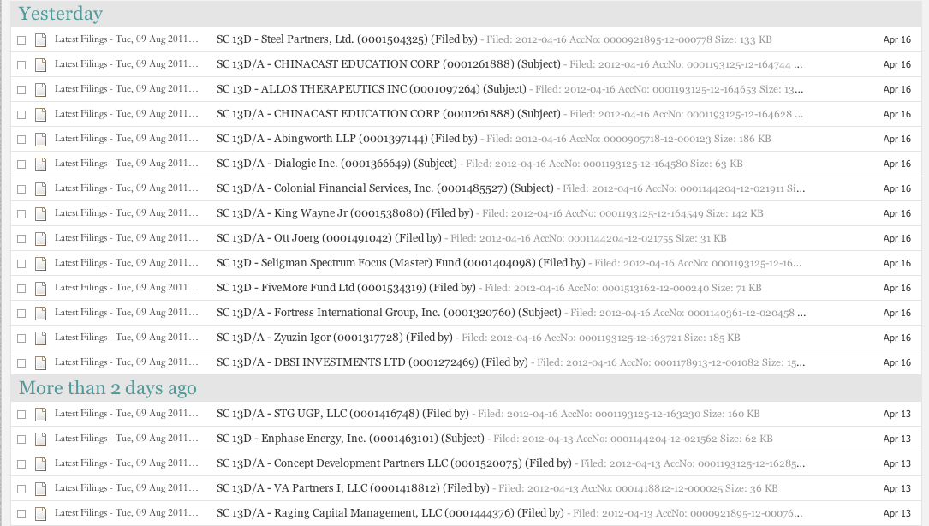
Examples of how I use RSS
This is a slightly different feed, showing every 13D filed with the SEC every day.

Slide 19
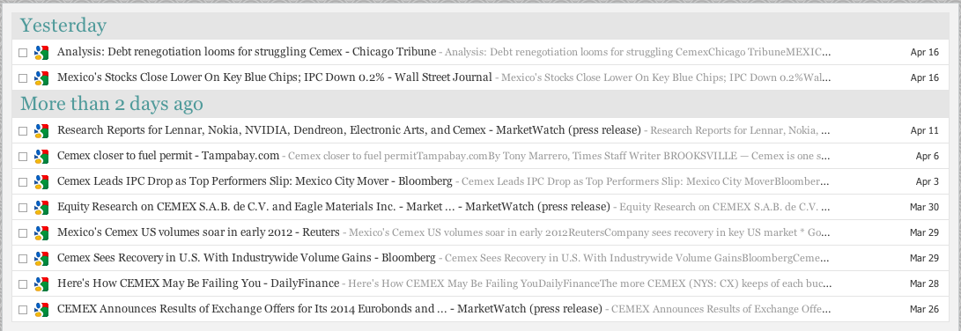
Examples of how I use RSS
In the earlier slide, we created a news alert for any article that mentions Cemex. Here’s what that feed looks like in Netvibes.

Slide 20
Checklists
In The Checklist Manifesto, Atul Gawande makes a powerful case for the benefits of using checklists in a complex business like investing.
Checklists promote accuracy: In a complex business like investing, there are many different ways to screw up each investment. By forcing you to analyze each possible problem in a structured way, the checklist encourages high quality work.
Checklists promote efficiency: The order and routine of checklists soon become familiar. You can get a huge amount of work done with a familiar checklist template.
Checklists are not just for buying: A checklist can be a great way to analyze an investment that’s underwater, or a stock that’s risen a lot where you need to decide whether to hold or sell.

Slide 21
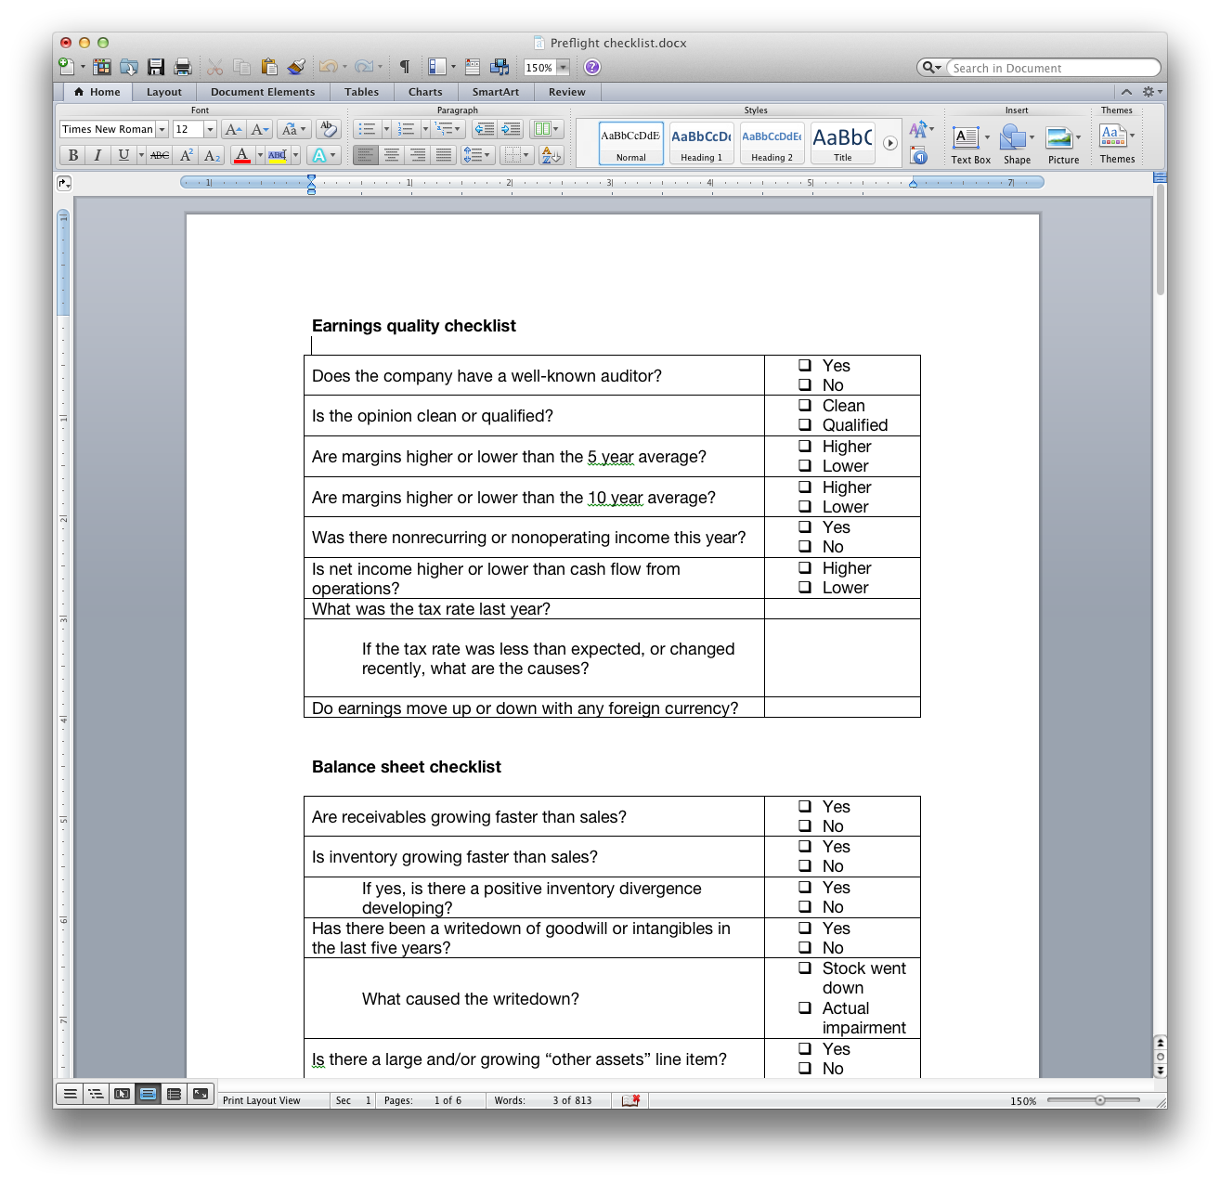
Checklists
My buy checklist has sections for earnings quality, balance sheet, cash flow items, return on invested capital, quality of annual report, competitive environment, etc.

Slide 22
Pulling it all together
With these tools, I can follow hundreds of companies, maintain up to date valuations, focus my work on big opportunities, and monitor my portfolio companies carefully.
Rotational system: By rotating through the companies I follow on my spreadsheets, I always have a rough idea of valuation and a good sense of how the companies are performing.
Knowing when to act, and when not to: The color codes show me whether it’s a good time to invest. When I see lots of yellow and green (potential 3-baggers and 4-baggers), I have lots of work to do. When I don’t, I have the discipline to sit still while still being productive by working through my rotations.
Familiarity: I rarely invest in companies that I haven’t followed for a long time. Familiarity reduces errors.

Slide 23
Pulling it all together
With these tools, I can follow hundreds of companies, maintain up to date valuations, focus my work on big opportunities, and monitor my portfolio companies carefully.
Everything, everywhere: With cloud based tools like this, you can access your investment process at all times using nothing but a browser and/or a smartphone.
The tools are flexible: You can tune this workflow to any goal – finding big multi-baggers, avoiding disaster, earning returns faster. Whatever your style, the more you invest in your process, the better you’ll be.

