Slide 1
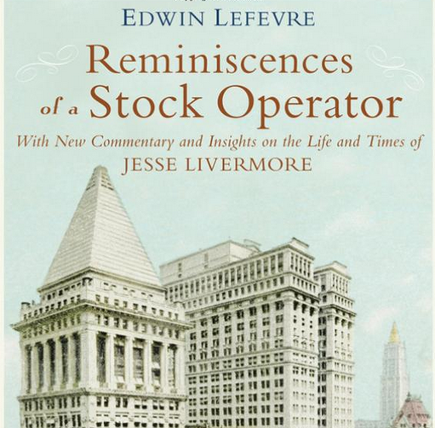
The Story
Behind
the Story
Behind
the Story
TRADERS ADVANTAGE & STRATEGIC ADVANTAGE jonmarkman.com / markmancapital.net
JON MARKMAN

Slide 2
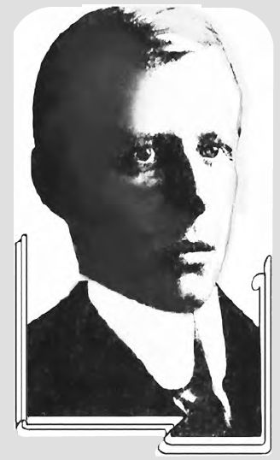
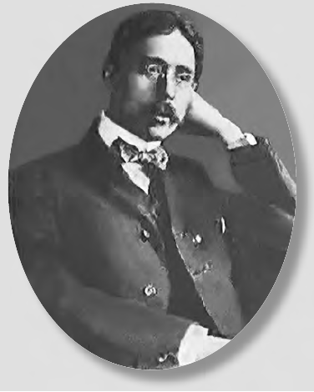
‘‘Reminiscences’’ was a collaboration not a monologue.

Slide 3
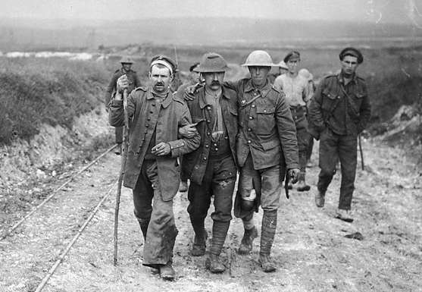
Imagine 1923, world still healing from WWI.

Slide 4
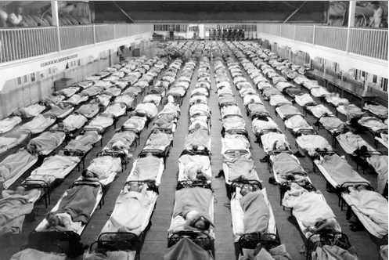
Imagine 1923, still reeling from 50M flu deaths.

Slide 5
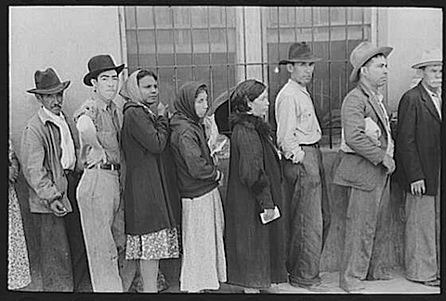
Imagine 1923, reeling from the 1920 depression.

Slide 6
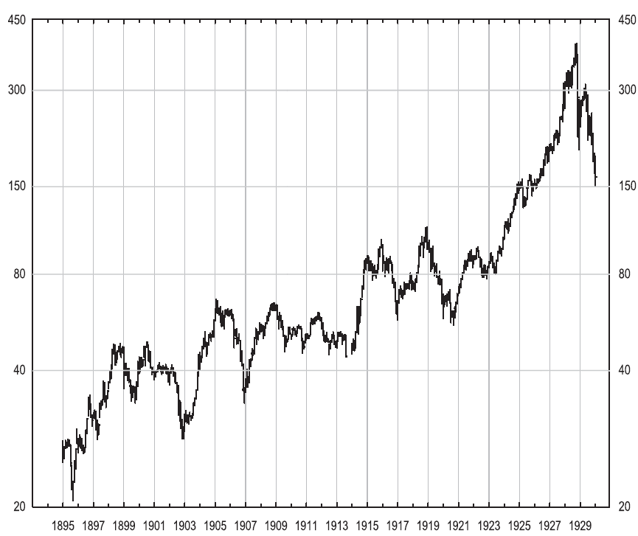
10 years of slop preceded the Roaring ‘20s
The Roaring ‘20s started with a tired yawn.

Slide 7
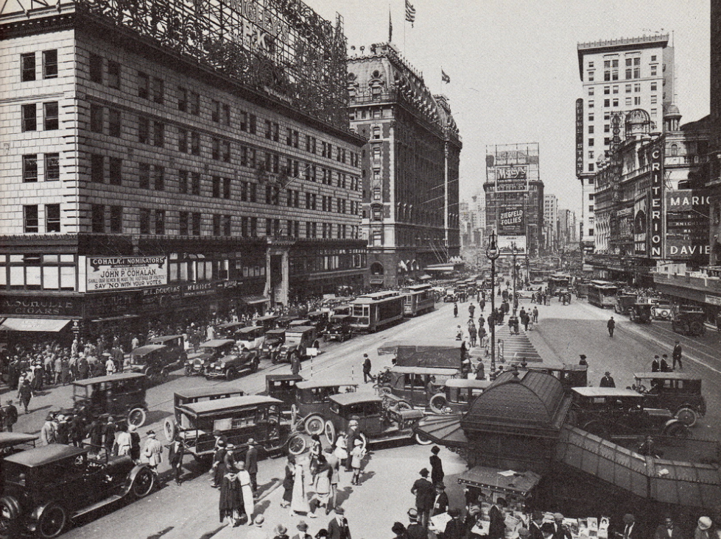
10 years of slop preceded the Roaring ‘20s
U.S. cities began to teem with rural migrants

Slide 8
Out of nowhere came a 460% advance into ‘29.
Suddenly stocks caught a spark, and boom!

Slide 9
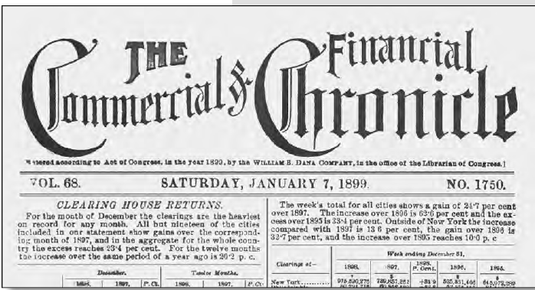
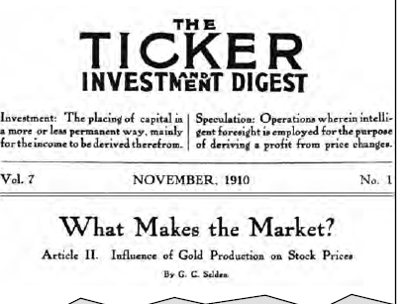
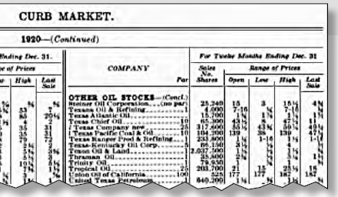
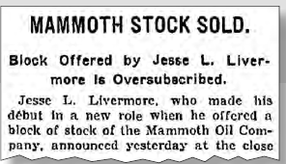
Newspapers covered stocks like crazy!

Slide 10
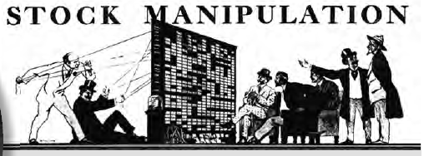
Lefevre specialized in uncovering manipulation

Slide 11
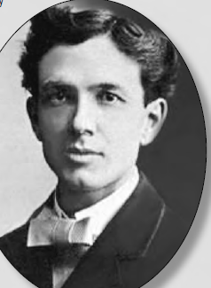
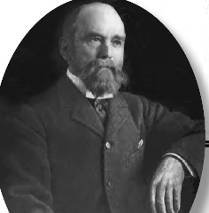
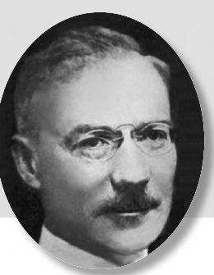
Lefevre had his pick of traders to profile.

Slide 12
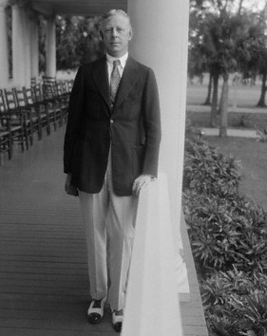
Lefevre choose cool, reticent Jesse Livermore.

Slide 13
Lefevre and Livermore remind us:
-- There is never anything new on Wall Street because speculation is as old as the hills.
-- In a bull market you must trade w/ the bulls; in a bear market you must trade w/ the bears.
-- Anticipation and fast reaction -- born from experience and planning -- are a trader’s key assets.
-- Never argue with the tape.
-- You don’t know until you bet.
-- Only the game can teach you the game
Lefevre choose cool, reticent Jesse Livermore.

Slide 14
Lefevre and Livermore remind us:
-- There is never anything new on Wall Street because speculation is as old as the hills.
-- In a bull market you must trade w/ the bulls; in a bear market you must trade w/ the bears.
-- Anticipation and fast reaction -- born from experience and planning -- are a trader’s key assets.
-- Never argue with the tape.
-- You don’t know until you bet.
-- Only the game can teach you the game
Lefevre choose cool, reticent Jesse Livermore.

Slide 15
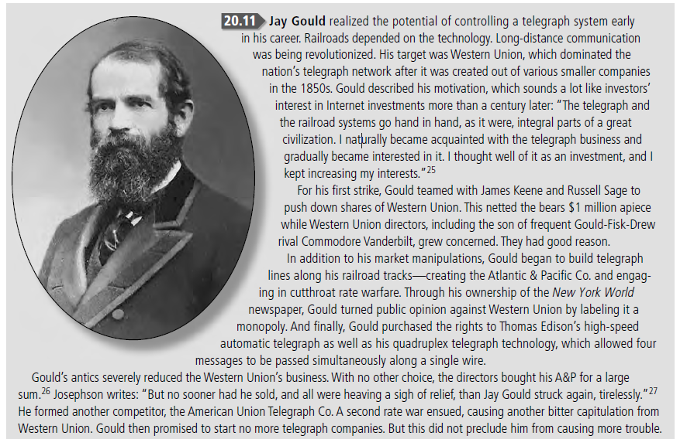
Jay Gould, master manipulator, tycoon, liar, thief.

Slide 16
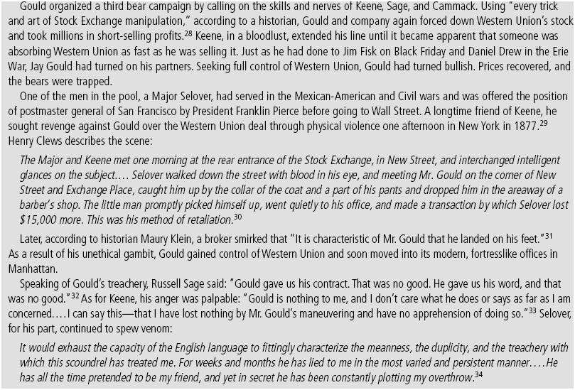
Jay Gould, master manipulator, tycoon, liar, thief.

Slide 17
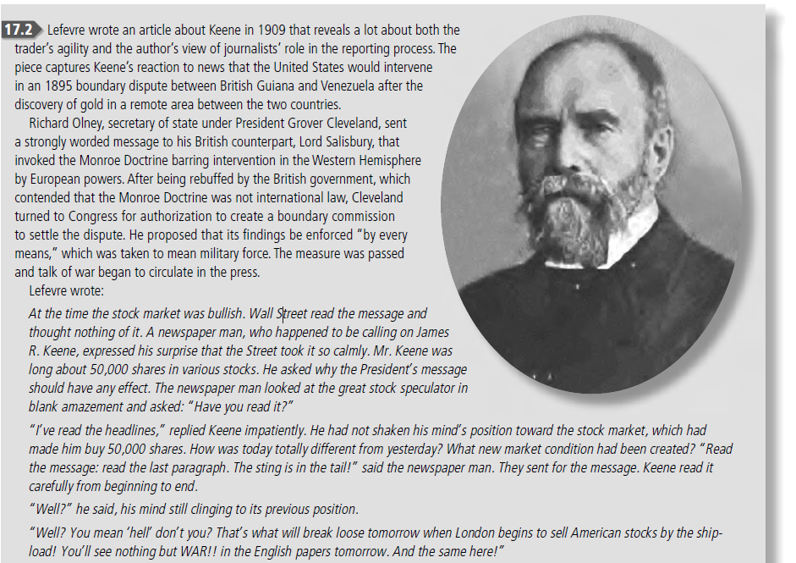
James Keene: Livermore’s hero & competitor.

Slide 18
GM founder made millions in stock; died in poverty.

Slide 19
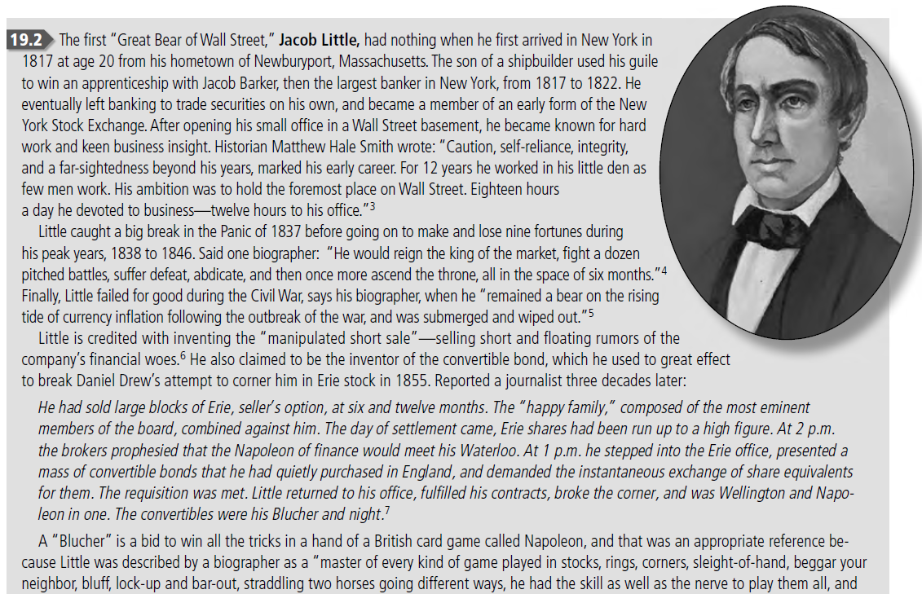
Jacob Little: the first “Great Bear of Wall Street.”

Slide 20
Saunders blew up cornering Piggly-Wiggly.

Slide 21
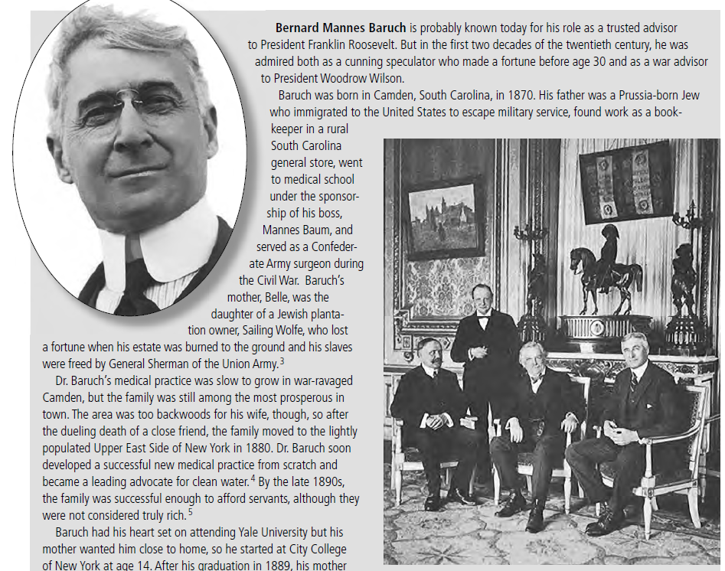
Bernard Baruch: Legend in stocks, sugar, war.

Slide 22
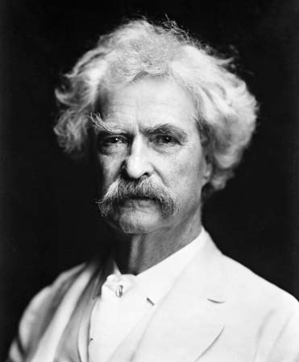
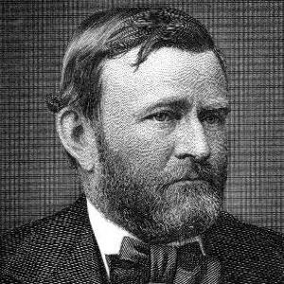
Twain saved Grant from destitution after a Ponzi scheme.

Slide 23
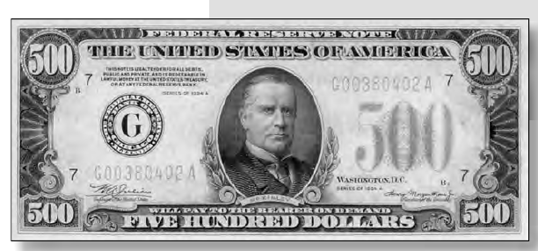
The $500 & $1,000 were common til nixed by Nixon.

Slide 24
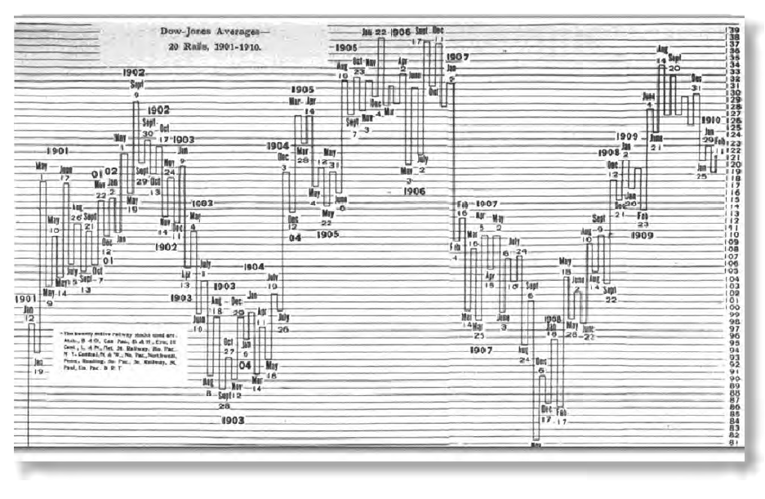
Many new chart styles emerged in the ‘20s.

Slide 25
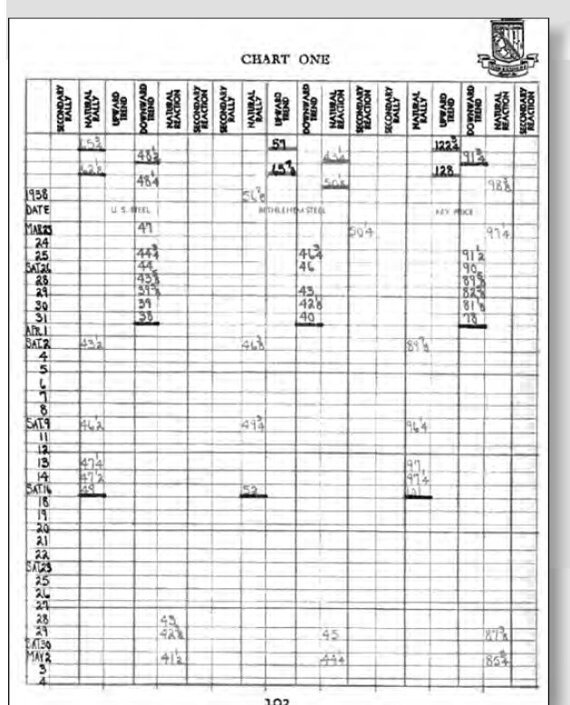
Livermore’s sector system: He kept notes by hand.

Slide 26
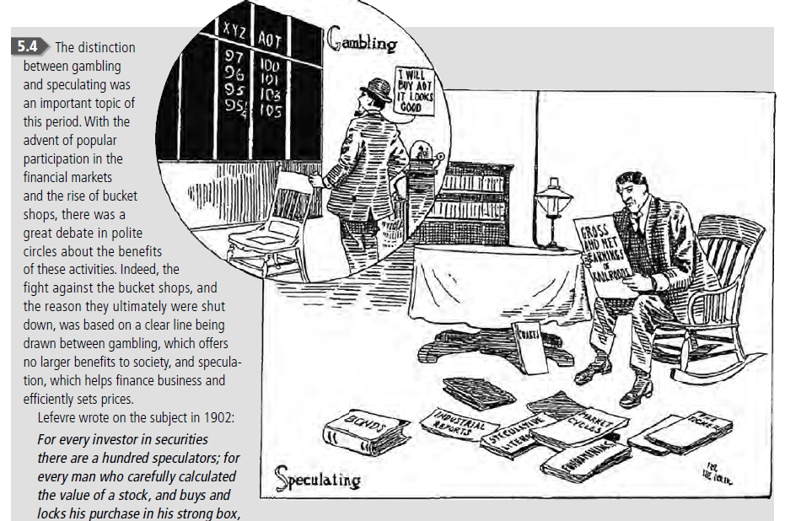
Gambling or speculation? Debate raged in 1902.

Slide 27
Lefevre has a million synonyms for ‘’swindle’’.
-- “Boodle” was primarily slang for bribes or illicit payments and counterfeit cash. ‘’Clergymen call the NYSE a boodlers battlefield.’’
-- “Thimblerig” was a shell game using three thimbles and a foam ball. Portrayed on the street as a gambling game, it was instead a con game. ‘They thimblerigged the market.’’
-- “Coppering” came from faro, where placing a penny on a deck of cards reversed the polarity of the next drawn card. A winner became a loser. If you ‘copper’ a friend’s tip, you bet against it.
Cheating was endemic. Few rules prevented it.

Slide 28
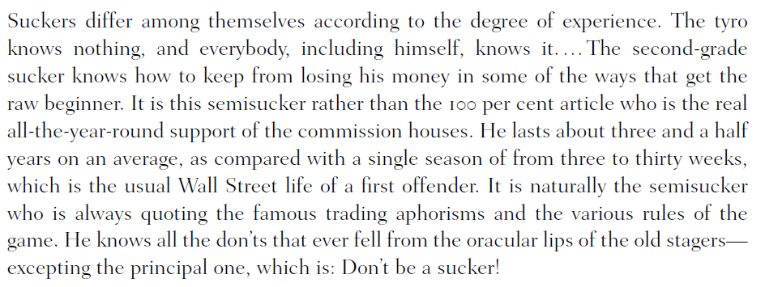
Lefevre believed that all traders were suckers.

Slide 29
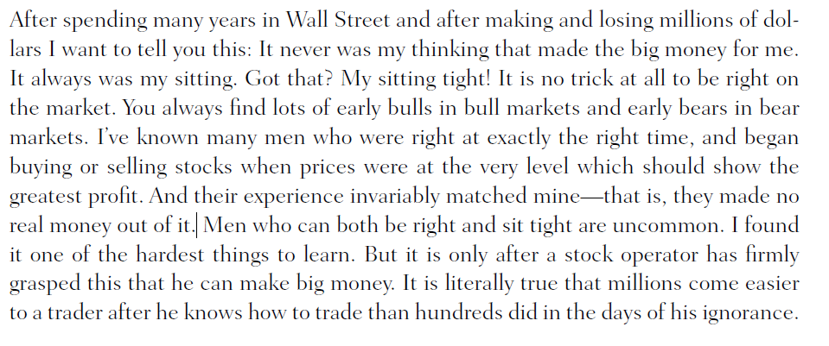
L&L believed “sitting” not trading, made fortunes.

Slide 30
L&L believed “sitting” not trading, made fortunes.

Slide 31
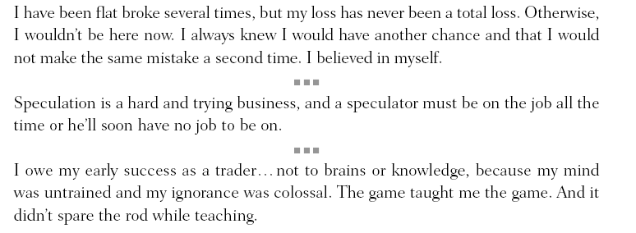
L&L believed “sitting” not trading, made fortunes.

Slide 32
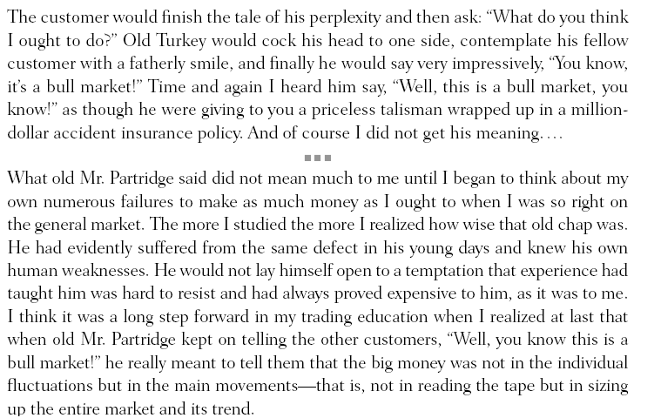
L&L believed “sitting” not trading, made fortunes.

Slide 33
L&L believed “sitting” not trading, made fortunes.

Slide 34
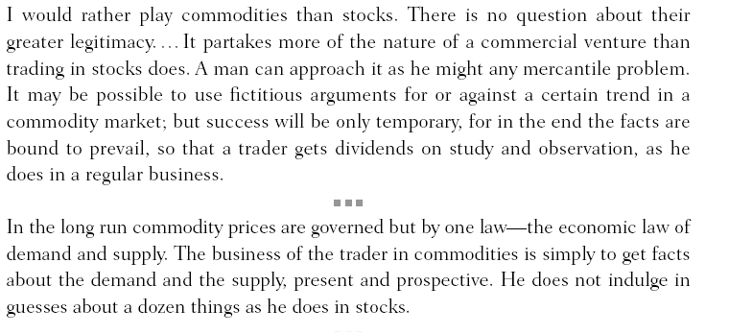
L&L believed “sitting” not trading, made fortunes.

Slide 35
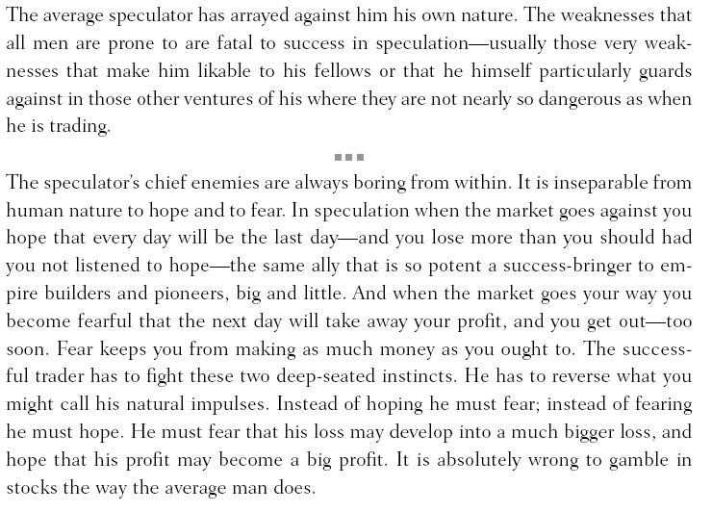
L&L believed “sitting” not trading, made fortunes.

Slide 36
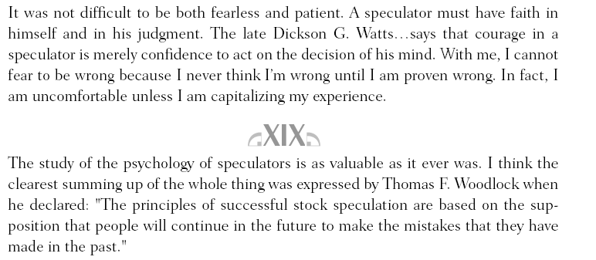
L&L believed “sitting” not trading, made fortunes.

Slide 37
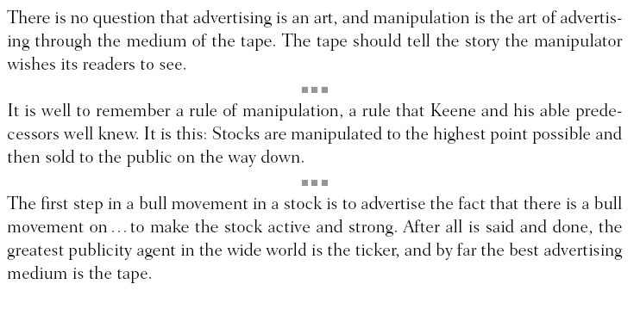
L&L believed “sitting” not trading, made fortunes.

Slide 38
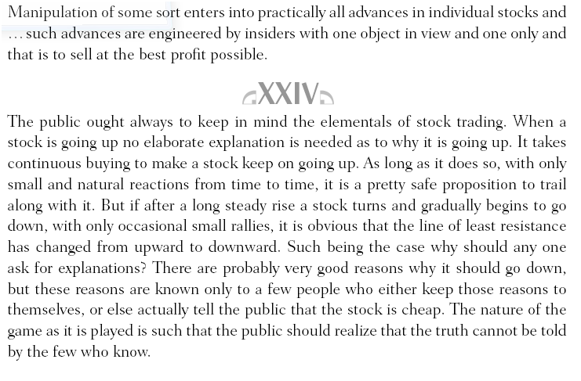
L&L believed “sitting” not trading, made fortunes.

Slide 39
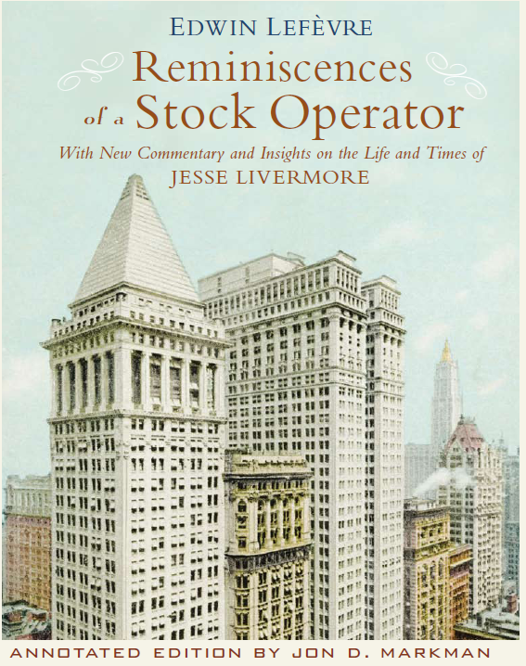
Available at bookstores and Amazon.com
Visit me at:
TRADERS ADVANTAGE Investorplace booth
Or …
-- Jonmarkman.com
-- markmancapital.net
-- markmanportfolios.com
-- msnmoney.com

