Slide 1
Not the huge, risky mess you think it is
Value-X Vail June 2012
kai@shihinvestments.com

Slide 2
Valuation
Metric | Multiple | Implied Price & Appreciation
Tangible Book Value | 1x | $13 / 68%
Mayo’s 2014 earnings est. | 10x | $12 / 55%
Mayo’s 2014 dividend est. | 20x | $17 / > 100%
Book Value | 1x | $20 / > 100%
Consensus 2014 earnings est. | 10x | $15 / 93%
Mayo has a
sell rating
Implied appreciation sounds large, but only means BAC returning to post-crisis prices, mid-2009 through mid-2011.
Consensus analyst: earnings more than double in 2 years.
* Based on 6/18 price of $7.76

Slide 3
Cheap for a Reason?
Mortgage Litigation
Europe
JPM Trading Losses

Slide 4
Litigation Overview
Complicated topic: multiple plaintiffs, jurisdictions, laws claims
Some view outcomes as random with huge tail risks – rendering BAC un-investable
Perspective: opportunity for value investors if one can understand risk
2004-2008 originations: damage is done, question is who pays.
BAC has paid $13Bn in claims and has $16Bn in reserves , plus unstated litigation reserves
By far the most reserves in the industry.
Question is final costs relative to existing reserves.

Slide 5
Simplify: group risk into three buckets
Risk Bucket | Outstanding ($B) | Claims ($B)
GSE (Fannie/Freddie) | $426 | $8
Private Investors (Pimco, AIG, etc) | $212 | $5
Mortgage Insurers (MBIA, etc) | $13 | $3

Slide 6
Fannie / Freddie
BAC has been repurchasing GSE mortgages for years.
80% of historical claims already settled @ 31% loss rate
$8Bn claims remain, but claims still growing
Reserves based on historical experience & loss rates
Baseline estimate: already reserved based on years of loss experience
Downside: Fannie may become more aggressive in claims.
Double current claims ($8Bn) @ 31% loss rate = $2.5Bn

Slide 7
Risk Bucket | Outstanding ($B) | Claims ($B) | Downside ($B)
GSE (Fannie/Freddie) | $426 | $8 | $2.5
Private Investors (Pimco, AIG, etc) | $212 | $5
Mortgage Insurers (MBIA, etc) | $13 | $3

Slide 8
Private Plaintiffs = Many Dice Rolls?

Slide 9
Perspective: One die roll, already cast
For efficiency purposes, similar litigation
is sent to one judge, in this case judge Pfaelzer in CA.
She has dismissed virtually every Federal
(i.e. securities laws) claim against BAC.
She has ruled that BAC can’t be forced to pay for Countrywide’s mistakes.

Slide 10
Statute of Repose, Limitations
Statute of repose starts with public offering irrespective of when the injury occurred.
Securities act: 3 years (2004-2008 originations)
Statute of limitations starts when the plaintiff
“should have known”
SOX: 2 years
2007 – lawsuits, media over Countrywide
Most lawsuit later than mid-2010 are beyond this period.
Big lawsuits - generally too late for federal.
Most firms didn’t believe they had a case.

Slide 11
What about state claims?
Most state claims also too late.
New York fraud still possible
Only applies to New York-based companies
Hard to win.
NY appellate court: bar for sophisticated investors to cry fraud is very high.
US Supreme court: Janus decision. Very hard to stick BAC with Countrywide’s fraud.

Slide 12
Private Investor - Valuation
Base case: $8.5Bn Countrywide settlement approval settles most Countrywide claims
Given statute of repose rulings, most plaintiffs would receive nothing if settlement not approved.
Reserves already established assuming settlement.
Downside case: NY fraud lawsuits bear fruit
Estimate incremental $2.5Bn losses

Slide 13
Risk Bucket | Outstanding ($B) | Claims ($B) | Downside ($B)
GSE (Fannie/Freddie) | $426 | $8 | $2.5
Private Investors (Pimco, AIG, etc) | $212 | $5 | $2.5
Mortgage Insurers (MBIA, etc) | $13 | $3

Slide 14
MBIA
Complicated case
MBIA also insures some of BAC’s holdings
Court generally favoring MBIA
Dollar values very small relative to other buckets
Baseline: reserves similar to existing monoline settlements
Downside: because court generally favoring MBIA, could be another $1Bn in costs.

Slide 15
Risk Bucket | Downside ($B)
GSE (Fannie/Freddie) | $2.5
Private Investors (Pimco, AIG, etc) | $2.5
Mortgage Insurers (MBIA, etc) | $1
Mortgage Sub - Total | $6
Europe

Slide 16
PIIGS exposure
Investors have great fear of 2008-2009 contagion.
Feels like an unquantifiable, huge risk
Believe the risk is quantifiable w/ recent PIIGS disclosures
Already sold PIIGS consumer credit cards.
Total exposure to PIIGS at $9.7Bn
Virtually no PIIGS sovereign exposure
Exposure is to corporations ($6Bn)
PIIGS exposure declined by ~$6Bn over past 5 quarters

Slide 17
Europe: Medium-Term Upside?
BAC is seeing record deposits & strong inflows, in part from Euro companies.
The strong capital position of global US banks vs European banks means they can either buy assets or take global business from European banks.
Similar to WFC’s taking mortgage business from BAC after the financial crisis.
Agree with Chanos on Santandar.
Already signs that US banks are taking business from European banks.

Slide 18
Impact to Valuation
Base case: No contagion – “muddle through”
Greece might exit – minimal exposure.
Downside case: PIIGS leave immediately.
$3.5Bn loss – next slide
The downside case is shrinking over time with BAC mitigation

Slide 19
Downside Case Assumptions
Funded & unfunded loans,
counter-parties, securities
Hedges, CDS
GIIPS ($MM) | Gross exposure | Loss Rate | Total Loss | Hedges | Loss Rate | Hedge Gains | Total
Sovereign | ($2,516) | 50% | ($1,258.00) | $ 1,501.00 | 50% | $ 750.50 | ($507.50)
Financial | ($3,857) | 50% | ($1,928.50) | $ 1,029.00 | 50% | $ 514.50 | ($1,414.00)
Corporations | ($8,678) | 35% | ($3,037.30) | $ 2,769.00 | 50% | $ 1,384.50 | ($1,652.80)
Total | ($15,051) |  | ($6,224) | $ 5,299.00 |  | $ 2,649.50 | ($3,574.30)
Severe loss assumption for both exposures & hedges
Assumes all unfunded loans become funded
PIIGS ex-Italy ~$1.7Bn
Direct exposure is small & shrinking, even with severe assumptions.

Slide 20
Risk Bucket | Downside ($B)
GSE (Fannie/Freddie) | $2.5
Private Investors (Pimco, AIG, etc) | $2.5
Mortgage Insurers (MBIA, etc) | $1
Mortgage Sub - Total | $6
Europe | $3.5
Total | $9.5

Slide 21
Earnings Outlook & Stock Buyback Opportunity
EPS forecasts | Low | Consensus
2012 | $0.38 | $0.65
2013 | $.49 | $1.04
2014 | $1.20 | $1.46
Why doubling in two years?
Earnings growth mainly via cost cuts that don’t impact revenue

Slide 22
Consensus earnings: strong growth
Driver | Earnings ($Bn)
2012 consensus earnings | $6.5
Cost cuts without revenue impact | +$5.5
Cost cuts with revenue impact | +$1.7
10bps NIM expansion | +$1.4
2014-2015 after-tax | $15
No cash taxes | $6.5
2014-2015 pre-tax | $21.5
Litigation, settlements, foreclosures, fines > $12Bn today
Assume ½ of BAC’s stated goal
Floating, fixed & debt repurchases
~consensus
Relevant metric for
cash flow, capital growth, stress tests, Basel 3, etc

Slide 23
Longer term
Deposits > $1tn - could see even more loans.
Underestimating loss rates?
No cash taxes
Estimates may be aggressive; even so, very cheap

Slide 24
BAC buybacks
Stress tests & Basel 3 likely to dictate buyback levels
Under Basel 3, BAC can return 100% of earnings and still grow capital.
Only true for BAC & C due to huge deferred tax assets.
Potential for very large buybacks over time.
Long term investors should be hoping for continued low prices ☺

Slide 25
Valuation – Base Case & Downside
 | Per Share – Base case | Per Share – Downside
Current Tangible Book Value | $13 | $13
Subtract: Additional Mortgage Losses | - | -$.6
Subtract: Europe Losses | - | -$.4
Subtract: Additional Buffer of 50% | - | -$.5
Add: Tax Benefit | - | $.5
De-risked Current Tangible Book Value | $13 | $12
Add: 2H 2012 - 2014 consensus earnings | $3 | $3
Tangible Book Value end 2014 | $16 | $15
Believe BAC management will buy shares until price is >= Tangible Book Value
Implies 100%+ returns to end of 2014.

Slide 26
Questions?

Slide 27
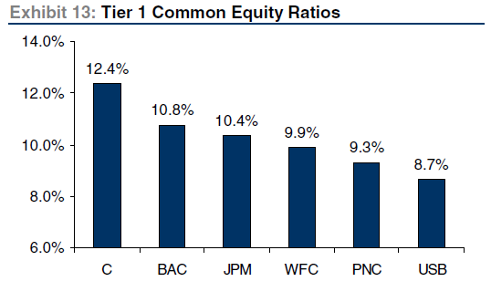
BAC Capital Levels
Source: CSFB April 30, 2012 report
BAC capital (in dollars) highest among US banks, record high for company
BAC capital ratios second highest among large US banks, record high for company
Recent capital increases faster than competitors
2% gain in the last 6 months
Currently ~5 years ahead of Basel 3 schedule
Capital levels appear sufficient.

Slide 28
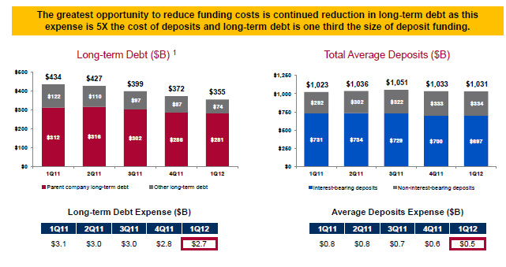
NIM expansion
BAC reduced annual debt expense by $1Bn in Q2 alone

Slide 29
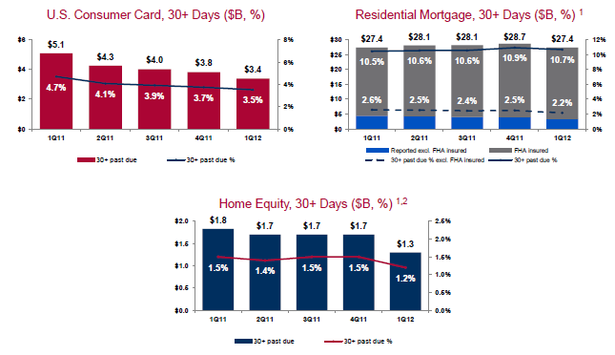
Credit Quality

Slide 30
Accounting Issues
Risk in US banks was 2007-2009, when US default rates were rapidly rising to unknown levels.
European banks currently have that risk w/ EU sovereign & real-estate debt.
In 2012 we can analyze how BAC marked their books during the financial crisis.
BAC over-reserved for losses during the financial crisis.
BAC has offset tens of billions of dollars of assets with gains selling other assets at > tangible book value.
Big settlements (foreclosure, etc) were reserved before they were announced.
Post-financial crisis, big banks have more regulators looking at balance sheet than likely any other industry.

