Slide 1
Pacific Sunwear of California
Fallen Angel
Shane Calhoun, CFA
shane@belcarocapital.com

Slide 2
A Brief History
Started as a surf shop in Newport Beach in 1980 with first mall-based store opened in 1981
Went public in March 1993 and was one of the best performing stocks up to its peak in 2005
Became dominate surf and skate retailer with over 965 store footprint in the U.S.
Diversified business with two other store concepts – d.e.m.o. (hip hop retailer), One Thousand Steps (shoe and accessories)

Slide 3
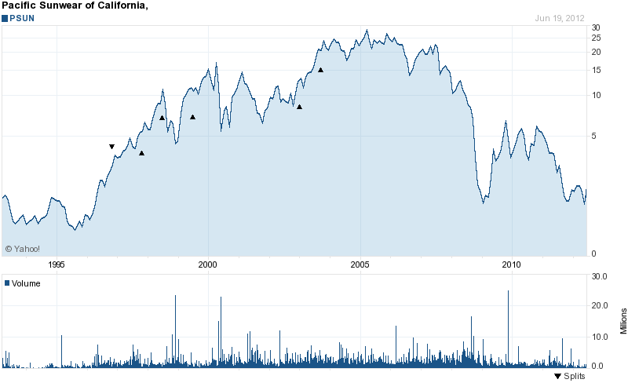
What happened?

Slide 4
…..lots of things
Victim of its own success
  Management teams of high multiple, high growth stocks tend to emphasize growth over returns on equity
  PSUN kept pushing growth in stores while ROIC was decreasing
  Forgot who got who made them – neglected heritage brands over higher margin private label.
  Branched off into unrelated store concepts – d.e.m.o, One Thousand Steps
  Exited footwear – prior management underestimated correlation between footwear and men’s apparel sales
  New competitors aggressively entered the scene to capitalize on this space – Zumiez, Hollister
  Significant economic slowdown
    Unveiled how poor the company had been managed in the previous 5 years
    Sales declines highlighted bad real estate deals (occupancy costs 20%)

Slide 5
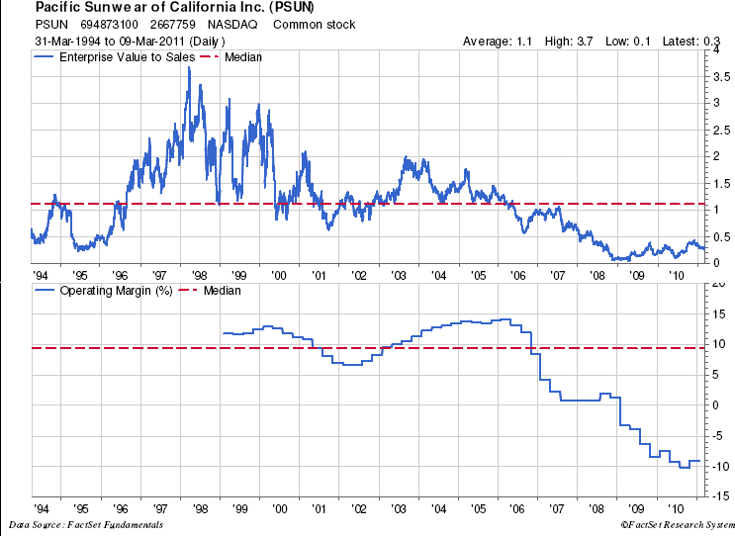
…..and valuations compress

Slide 6
Turnaround time
New Management Team
  CEO came in mid 2009 replaced most of senior management team by 2010
Business strategy
  Focus on heritage brands to get target customer (15-22 year old) reengaged
  Improve organization and culture
  Great products drive results -> men’s focus on brands, women’s revamp the whole deal (customer segmentation, merchandising, speed to market)
  More intelligent use of market data to properly merchandise stores “localization”
  Develop a coherent e-commerce strategy
  Reintroduce footwear and accessories

Slide 7
Roadmap to profitability
Increase the productivity of the stores
Get the stores back to positive comps

Slide 8
Shrink to Success
Right-size the business
Golden Gate Capital loans $60M to provide capital to close underperforming stores and to fund operations
Store base going from 877 in 2010 to 570 by end of FY2013
Closing 100-120 stores in 4Q2012
  Average sales for lower performing stores is $600k vs. $1.1M company average
  Higher productivity from existing stores will help drive improved gross margin
  By FY 2013 cash should increase by $10-15M from reduction in inventory needs
  This exits exposure to C & D properties with remaining 600 in A & B malls

Slide 9
Driving Positive Comps
Revamp women’s business – progress being made, core customer being reengaged
Broaden out shoes and apparel (currently 425 stores) – men’s footwear up 38% in 2011, women’s up 42%
Fine tune merchandising (localization) and e-commerce to drive further sales, optimize inventory needs, and strengthen relationship with customer
Trending in right direction 2009 (-20%) 2010 (-8%) 2011 (-1%)

Slide 10
Risks
Balance sheet not strong enough to withstand another two years like 2009 and 2010 without additional capital raise
Can’t get women’s line right
Customers move away from surf & skate genre

Slide 11
Some numbers

Slide 12
Earnings Power
2001 store count equal to where management has outlined as part of the strategy
Not an apples-to-apples comp – 2001 includes 101 demo stores/$900k rev store = total 665 stores
Company was in hyper growth mode in 2001 (added 100+ new stores in 2002) GP should be higher for more mature stores
Lots of levers to pull to drive margins – reduce headcount, better inventory management, upside to store revs from here as shoes/apparel added back, potential traffic gains from closed stores, greater e-commerce penetration, etc…

Slide 13
…..but it’s still a retail turnaround in crappy environment
Several have a huge vested interest
  GGC convert is at $1.75 for 13.5M shares
  They have $60M of skin in the game
  The “Greeks” have 30% of the outstanding shares at 2-3x current share price
  They are still the preferred vendor – QZK, Volcom, etc… need these guys to stay around
  At .2 forward EV/Sales it’s worth a look

