Slide 1
FINDING VALUE OFF THE BEATEN PATH
HALOGEN SOFTWARE (TSE:HGN)
ValueX Vail 2015

Slide 2
EXECUTIVE SUMMARY OF GREENHAVEN ROAD
Operating Background
Managed a paper bag factory after graduating college
Co-Founder of Acelero Learning. Several roles including CFO, CTO, Chief Strategy Officer, and currently board member. Acelero has grown from three co-founders in a tiny office to 1,100+ employees
Who We Are
A long-biased, value focused hedge fund. Intensive up-front research, concentrated positions and then…patience.
www.greenhavenroad.com
What We Believe
Fundamentals matter – the market will recognize this over time.
Diversifying away risk also means diversifying away returns – invest in only the best ideas..
Stakeholder interests must be aligned – a meaningful personal investment in the fund and LP-friendly investment terms are just the starting point.
There is power in simplicity – no need to over-complicate the investment process and leverage isn’t necessary to generate returns
Notes:
FIX LOGO

Slide 3
PERFORMANCE HISTORY THROUGHOUT LIFE OF STRATEGY – BY MONTH
Strategy has compounded >24% and the fund >19% per year net of fees
 | JAN | FEB | MAR | APR | MAY | JUN | JUL | AUG | SEP | OCT | NOV | DEC | YTD | S&P 500
2005 | -0.74 | 6.33 | 3.51 | -10.95 | 12.55 | -1.15 | 7.69 | 1.08 | 2.09 | 2.75 | 9.46 | -3.50 | 30.54% | 4.89%
2006 | 2.19 | -5.80 | 11.28 | 2.86 | -6.86 | -0.43 | 3.39 | 1.26 | 8.46 | 7.06 | 2.86 | -6.50 | 19.47% | 15.79%
2007 | 1.21 | -1.72 | 3.03 | 6.06 | 9.45 | -1.05 | -1.71 | 3.48 | 9.08 | 12.37 | -3.61 | -3.19 | 36.95% | 5.49%
2008 | -24.05 | 0.76 | -0.18 | 18.14 | 9.05 | -9.06 | -1.52 | 0.77 | -20.12 | -11.20 | -6.64 | 2.00 | -40.01% | -37.00%
2009 | 2.14 | -0.88 | 24.03 | 14.26 | 11.55 | 3.71 | 12.87 | 12.04 | 6.20 | 0.77 | 3.53 | -0.05 | 132.45% | 26.46%
2010 | -3.02 | 5.29 | 8.99 | -9.56 | 13.23 | -13.26 | -3.89 | 19.46 | 21.39 | 6.04 | 4.98 | -2.98 | 49.68% | 15.05%
2011 | FUND 1.03 | LAUNCH 4.20 | 0.01 | 0.27 | 1.68 | -1.00 | 0.41 | -7.86 | -13.06 | -0.93 | 0.01 | 6.47 | -9.85% | 2.11%
2012 | 11.85 | 1.99 | 4.95 | -3.79 | -14.22 | -0.96 | -4.35 | 8.67 | 1.91 | -5.05 | 3.45 | 2.55 | 4.42% | 15.98%
2013 | 5.16 | 10.04 | 3.48 | 3.40 | 10.69 | -1.26 | 3.36 | -2.24 | 7.29 | 2.64 | 7.83 | 1.49 | 64.79% | 32.41%
2014 | 3.07 | 4.46 | -1.54 | 0.33 | 5.74 | 4.41 | -2.57 | 5.88 | -1.22 | 2.66 | 0.68 | -0.09 | 23.56% | 13.69%
2015 | -0.11 | 7.52 | 0.85 | -.0.56 | 6.04 |  |  |  |  |  |  |  | 14.21% | 3.35%
www.greenhavenroad.com
*All figures are net of incentive fees. Pre-fund launch returns through December 2010 have been compiled by Fulvio and Associates, a leading alternative investment management audit firm as if incentive fee structure had been applied
Notes:
FIX LOGO

Slide 4
EXAMPLE OF POORLY RECEIVED IDEA
Ideas are often poorly received – but perform well
Rally Software is a similar story to Halogen
Was rated 20th percentile before buyout, now 36th percentile despite almost doubling in 1 year
www.greenhavenroad.com
Notes:
Let’s do this on a slide like slide number 2, Can you add in animation so that the bullet points come up one at a time

Slide 5
HALOGEN SOFTWARE
Basics
TICKER: | HGN (TSE) | Net Cash: $41M USD
PRICE (6/23): | $11.00 CAD | Insider Ownership: 46%
MARKET CAPITALIZATION | 241M CAD / $195M USD | 52 Week Hi/Low: $11.00/$7.50
www.greenhavenroad.com
Business Description
The Company’s Words: Halogen Software Inc. is a provider of cloud-based talent management solutions. The Company's software offers an organically built cloud-based talent management suite that reinforces and drives employee performance across all talent programs whether that is recruiting, performance management, learning and development, succession planning or compensation.
Glass Half Empty View: Busted small cap Canadian Tech IPO with limited volume – No Thanks.
My View: Personnel and Benefits are most operating businesses largest expenses. For service businesses they are typically greater than 70%. Optimizing these expenses is a big deal. Tell me more.
Notes:
Let’s do this on a slide like slide number 2, Can you add in animation so that the bullet points come up one at a time

Slide 6
CASE STUDY: LEADING EARLY EDUCATION PROVIDER (NON HALOGEN CUSTOMER)
HR Has silo specific solutions
FUNCTION
PROVIDER
SATISFACTION LEVEL
Recruiting
Taleo
Medium
Onboarding
Email
Low
On Line Training
Cornerstone
Very Low
Performance Reviews
ADP
Lower than Low
www.greenhavenroad.com
360 Ratings
Censeo
Low
Meyers Briggs/Profiling
Predictive Index
Medium
1:1 Meeting Tracking
Paper Folders
Low
Succession
NA
NA
Compensation
Excel
Low
Notes:
Let’s also make this like slide 2, with a white background. Can you make the three lines at the bottom bullet points that are animated so they come up one at a time

Slide 7
CASE STUDY: LEADING EARLY EDUCATION PROVIDER (NON HALOGEN CUSTOMER)
Silo Specific Solutions are Sub Optimal
None of these Systems Speak to Each Other
There are multiple systems to maintain. An employee gets married and changes her name – the change has to be made in eight places
25% Turnover means hundreds of new employees are getting up in 8 systems per year.
To conduct an effective performance review requires accessing multiple systems.
www.greenhavenroad.com
Limited Transparency and Flawed
There is limited to no transparency to see if key activities such as 1:1 meetings. Are they happening? What is being discussed? If there is a change in managers, the new manager is often flying blind when using a paper based system, unless it is a very smooth and thoughtful transition.
Halogen Organically Developed for Interoperability
Notes:
Let’s also make this like slide 2, with a white background. Can you make the three lines at the bottom bullet points that are animated so they come up one at a time

Slide 8
TYPICAL HALOGEN CUSTOMER
Has 500 Seats
Buys 2.3 Products out of 8 Offered
Almost all customers use Performance Review Offering
Multi-rater (360 review) is next most popular followed by Learning and Compensation
Performance is the most expensive – generally 2X the other offerings
www.greenhavenroad.com
Spends $25K+ on Halogen > $30M on Personnel/Benefits
The average spend per customer is approximately $25K on Halogen to help optimize over $30M+ in Personnel spend or less than 1/10 of 1%
Solves Real Problems / Gets More Valuable Over Time
Spends more each year
As the offerings get populated with critical data, the applications become more useful over time.
Switching is possible, but relative to the product cost should not be an attractive proposition
Notes:
FIX LOGO – Can you animate so the HAS 500 Seats comes up, then Buys 2.3 Products, then Spends $30K

Slide 9
WELL RECEIVED IN MARKETPLACE
www.greenhavenroad.com
Source: Halogen Software Investor Presentation
Notes:
FIX LOGO

Slide 10
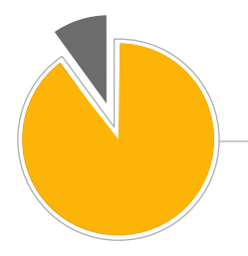
UNDER PENETRATED MARKET
Long runway for growth
$15B
300,000 Mid-Market*
Organizations Worldwide
Total Addressable Market
*100-10,000 employees
www.greenhavenroad.com
>90% have no Talent
Management software solution
*Company estimates based on various sources and management’s calculations
Source: Halogen Investor Presentation
Notes:
FIX LOGO

Slide 11
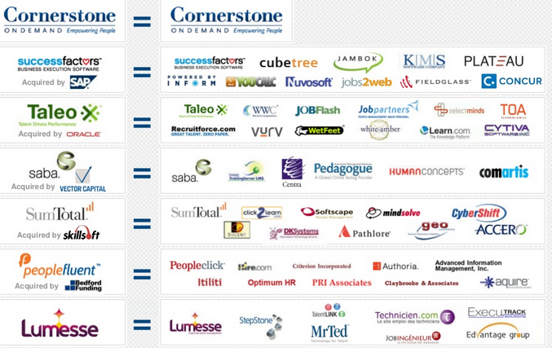
FRAGMENTED COMPETITIVE LANDSCAPE
No Dominant Player
www.greenhavenroad.com
Source: Cornerstone on Demand
Notes:
FIX LOGO

Slide 12
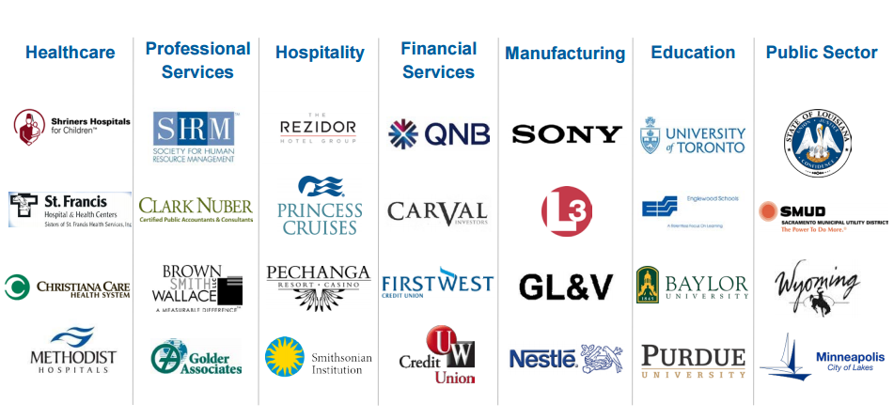
BROAD CUSTOMER BASE
No Customer > 2% of Revenue
www.greenhavenroad.com
Source: Halogen Software Investor Presentation
Notes:
FIX LOGO

Slide 13
RECURRING REVENUE
(US$M)
90%
Of quarterly
revenue
+
$57.6
Is recognized from customers that were
In place at beginning of quarter
www.greenhavenroad.com
Subscription-based model
2 year initial contract + automatic
Annual renewals
Dollar retention rate > 100%¹
Low customer concentration >2%
Annualized Quarterly Recurring Revenue
Notes:
FIX LOGO

Slide 14
“Another misconception for investors is that we are either going to miss or exceed our guidance by a large margin. The math’s too simple. It’s a rental model. It’s like a utility here. We are highly predictable. Some people might argue we’re a bit boring.”
www.greenhavenroad.com
CEO Interview

Slide 15
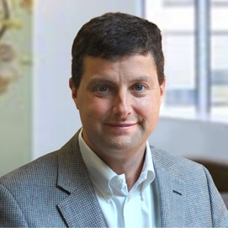
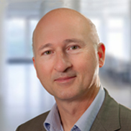
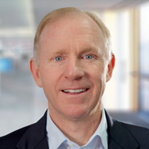
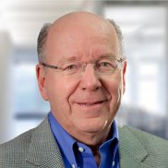
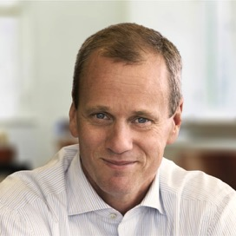
46% INSIDER OWNERSHIP & QUALITY BOARD
Board of Directors
Paul Loucks
Mike Slaunwhite
Peter Hoult
CEO
Executive
Chairman
International
Business Consultant
www.greenhavenroad.com
Harry Gruner
Tim Williams
Rob Ashe
JMI Founder
and Partner
Former CEO
Blackbaud
Former CEO
Cognos

Slide 16
RISKS
Better Funded Competitors
This is a small company to be building out a multinational footprint. There is not the balance sheet to take on the Oracle’s of the world if they are determined to give product away to gain share.
Recession
A downturn in the job market will impact the number of seats per customer
HR is a cost center and subject to budget cuts
www.greenhavenroad.com
JMI Overhang
Private equity fund JMI owns 11% of the equity. JMI made their first investment in 2008 and have been selling their position down from over 20%
Listing in Canada was a Questionable Decision
At the time of the Halogen IPO, they were the first Canadian technology IPO in 18 months – they currently trade below their IPO price and competitors
Limited Liquidity
Share volume is “chunky” with average trade volume sub $500K so most appropriate for PA’s and small funds
Notes:
FIX LOGO

Slide 17
VALUATION / ENDGAME/ METRICS TO WATCH
GAAP Earnings are not Informative
The company is spending aggressively to acquire customers with a high lifetime value
The company is building out additional modules which are being expensed but can/should be viewed as growth capex
Revenue Growing High Teens
Sales and Marketing spend is running 2-3X revenue growth created
EV/ Recurring Revenue is below 3X
www.greenhavenroad.com
Attractive Acquisition
This is a bite size company in a space with a history of company’s growing through acquisition. Even at 2X todays price, net of cash, this is a sub $400M check for an acquirer and likely accretive.
The broad mid size customer base is attractive to sell additional products into
Possible acquirers include: ADP, PayChex, Cornerstone, Oracle, IBM
Notes:
FIX LOGO

Slide 18
BALANCE SHEET AND CASH FLOW
Greater than 20% of Market Cap in Cash
The company has $41M USD in cash providing resources to grow
Use Very Little Cash on an Operating Basis
Despite losing over $45M on a GAAP basis from 2012-2014, the company consumed very little operating cash $2M
Divergence between GAAP and cash caused by accounting for preferred shares, unrealized forex loss, options, and depreciation.
www.greenhavenroad.com
Recast Financials
The company had $57M in 2014 revenue and a $15M loss. In a steady state the following expenses would likely be materially lower.
Sales and Marketing was $30M or >50% of revenue
Research and Development was $12M or >20% of revenue
General and Administrative was $10M or > 17% of revenue
The business could be profitable today.
Notes:
FIX LOGO

Slide 19
”So I think recognizing that this business can and will be tremendously profitable when we get to that very large base and when we change the focus from making sure that we’re maximizing the base, and harvesting the base as much as we possibly can”.
www.greenhavenroad.com
CEO Interview

Slide 20
SUMMARY
HIGH QUALITY COMPANY
Solves real problems at an affordable price
Large underpenetrated market provides a long runway
Customers can buy more seats and more offerings every year, and have. The Dollar Retention Rate >100%
Recurring revenue is highly predictable with two year contracts
Managed to capture long term value for shareholders, of which insiders are 46%
With >$40M in cash and operating cash flow near break even, the company has flexibility to grow
With high gross margins and high customer retention – growth is the rationale way to manage the business
www.greenhavenroad.com
Notes:
FIX LOGO

Slide 21
VALUATION EXERCISE
If the Company Went Steady State in 2016
Gross margins are currently > 75%
Dollar Retention is > 100% meaning the existing base is buying more each year – a vast majority of the $30M in sales and marketing is a growth expense – not necessary in steady state – Assume 2/3 stripped out if not trying to grow
R&D Could be rolled back substantially in steady state
General and Administrative could be rolled back if the company was not investing in new countries and growth
REVENUE | PRO FORMA STEADY STATE | 2015 E | 2014 | 2013 | 2012
Recurring Revenue | 62,144 | 60,925 | 50,771 | 42,067 | 32,661
Professional Services | 3,000 | 6,994 | 5,828 | 5,245 | 4,517
License | - | - | 60 | 672 | 825
Total Revenue | 65,144 | 67,919 | 56,659 | 47,984 | 38,003
Cost of Revenue
Recurring | 13,050 | 14,942.14 | 11544 | 8342 | 7199
Professional Services | 2,267 | 5,245 | 4404 | 3723 | 3404
License | 0 | 0 | 14 | 23 | 19
Total Cost of Revnue | 15,317 | 20,187 | 15962 | 12088 | 10622
Gross Profit | 49,827 | 47,731 | 40,697 | 35,896 | 27,381
Expenses
Sales and marketing | 10,000 | 32,756 | 30,330 | 22,248 | 18,515
Research and Development | 6,000 | 13,166 | 12,191 | 9,955 | 7,759
General and Administrative | 9,000 | 11,809 | 10,934 | 8,825 | 6,831
Foreign exchange (gain) loss | - | - | 2,742 | 1,390 | (380)
Total Expenses | 25,000 | 57,731 | 56,197 | 42,418 | 32,725
Operating income (loss) | 24,827 | (10,000) | (15,500) | (6,522) | (5,344)
www.greenhavenroad.com
CONCLUSION
Agree with company assertion that it could be substantially profitable if not pursuing growth
Notes:
FIX LOGO

Slide 22
VALUATION EXERCISE
Avg. Revenue Per Customer | $ 27,500
Number of Years (Churn <10%) | 10
Expected Revenue Per Customer | $ 275,000
Gross Contribution (78%) | $ 214,500
Customer Acquisition Cost* | $ 100,000
Gross Contribution / Customer | $ 114,500
* Added 400 customers in 2013/2014 - assume $40M of Sales and Marketing of $52M
Lifetime Value of a Customer
Assumes 10% churn which is higher than historical
Assumes $27.5K per year in avg. spend
Assumes 78% gross margin on recurring revenue in line with historical
COMPARABLES
Halogen currently sells for less than 2.5 EV/Recurring Revenue. Q1 recurring revenue was up 20% y/y
Bessemer Cloud Index of the top 30 cloud companies sells for 6X EV/Recurring Revenue with revenue growth of 27%
Acquisitions in the space of Taleo and Success Factors both occurred above 5X EV/Recurring Revenue (or >2X current multiple) To be fair, Taleo projected growth was higher than Halogen (34% vs. 20%)
www.greenhavenroad.com
Notes:
FIX LOGO

Slide 23
Scott Miller
917 880 2051 scott@greenhavenroad.com
www.greenhavenroad.com
FINDING VALUE OFF THE BEATEN PATH

Slide 24
DISCLAIMER
This document, which is being provided on a confidential basis, shall not constitute an offer to sell or the solicitation of any offer to buy which may only be made at the time a qualified offeree receives a confidential private offering memorandum (“CPOM”) / confidential explanatory memorandum (“CEM”), which contains important information (including investment objective, policies, risk factors, fees, tax implications and relevant qualifications), and only in those jurisdictions where permitted by law. In the case of any inconsistency between the descriptions or terms in this document and the CPOM/CEM, the CPOM/CEM shall control. These securities shall not be offered or sold in any jurisdiction in which such offer, solicitation or sale would be unlawful until the requirements of the laws of such jurisdiction have been satisfied. This document is not intended for public use or distribution. While all the information prepared in this document is believed to be accurate, Greenhaven Road Capital Fund 1 LP and MVM Funds makes no express warranty as to the completeness or accuracy, nor can it accept responsibility for errors, appearing in the document.
An investment in the fund/partnership is speculative and involves a high degree of risk. Opportunities for withdrawal/redemption and transferability of interests are restricted, so investors may not have access to capital when it is needed. There is no secondary market for the interests and none is expected to develop. The portfolio is under the sole trading authority of the general partner/investment manager. A portion of the trades executed may take place on non-U.S. exchanges. Leverage may be employed in the portfolio, which can make investment performance volatile. An investor should not make an investment, unless it is prepared to lose all or a substantial portion of its investment. The fees and expenses charged in connection with this investment may be higher than the fees and expenses of other investment alternatives and may offset profits.
There is no guarantee that the investment objective will be achieved. Moreover, the past performance of the investment team should not be construed as an indicator of future performance. Any projections, market outlooks or estimates in this document are forward-looking statements and are based upon certain assumptions. Other events which were not taken into account may occur and may significantly affect the returns or performance of the fund/partnership. Any projections, outlooks or assumptions should not be construed to be indicative of the actual events which will occur.
The enclosed material is confidential and not to be reproduced or redistributed in whole or in part without the prior written consent of Greenhaven Road Capital Fund 1 LP and MVM Funds. The information in this material is only current as of the date indicated, and may be superseded by subsequent market events or for other reasons. Statements concerning financial market trends are based on current market conditions, which will fluctuate. Any statements of opinion constitute only current opinions of Greenhaven Road Capital Fund 1 LP and MVM Funds, which are subject to change and which Greenhaven Road Capital Fund 1 LP and MVM Funds do not undertake to update. Due to, among other things, the volatile nature of the markets, an investment in the fund/partnership may only be suitable for certain investors. Parties should independently investigate any investment strategy or manager, and should consult with qualified investment, legal and tax professionals before making any investment.
The fund/partnership is not registered under the investment company act of 1940, as amended, in reliance on an exemption thereunder. Interests in the fund/partnership have not been registered under the securities act of 1933, as amended, or the securities laws of any state and are being offered and sold in reliance on exemptions from the registration requirements of said act and laws.
The S&P 500 and Russell 2000 are indices of US equities. They are included for informational purposes only and may not be representative of the type of investments made by the fund.
www.greenhavenroad.com
Notes:
THIS SLIDE NEEDS DATA AND WILL PROBABLY BE SPLIT INTO TWO OR THREE SILDES – THIS IS REALLY A PLACE HOLDER

