Slide 1
Liberty broadband (LBRDK)
VALUEx Vail 2015
Patrick Brennan, CFA Robert Mori, CFA
Brennan Asset Management Mori Huston Partners

Slide 2
Guide
Overview
Cable=Great Business
TWC and Bright House Deal Overview/Projections
Deal Closing/Regulatory Risk

Slide 3
CHTR Recent History
2009: Charter files/reemerges from bankruptcy:
2012: Tom Rutledge becomes CEO
2013: Liberty invests $2.6B in CHTR (~27%)
2013-2014: CHTR makes series of offers for TWC ($114-$133)
2014: TWC/CMCSA agree to merger for ~$159
2014: CHTR agrees to series of swaps/divestitures with CMCSA
2015: CMCSA withdraws offer under regulatory pressure
2015: CHTR/TWC agree to merger for ~$195

Slide 4
Operation/Financing Dream Team?
Tom Rutledge
COO Cablevision 2004-2011; CHTR CEO 2012
Considered pioneer of triple play offering
CVC consistently held highest cable metrics
Dr. John Malone
CEO TCI Cable 1976-1996
One of great capital allocators all time
Predicts high teen/low 20% IRR on CHTR/TWC/Bright House

Slide 5
LBRDK Summary
CHTR/TWC/Bright House
Scale benefits
TWC spotty historical performance
Broadband growth story
Cost synergy sandbagging
Cable anywhere traction
Mobile wildcard
Liberty Broadband=7-10% CHTR Discount

Slide 6
Current LBRDA
 | Shares | Value
True Position (Wholly owned Asset) |  | $150
Cash |  | $763
Total CHTR Shares | 28.8 | $4,910
TWC Shares | 2.4 | $428
Margin Loans & Other Revolving Facility Draws |  | ($412)
NAV |  | $5,840
LBRDA Shares |  | 26
LBRDB Shares |  | 2
LBRDK Shares |  | 75
Total Shares |  | 103
NAV Per Share |  | $56.60
Current LBRDK Price |  | $52.03
LBRDK/NAV |  | 92%
$4.4B New LBRDA Stock (~78mm shares)
LVNTA: $2.4B
Coatue, Jana Partners, Soroban Capital: $2.0B
Investments funded at LBRDA NAV

Slide 7
Guide
Overview
Cable=Great Business
TWC and Bright House Deal Overview/Projections
Deal Closing/Regulatory Risk

Slide 8
Cable=Great Business
Limited competition
Pricing power
Recession resistant/supports leverage
Customers hate you but still purchase

Slide 9
Broadband Pricing
CMCSA- Napa, CA | Initial Monthly Price | Year 2 Price | Contract | Channels | HBO | Modem | DVR | 2 DVR
25 MBPS Internet Only | $39.99 | $66.00 | No
50 MBPS Internet Only | $44.95 | $80.00 | No
Double Play (25) | $69.99 | $99.99 | 2 Year | 140 |  | $10.00 | $10.00 | $17.00
Double Play (50) | $79.99 | $109.99 | 2 Year | 140 | HBO | $10.00 |  | $19.95
Triple Play (25) | $99.00 | $144.95 | 2 year | 140 |  | $10.00 | Cloud | Cloud
Triple Play (50) | $104.00 | $149.95 | 2 Year | 140 |  | $10.00 | Cloud | Cloud
TWC - New York, NY
20 MBPS Internet Only | $44.99 | $61.90 | No
50 MBPS Internet Only | $64.99 | $99.95 | No
Double Play (15) | $89.99 | $159.04 | No | 200 |  | $8.00 | $12.00 | $0.00
Double Play (30) | $129.99 | $155.85 | No | 200 |  | $8.00 | $12.00 | $0.00
Triple Play (30)* | $89.99 | $89.99 | No | 200 |  | $8.00 | $12.00 | $0.00
Triple Play (50)* | $109.99 | $109.99 | No | 200 |  | $8.00 | $0.00 | $0.00
*Price stays constant subject to market conditions
CHTR - Athens, AL
60 MBPS Internet only | $44.99 | $64.94 | No |  |  | $5.00 | $6.99 | $6.99
100 MBPS Internet only | $99.99 | $119.99 | No |  |  | $5.00 | $6.99 | $6.99
Double Play (60) | $89.98 | $99.98 | No | 125 | HBO | $5.00 | $6.99 | $6.99
Triple Play (60)* | $99.97 | $99.97 | No | 125 | HBO | $5.00 | $6.99 | $6.99
Triple Play (60)* | $121.96 | $121.96 | No | 200+ | HBO | $5.00 | $6.99 | $6.99
* price good for 36M, after that +$20
20 min
call
9 min get
address;
29 min call
12 min
call

Slide 10
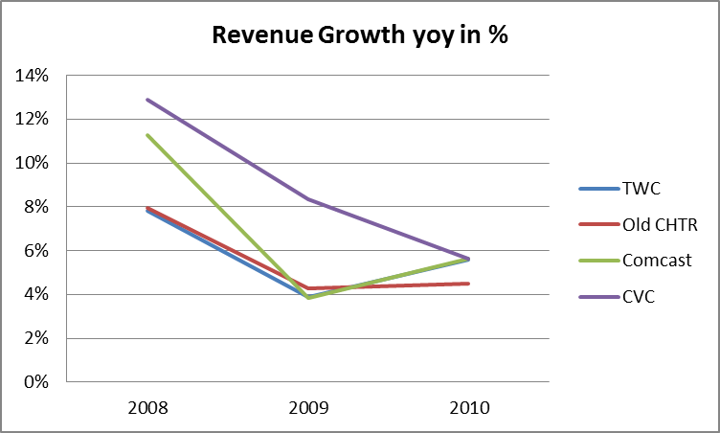
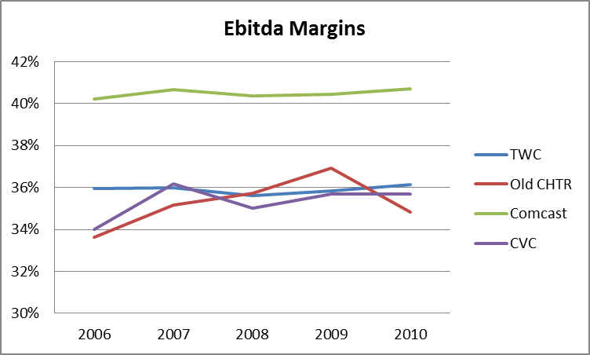
Cable=Great Business
Cable performance during last recession very stable
Cable TV / broadband far down on consumer savings list

Slide 11
Cable=Great Business
Overlap with Competing Fiber Offering – FiOS (Verizon) & U-verse (AT&T)
 | FioS (Verizon) | U-verse (AT&T) | passings | overlap
Old Charter | 4% | 30% | 12.9 | 4.4
TWC | 14% | 28% | 30.5 | 12.8
Brighthouse | 75% | 0% | 4.7 | 3.5
New Charter | 17% | 26% | 48.1 | 20.7
 |  |  | Total Overlap with Fiber Competition | Current Broadband Penetration
New Charter | overlap similar for FioS and U-verse |  | 43% | 40.4%
Comcast | most overlap with U-verse |  | 60% | 40.2%
Cablevision | most overlap with FioS |  | 70% | 54.7%
High overlap with fiber doesn’t necessarily result in low penetration

Slide 12
Competitor Capital Structure Problem
Dividend payouts for VZ/T are high and will be maintained.
Capital flexibility for accelerated fiber build-out very limited.
Telecoms need capital to buy additional spectrum.
Verizon | 2013 | 2014 | 2015 | 2016 | 2017
Capex as % of Rev | 14% | 14% | 13% | 13% | 13%
Div as % of FCF | 43% | 58% | 65% | 63% | 62%
AT&T | 2013 | 2014 | 2015 | 2016 | 2017
Capex as % of Rev | 16% | 16% | 14% | 14% | 13%
Div as % of FCF | 46% | 469% | 92% | 89% | 90%
Pro Forma incl DTV Street est. |  |  |  | 65%-75%

Slide 13

Cable=Great Business
“Along with death and taxes, lousy cable service seems to be one of life’s certainties.”
Consumer Reports May 2015

Slide 14
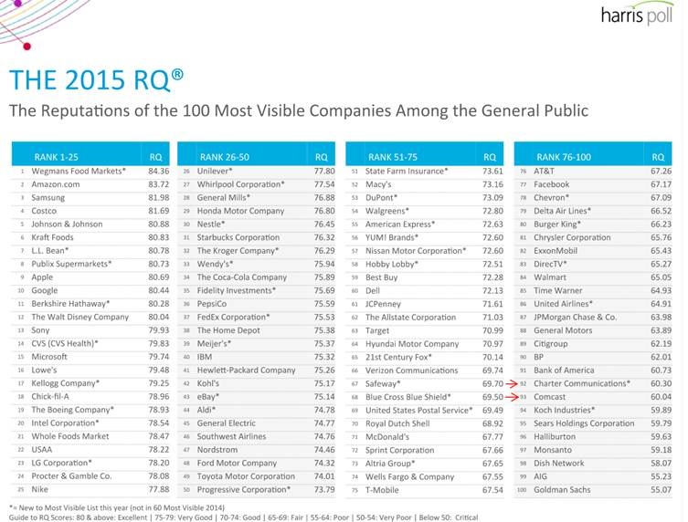
Cable=Great Business

Slide 15
Guide
Overview
Cable=Great Business
TWC and Bright House Deal Overview/Projections
Deal Closing/Regulatory Risk

Slide 16
Deal Summary
TWC ($78.7 billion)
$100 cash/0.5409 share of CHTR or $115 Cash/0.4562
$2 billion break-up fee
$800 million synergy target
Bright House ($10.4 billion)
$5.9 billon common units (convert CHTR shares)
$2.5 billion preferred units (6% cash coupon/40% conversion premium)
$2 billion cash
Advance/Newhouse – FL strength

Slide 17
CHTR vs. Competition

Slide 18
Combined Company

Slide 19
Did CHTR Overpay?
Acquisition multiples:
TWC: EV/2015 Ebitda 9.1x, incl. synergies & tax benefits 8.3x
BHN: EV/2014 Ebitda 7.6x, incl. synergies & tax benefits 6.5x
Recent deal comparables:
 |  |  | On-Year Forward Ebitda Multiples
Announcement Date | Acquiror | Target | Tax-Adjusted | Not Tax-Adjusted
20-May-2015 | Altice | Suddenlink | n.a. | 9.3x | (2015 Ebitda & 7.3x/7.6x after syn.)
19-Mar-2013 | Liberty Media Corp | Charter Communications (25% stake) | 8.0x | 8.6x
7-Feb-2013 | Charter Communications | Bresnan Broadband Hldgs | n.a. | 8.0x
18-Jul-2012 | BC Partners | Suddenlink | n.a. | 8.3x
18-Jul-2012 | Cogeco Cable | Atlantic Broadband | n.a. | 8.3x
1-Jun-2012 | Oak Hill Capital Partners | Wave Division Holdings | n.a. | 8.0x
14-Aug-2011 | Time Warner Cable | Insight Communications Company | 7.7x | 8.4x
14-Jun-2010 | Cablevision Systems Corp | Bresnan Broadband Hldgs | n.a. | 8.2x

Slide 20
Major Model Assumptions
Synergy sandbagging – ~2x management estimates
Continue programming cost escalation
Video subscriber loss
Broadband penetration/ARPU growth
$11B+ NOL gone by end of 2017
>=4.0x leverage

Slide 21
Synergy Snapshot
 | 2016E | 2017E | 2018E | 2019E
% Programming Costs By Year | 100% | 100% | 100% | 100%
Yearly Programming Synergy | $629 | $672 | $729 | $791
BrightHouse Video Customers | 2.0 | 1.9 | 1.9 | 1.9
CHTR Video Customers | 4.1 | 4.1 | 4.1 | 4.1
TWC Video Customers | 10.4 | 10.3 | 10.3 | 10.4
CHTR Monthly Programming Per Sub | $58.41 | $63.08 | $68.13 | $73.58
TWC Monthly Programming Per Sub | $45.71 | $49.37 | $53.32 | $57.59
Total Pro-Forma Oper. Exp (Ex-Prog, SC) | $14,987 | $15,577 | $16,100 | $16,676
Est % Savings | 1.0% | 2.5% | 3.0% | 5.0%
Total Other Cost Reduction | $150 | $389 | $483 | $834

Slide 22
Synergy Snapshot
Liberty Global - Virgin Media: Closing Mid 2013
Liberty Global – Ziggo: Closing Nov 2014
Orig. synergy est. $160M: out of which $95M Opex (-24%),
Already increased synergy estimate by 50% to $250M
Altice - Suddenlink deal est. 25-30% of opex savings ex progr.
Est. vs Actual Synergies | 2013 | 2014 | Q1 2015 | Orig.est.
Revenue yoy % change | 0.5% | 2.3% | 1.2%
Ebitda yoy % change |  | 13.0% | 5.4%
Ebitda Margin | 39% | 43% | 45%
Opex yoy % change |  | -4.4% | -1.7%
Opex yoy $ change |  | -112 | -11 | -110
Capex yoy $ change |  | -128 |  | -70

Slide 23
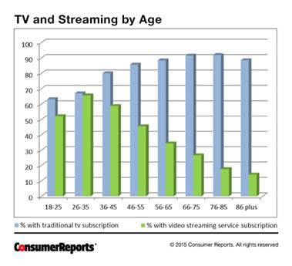
Video Streaming by Age

Slide 24
Content Costs Sustainable?
Source: SNL Kagan

Slide 25
Content Costs – This bad?
 | Cable Operator Avg
Video ARPU | $81.03
Less Programming/Retrans | ($45.86)
Contribution Video Sub | $35.17
% Contrib Margin | 43.4%
Less: Indirect cost per PSU | ($24.55)
OCF per Video Sub | $10.62
% OCF Margin | 13.1%
Less: Capex per PSU | ($11.58)
FCF per Video Sub | ($0.96)
% Free Cash Flow Margin | -1.2%
Source: SNL Kagan/Cable One June 15, 2015 Presentation

Slide 26
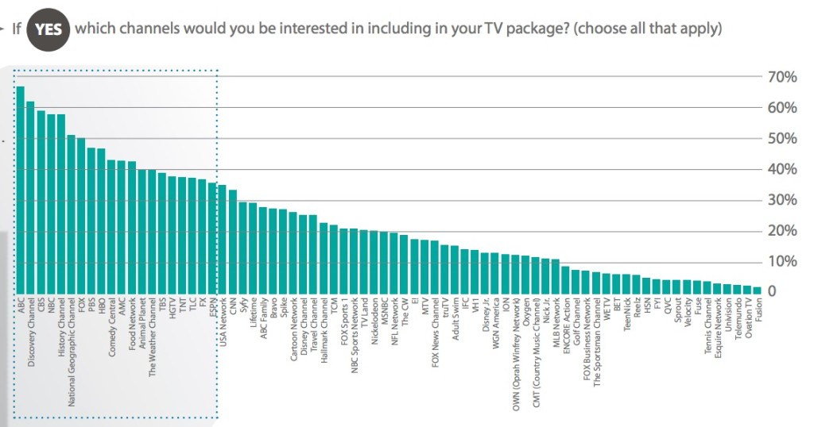
Tiered Cable? Choices Surprise…
Source: Digitalsmiths

Slide 27
Broadband Penetration/ARPU
 | 2013 | 2014 | 2015E | 2016E | 2017E | 2018E | 2019E
CHTR Broadband Penetration Rate | 37% | 40% | 42% | 44% | 46% | 48% | 50%
TWC Broadband Penetration Rate | 37% | 38% | 39% | 41% | 42% | 43% | 44%
CHTR Broadband ARPU | $43.16 | $46.93 | $49.27 | $51.74 | $53.81 | $55.96 | $58.20
TWC Broadband ARPU | $43.92 | $46.95 | $48.83 | $50.78 | $52.81 | $54.92 | $57.00
CHTR Video Subscribers | 4.2 | 4.2 | 4.2 | 4.1 | 4.1 | 4.1 | 4.1
TWC Video Subscribers | 11.2 | 10.8 | 10.6 | 10.4 | 10.3 | 10.3 | 10.4
CHTR Video Penetration Rate | 34% | 33% | 33% | 33% | 32% | 32% | 32%
TWC Video Penetration Rate | 37% | 35% | 34% | 33% | 32% | 32% | 32%
CHTR Video ARPU | $79.56 | $88.82 | $92.37 | $94.22 | $96.11 | $98.03 | $99.99
TWC Video ARPU | $74.90 | $75.85 | $76.61 | $77.37 | $78.15 | $78.93 | $78.93

Slide 28
Our Assumptions vs. TWC Mgmt
 | 2014E | 2015E | 2016E
TWC Revenue | $22,812 | $23,865 | $25,026
TWC Mgmt Revenue | $23,160 | $24,146 | $25,657
TWC EBITDA (Ex-M&A Charges) | $8,228 | $8,343 | $8,947
TWC Mgmt. EBITDA (Ex-M&A Charges) | $8,425 | $8,600 | $9,400
TWC Capex | ($4,097) | ($4,176) | ($4,129)
TWC Management Capex | ($3,700) | ($3,800) | ($3,800)
Leveraged Cash Flow | $2,253 | $2,390 | $2,184
TWC Mgmt. Leveraged Cash Flow | $2,650 | $2,120 | $2,670
Management assumptions from CMCSA/TWC S-4 merger documents

Slide 29
Pro-Forma Financials
 | 2015E | 2016E | 2017E | 2018E | 2019E
CHTR Revenue | $9,721 | $10,261 | $10,812 | $11,392 | $12,007
TWC Revenue | $23,865 | $25,026 | $26,211 | $27,403 | $28,748
BrightHouse Revenue | $3,971 | $4,150 | $4,336 | $4,532 | $4,735
Total Revenue | $37,558 | $39,437 | $41,359 | $43,327 | $45,490
Total Revenue Growth |  | 5.0% | 4.9% | 4.8% | 5.0%
CHTR EBITDA (Ex-Stock Comp) | $3,423 | $3,558 | $3,766 | $3,991 | $4,200
TWC EBITDA (Ex-Stock Comp) | $8,525 | $9,129 | $9,486 | $9,834 | $10,164
BrightHouse EBITDA | $1,461 | $1,527 | $1,596 | $1,668 | $1,743
Programming Synergies | $0 | $629 | $672 | $729 | $791
Other Synergies | $0 | $150 | $389 | $483 | $834
Synergy Adjusted EBITDA | $13,409 | $14,992 | $15,910 | $16,705 | $17,730
EBITDA Margin | 35.7% | 38.0% | 38.5% | 38.6% | 39.0%
EBITDA Per Home Passed | $279 | $308 | $323 | $335 | $351
CHTR EBITDA Growth Rate | 7.3% | 3.9% | 5.9% | 6.0% | 5.2%
TWC EBITDA Growth Rate | 1.4% | 7.1% | 3.9% | 3.7% | 3.4%
BrightHouse EBITDA Growth Rate | 4.4% | 4.5% | 4.5% | 4.5% | 4.5%
Pre-Synergy EBITDA Growth | 0.0% | 6.0% | 4.5% | 4.3% | 4.0%
Total EBITDA Growth Rate (Post Synergies) | 3.1% | 11.8% | 6.1% | 5.0% | 6.1%

Slide 30
Pro-Forma Valuation
 | 2016E | 2017E | 2018E | 2019E
Pro-Forma EBITDA | $14,992 | $15,910 | $16,705 | $17,730
Multiple | 8.0x | 8.0x | 8.0x | 8.0x
Enterprise Value | $119,937 | $127,278 | $133,636 | $141,842
Less Net Debt | ($62,947) | ($63,947) | ($67,547) | ($73,047)
Equity Value | $56,990 | $63,330 | $66,089 | $68,795
Shares Outstanding | 314 | 286 | 255 | 220
Share Price | $182 | $222 | $260 | $312
Implied Multiple Free Cash Flow Per Share | 13.5x | 11.8x | 15.2x | 14.5x
Pro-Forma Net Leverage | 4.2x | 4.0x | 4.0x | 4.1x
Change in Shares Outstanding |  | -8.9% | -11.0% | -13.4%

Slide 31
Guide
Overview
Cable=Great Business
TWC and Bright House Deal Overview/Projections
Deal Closing/Regulatory Risk

Slide 32
Deal Closing Risk
“There’s very little dirty underwear that people can find at the bottom of the suitcase. It’s all out there.” JM June 2015
CMCSA/TWC widely thought to be approved
New 25M standard
CMCSA=57%
CHTR=30%
Not vertically integrated
Combined CHTR/Bright House/TWC<CMCSA
TWC buying CHTR=No issue vs. CHTR buying TWC

Slide 33
Standalone Charter Value
 | 2015E | 2016E | 2017E | 2018E | 2019E
EBITDA | $3,423 | $3,558 | $3,766 | $3,991 | $4,200
Multiple | 8.5x | 8.5x | 8.0x | 8.0x | 8.0x
Enterprise Value | $29,092 | $30,239 | $30,129 | $31,929 | $33,597
Less Net Debt | ($13,699) | ($14,661) | ($15,330) | ($16,106) | ($16,398)
Less Breakup Fee |  | ($2,000) | ($2,000) | ($2,000) | ($2,000)
Equity Value | $15,392 | $13,578 | $12,799 | $13,823 | $15,199
Shares Outstanding | 98.2 | 90.7 | 79.9 | 69.8 | 60.6
Value Per Share | $156.7 | $149.8 | $160.1 | $197.9 | $250.7
Free Cash Flow Per Share (No Taxes) | $8.53 | $10.61 | $13.95 | $18.50 | $24.06
Implied Multiple | 18.4x | 14.1x | 11.5x | 10.7x | 10.4x

Slide 34
Regulatory Jargon/Risks
Communications Act 1934 - Information Service vs. Telecommunication Service
1984 Communications/1992 Consumer Protection
Section 706 Telecommunications Act 1996
CMCSA vs. BitTorrent (35% in 2004)
VZ vs. FCC
Forbearance versus Litigation

Slide 35
Risks/Upside
Risks:
Deal closing (8%)– CHTR seen as stranded cable asset
Higher video losses/programming costs
Title 2 affects broadband
Wifi technology breakthrough
Upside ($500+):
Mobile opportunity – assume none
TWC margin improvement/further broadband penetration
Additional acquisitions
Smaller multiple contraction

Slide 36
LBRDA Upside
 | Shares | Value
True Position (Wholly owned Asset) |  | $150
Cash |  | $163
Existing Charger Shares | 28.8
New CHTR Shares for TWC Purchase | 24.3
New CHTR Shares for BrightHouse Purchase | 4.0
TWC Shares Converted to CHTR Shares | 2.7
Total CHTR Shares | 59.8 | $18,670
Margin Loans & Other Revolving Facility Draws |  | ($412)
NAV |  | $18,571
LBRDA Shares |  | 26.1
LBRDB Shares |  | 2.5
LBRDK Shares |  | 74.6
New LBRDK Shares Issued for TWC/Brighthouse |  | 78.3
Total Shares |  | 181.4
NAV Per Share |  | $102.36
Assumed Discount |  | 5.0%
Assumed LBRDK Price |  | $97.24
Assumed CHTR Price |  | $312.00

Slide 37
Conclusion
Cable strong, recession resistant business
Good operator/Capital allocator
More likely than not deal closes
Broadband growth story
History suggests significant synergy upside
Attractive risk/reward

Slide 38
Disclosures
Past BAM’s investment decision making process involves a number of different factors, not just those discussed in this document. The views expressed in this material are subject to ongoing evaluation and could change at any time.
Past performance is not indicative of future results, which may vary. The value of investments and the income derived from investments can go down as well as up. It shall not be assumed that recommendations made in the future will be profitable or will equal the performance of the securities mentioned here. While BAM seeks to design a portfolio which reflects appropriate risk and return features, portfolio characteristics may deviate from those of the benchmark.
Although BAM follows the same investment strategy for each advisory client with similar investment objectives and financial condition, differences in client holdings are dictated by variations in clients’ investment guidelines and risk tolerances. BAM may continue to hold a certain security in one client account while selling it for another client account when client guidelines or risk tolerances mandate a sale for a particular client. In some cases, consistent with client objectives and risk, BAM may purchase a security for one client while selling it for another. Consistent with specific client objectives and risk tolerance, clients’ trades may be executed at different times and at different prices. Each of these factors influence the overall performance of the investment strategies followed by the Firm.
Nothing herein should be construed as a solicitation or offer, or recommendation to buy or sell any security, or as an offer to provide advisory services in any jurisdiction in which such solicitation or offer would be unlawful under the securities laws of such jurisdiction. The material provided herein is for informational purposes only. Before engaging BAM, prospective clients are strongly urged to perform additional due diligence, to ask additional questions of BAM as they deem appropriate, and to discuss any prospective investment with their legal and tax advisers.

Slide 39
Liberty Broadband (LBRDK)
Patrick Brennan, CFA
Brennan Asset Management
patrick@brennanvalue.com
Robert Mori, CFA
Mori Huston Partners
robert.mori@morihuston.com
VALUEx Vail 2015

