Slide 1

The Search for the next wells fargo
Greg Porter
President and CIO
5280 Capital
greg@5280capital.com June 2015

Slide 2
Disclaimers
These are my honest views as of today
I have a position in ServisFirst Bancshares
This isn’t investment advice
You shouldn’t rely on this presentation to make investment decisions
There is no guarantee I am right
If you do decide to invest, do your own damn work!

Slide 3
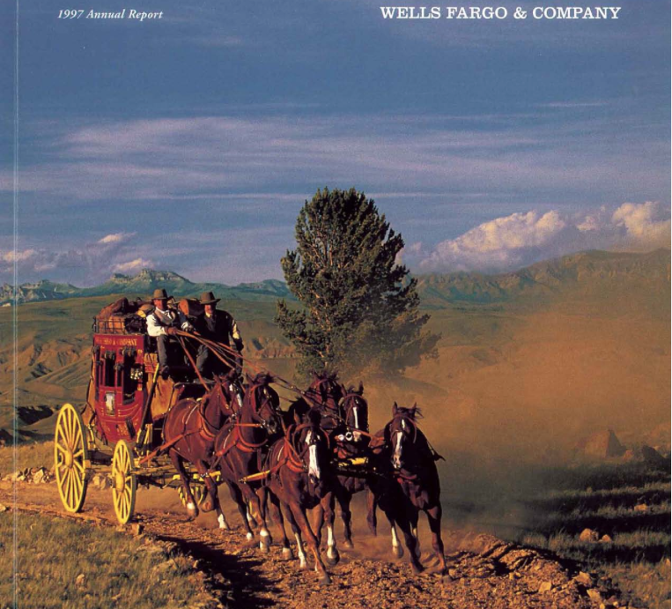
Outstanding Long Term Performance

Slide 4
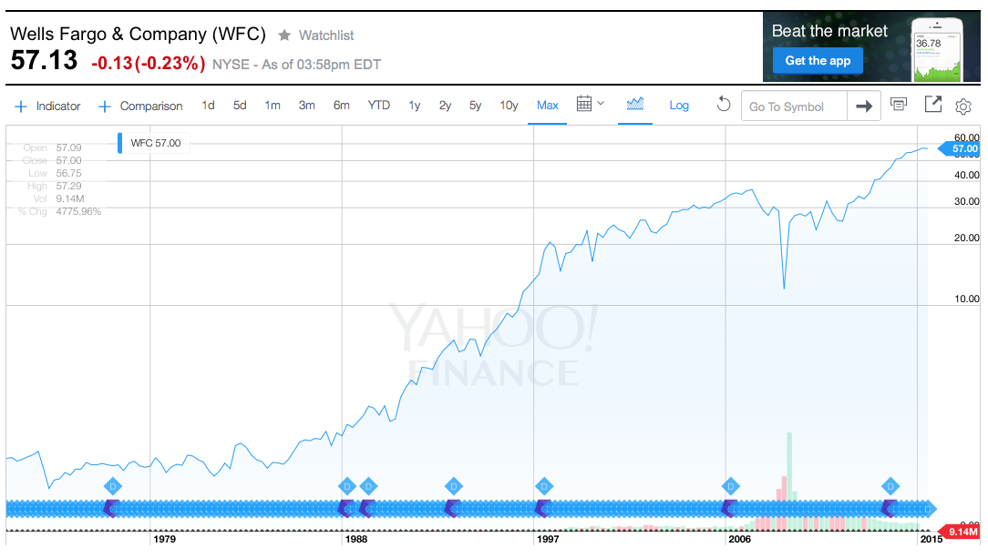
Wells Fargo -- Almost a 50 Bagger

Slide 5
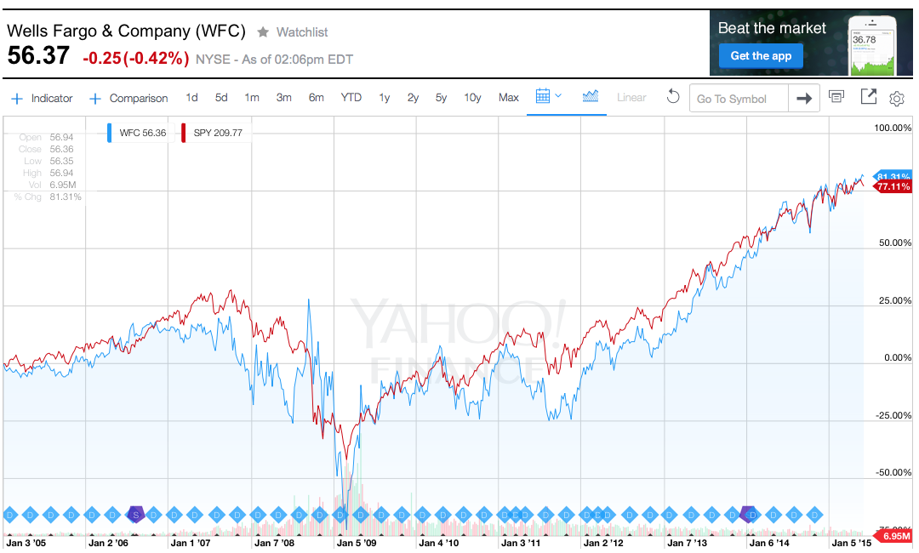
Recent Results are Rather Ordinary and Track S&P 500

Slide 6
Wells Fargo is Now a Huge Bank
Largest U.S. bank by market cap - $297 billion
Ranks 3rd in U.S. in total assets – $1.571 trillion
Ranks 2nd in U.S. in total deposits – $1.244 trillion

Slide 7
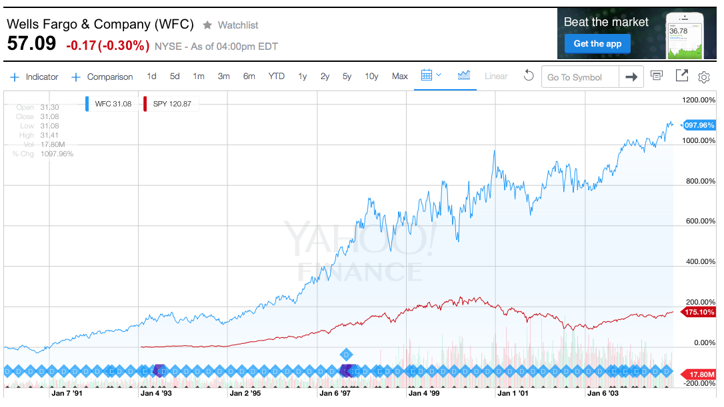
Much of Wells Fargo’s Stock Gains
Came in 1990-2004 Period

Slide 8
1990 – 2004
15 Years of Strong Performance
Total stockholder return – 21% annually
Average ROE of 18%
Average earnings growth of 11%
Assets grew from $24 billion to $410
  Significant organic growth
  Geographic expansion
  Numerous acquisitions including Norwest acquisition of Wells Fargo
Market cap grew from $2.1 billion to $105 billion

Slide 9
The Search for the Next
Wells Fargo
Identify a bank similar to Norwest in 1990
Large enough to have some scale and professional management
Small enough to be able to compound value at high rates for many years

Slide 10
The Search
Sandler O’Neill Sm-All Stars List – 35 banks
Raymond James Community Bankers Cup – 31 banks
Search for banks with market capitalizations between $200 million and $5 billion and an ROA > 1%
Reviewed over 70 banks

Slide 11
The Search
Two part process
  Narrow the field to the best of the best
  Study what it takes to sustain greatness over time

Slide 12
The Semi-Finalists
Access National (ANCX)
Bank of the Ozarks (OZRK)
Bryn Mawr Bank Corporation (BMTC)
CVB Financial (CVBF)
Eagle Bancorp (EGBN)
First Financial Bankshares (FFIN)
Glacier Bancorp (GBCI)
Independent Bank Group (IBTX)
Lakeland Financial (LKFN)
Pinnacle Financial (PNFP)
ServisFirst Bancshares (SFBS)
Washington Trust Bancorp (WASH)
Western Alliance Bancorporation (WAL)
West Bancorporation (WTBA)

Slide 13
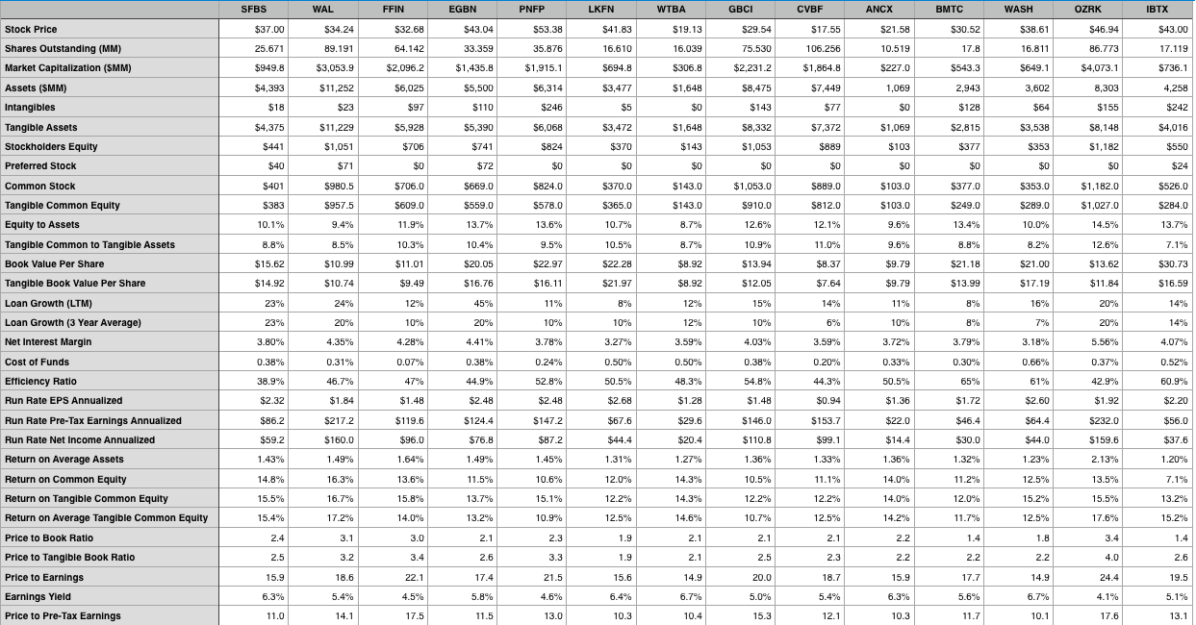
Comparison of Semi-Finalists

Slide 14
Characteristics of a Great Small Bank
High ROE
Ability to grow
Great management

Slide 15
Sustainability of a High ROE
Lending is mostly a commodity business –in a commodity environment, the low cost operator is the long term winner
Keys to being a low cost operator
  Cheap funding cost
  Operating efficiency

Slide 16
Sustainability of a High ROE
Ability to make good loans
  Empire builders can temporarily inflate profitability as high growth initially looks profitable
  Skill only becomes obvious in a downturn
  Great Recession was the banking industry’s
  crucible

Slide 17
The Growth of a Great Small Bank
Location is important – can’t grow loans if there is no demand
  Both coast, the SE and the SW are growing quicker than Midwest and Rust Belt
Need geographic expansion AND market share growth

Slide 18
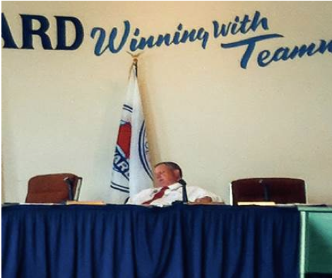
It’s All About Management
Management is the key differentiator between a good bank and a poor one
Donn Claussen, Chairman of Harvard Illinois Bancorp, caught sleeping during the bank’s Annual Meeting.

Slide 19
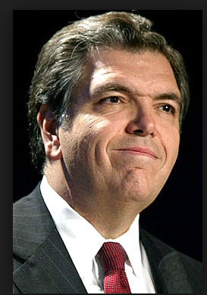
It’s All About Management
Management sets the agenda
  Cost control becomes a part of the culture
M & A
  Price discipline and integration skills
Good capital allocation decisions
No Chuck Princes – nobody is dancing just because the music is playing

Slide 20
Selecting a Winner
Best combination of:
  Good Management
  Low cost funding
  Efficient operations
  Growth opportunities
  Cheap stock price

Slide 21
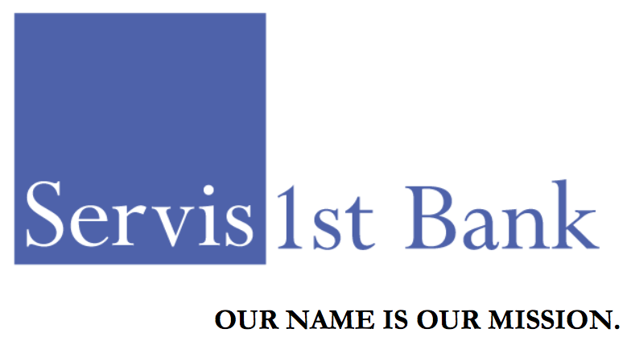
And the Winner is . . . .
ServisFirst Bancshares, Inc. (SFBS)

Slide 22
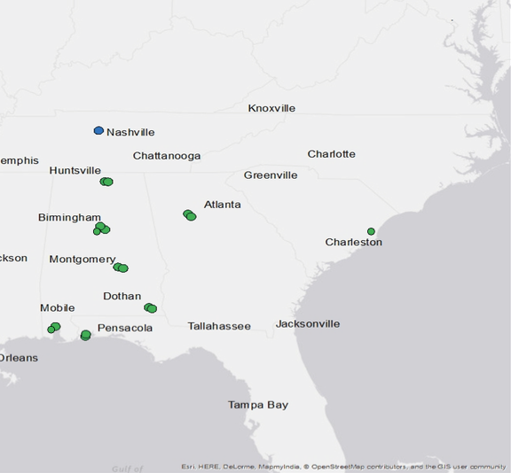
ServisFirst at a Glance
De novo bank formed in 2005
Started in Alabama and now expending throughout Southeast U.S.
Completed IPO in May 2014
16 branches and a loan production office
$4.4 billion in assets
$950 million market cap

Slide 23

Quality Management
CEO – Tom Broughton
Co-Founder of ServisFirst and CEO since inception
Previously founded First Commercial Bank in 1985. Built up the bank and sold it to Synovus. Remained at Synovus as regional CEO
Owns 2.5% of SFBS
Officers and Directors as a group own 13.5% of SFBS

Slide 24
Business Model
Focus is on commercial banking not retail
  Loan making and deposit taking
Expansion has come from hiring teams of new bankers in attractive geographies
Intense focus on attracting low cost core deposits
Ultra low branch count
  $253 million in deposits per branch compared to national average of $35 million

Slide 25
ServisFirst is a Low Cost Operator
Total funding cost – 38 bps
Efficiency ratio – 39% compared to industry average of around 60%
Cheap deposits and efficient operations lead to an ROA > 1.4%, nearly twice the industry average

Slide 26
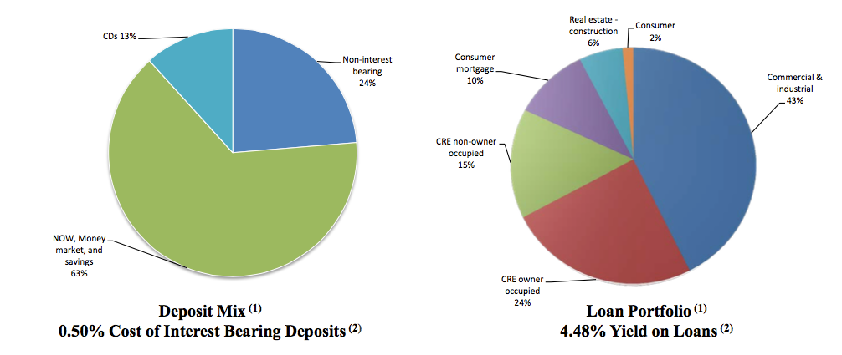
Loan and Deposit Mix
Non-interest bearing deposits have grown rapidly
Little reliance on CDs

Slide 27
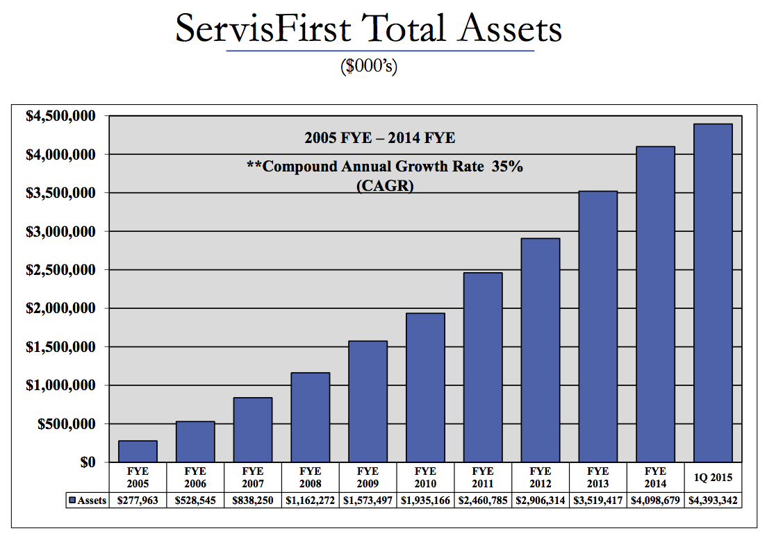
Consistent, Rapid Growth

Slide 28
The Growth of ServisFirst
All growth pre-2015 was organic
Consistently increased deposit market share
Early focus was on Alabama
Opened LPO in Nashville in 2013
Opened Charleston, SC branch in January 2015
Completed a small acquisition in February 2015 to enter the Atlanta market
Expect to continue to enter new markets in the Southeastern U.S.

Slide 29
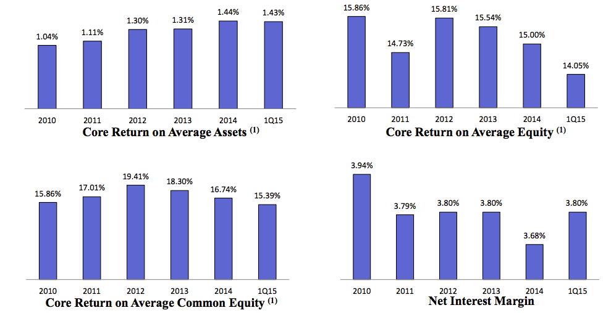
ROA and ROE

Slide 30
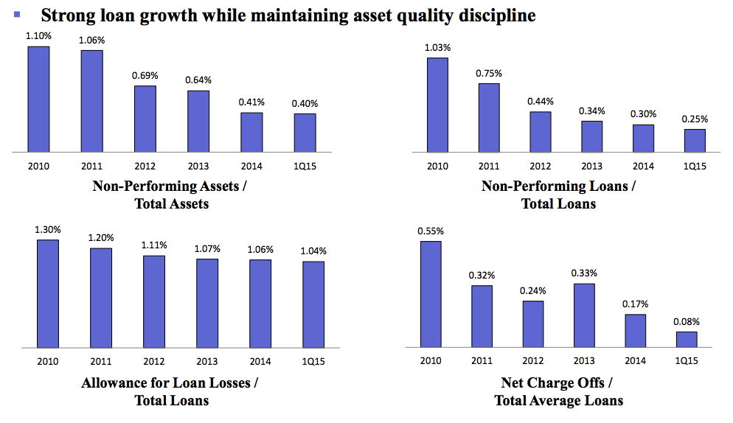
Loan Quality

Slide 31
Valuation
Price to book value multiple is high – 2.4X
Over reliance on price to book metric is lazy thinking
ServisFirst has exceptionally high ROE’s – focus on earnings power, not price to book

Slide 32
Buffett on Bank Valuation
Buffett interview (talking about Wells Fargo)
  Q: How do you view tangible common equity
  A: “What I pay attention to is earnings power. Coca-Cola has no tangible common equity. But they’ve got huge earnings power. And Wells . . . you can’t take away Wells’ customer base. It grows quarter by quarter. And what you make money off of is customers. And you make money on customers by having a helluva spread on assets and not doing anything really dumb. You don’t make money on tangible common equity
  Q: So what is your metric for valuing a bank?
  A: It’s earnings on assets, as long as they’re being achieved in a conservative way.

Slide 33
The Important Metrics
Stock price - $37.00
Current market capitalization – $950 million
Annual run-rate earnings (Q4 2014) – $2.32
Trailing multiple – 15.9X
2015 exit run-rate earnings – $2.86
Forward multiple – 12.9X
2014 return on common equity – 16.4%
2014 loan growth – 18%

Slide 34
Comparison to the Market
Market generally puts a lower multiple on bank stocks than the market as a whole
  Bank’s earnings are cyclical as loans are written off in recessions
  ROEs tend to be low
Reasons for low bank multiples don’t apply to ServisFirst
  High loan quality means less cyclicality
  ROE much higher than the overall market
  Growth much higher than the market
ServisFirst should trade at a premium to the market, not a discount

Slide 35
Comparison to other Semi-Finalists
Average metrics of semi-finalists banks
  Loan growth – 12%
  Cost of funds – 40 bps
  Efficiency ratio – 51.5%
  ROATCE – 13.6%
  Price to tangible book – 2.7X
  P/E (run rate earnings) – 18.6X
  Price to pre-tax earnings – 12.8
ServisFirst is growing faster, is more efficient, and generates higher returns on equity, yet its stock is cheaper on every metric.

Slide 36
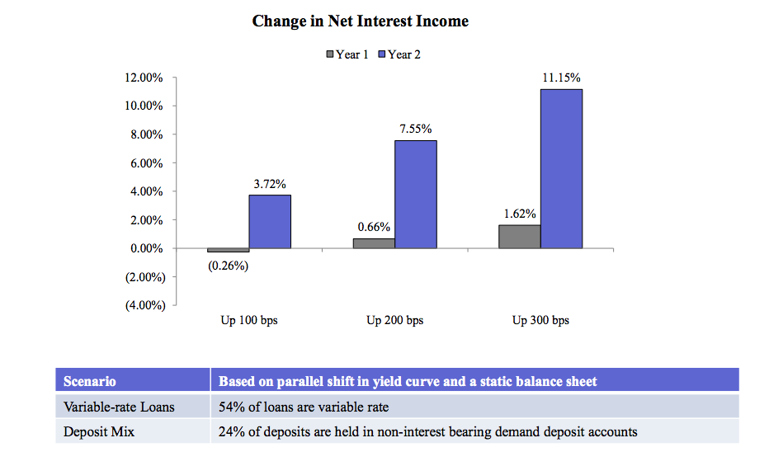
Higher Interests Rates
Would be Beneficial

Slide 37
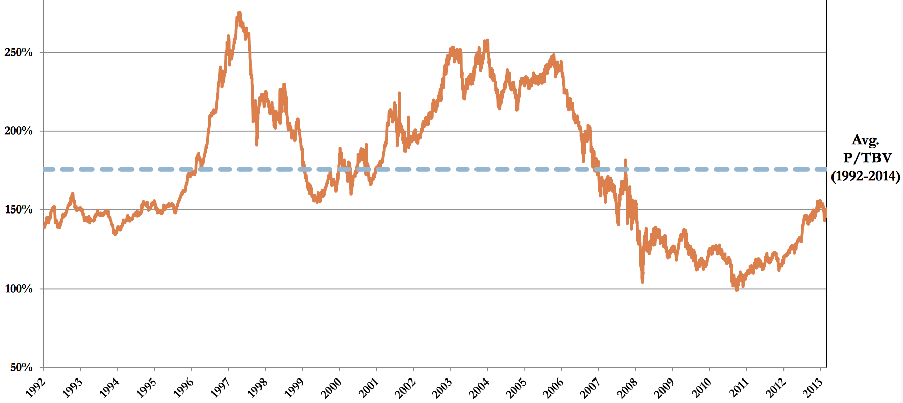
Bank Stock Prices
Remain Below Average

Slide 38
Conclusion
ServisFirst could be the next Wells Fargo
ROA and ROE are among the highest of all US banks
Rapid growth with pristine credit quality
Only in 9 markets – long growth runway
Stock trades at a forward earnings multiple of only 12.9X

