Slide 1
Social Networking
Sizhao Yang

Slide 2
Sizhao Yang
Co-founder/COO of BetterWorks
Founder Advisor for SV Angels
Co-creator of Farmville
Co-founder/CEO of MyMiniLife (acquired by Zynga)

Slide 3
Outline
Social Networking -> Tencent
Facebook
Zynga

Slide 4
Social Networking
Highly engaged network of users
Low customer acquisition costs
High LTV

Slide 5
Facebook Quick Facts
#2 website globally in total page views behind Google; should pass Google in first half of 2010.
At 30%, Facebook has the same global reach that Google had 1 year ago.
Both Google and Facebook should have global reach of ~50% by end of 2010.
2 years ago Facebook’s global reach was just 6%.
Internet users spend 3x as much time on a Facebook page as they spend on a Google page.
Over 700mm pieces of content are uploaded on Facebook daily (eg. 100mm photos daily).
Average user spends 55 minutes/day (~23% of total time online) on Facebook, 50% of users log on daily.
67% of US online users are on Facebook.
~70% of Facebook users live outside the US.
Among top 36 countries: Facebook’s page view rank is #1 in 4 countries; #2 in 23 countries; #3 in 9 countries

Slide 6
FB Overview
Highly engaged users
400 million users with an average of 55 minutes per day
Facebook drives more traffic to leading portals than Google
Facebook worth 100B by 2015 by same multiples as Google based on 2015 EBITDA multiples
Facebook is worth ~50B today. Discount of 15%
Facebook has to earn $7 per user in EBITDA to justify valuation

Slide 7
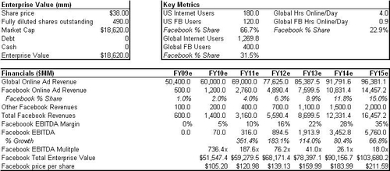
Facebook

