Slide 1
The Prince Henry Navigator I, II, and III ValueX Vail Presentation
June 16, 2011

Slide 2
With Apologies to Jared Diamond and Yali
“Vitaliy’s Question.”

Slide 3
Today’s Guarantee:
“How To Get Fired As An Endowment Manager.”

Slide 4
The Pitfalls of Investment Bureaucracy: Credit To Howard Marx
“Active management strategies demand uninstitutional behavior from institutions, creating a paradox that few can unravel.” David Swensen

Slide 5
One of Munger’s (Two) Most Helpful Lessons For Me
“I think I've been in the top 5% of my age cohort all my life in understanding the power of incentives, and all my life I've underestimated it.” Charlie Munger

Slide 6
Request:
“Devil’s Advocacy”
T

Slide 7
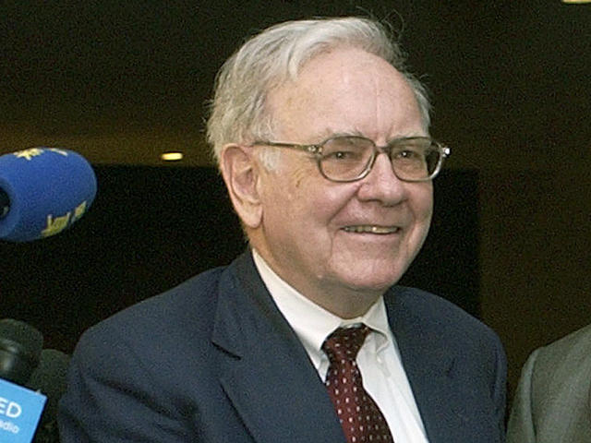

Slide 8
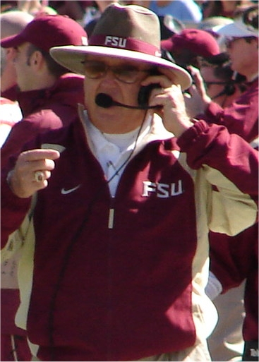

Slide 9
Coach Wooden’s Secret #1
“THE TEAM WITH THE BEST PLAYERS ALMOST ALWAYS WINS.”

Slide 10
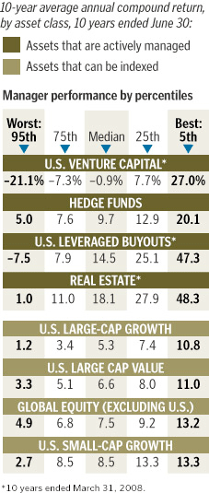
By Allan Sloan

Slide 11
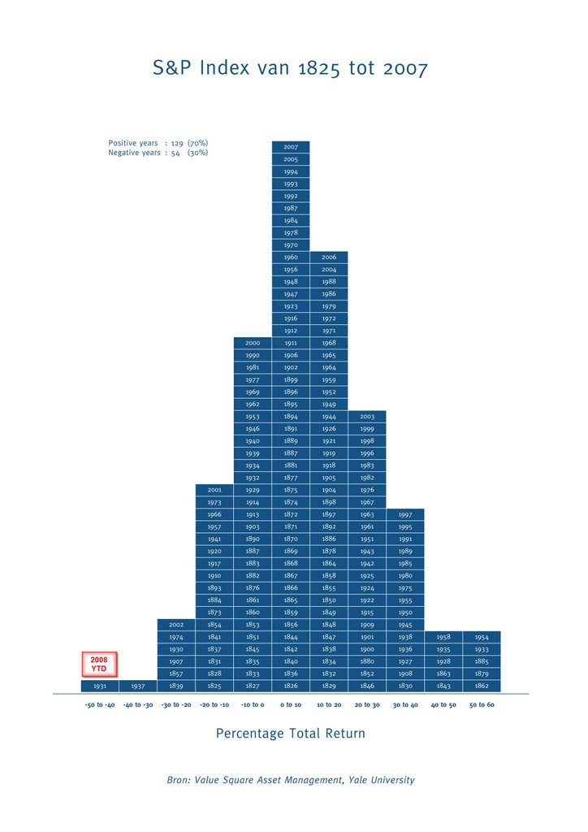
7) A very interesting chart that sure puts this year in perspective:
7) A very interesting chart that sure puts this year in perspective:

Slide 12
Munger “Invert, Always Invert.” So, How To Destroy Capital?
Invest in hyper efficient markets where we have little or no edge
Invest with same time frame as most others
Invest with people who have no Edge: “why are we getting so lucky?”
Invest with people whose incentives do not align with our own:
No exposure to the downside
Agents collecting non-success based fees
Agents collecting fees prior to principal i.e. hedge funds

Slide 13
Munger Again “More Accepted To Fail Conventionally Than To Succeed Unconventionally”?
Harvard Management Case
Cui Bono? Who Benefits?

Slide 14
Common Threads
L-T orientation: years not days, months, or quarters
Large percentage of personal net worth invested in fund
Comfort with making mistakes: 2 types of investors:
Investors who have made mistakes
Liars
Focus on weighted average batting average
Process above results

Slide 15
Churchill’s Advice
“However beautiful the strategy, you should occasionally look at the results.”
3 Criteria for Navigator Funds:
Preserve Capital: Yes
Beat The Indexes: Yes, S&P by 16%
Compound North of 13% Per Annum: Not Yet

Slide 16
Another Sanity Check: Prince Henry Cui Bono Fund
0 % Management Fee
6% Preferred Return
25% Incentive Fee: 15% to Manager, 10% to Navigator
Navigator Takes 1st $1 Million of Losses
5 Year Commitment Period
All Managers “Invested” In Each Other Via Fund

Slide 17

Animal Orchestra

Slide 18
THANK YOU
Thank You
Questions?

